Slide 1
Daily message
We are going to learn a new colour.

Slide 2








Slide 3




green
black
white

Slide 4
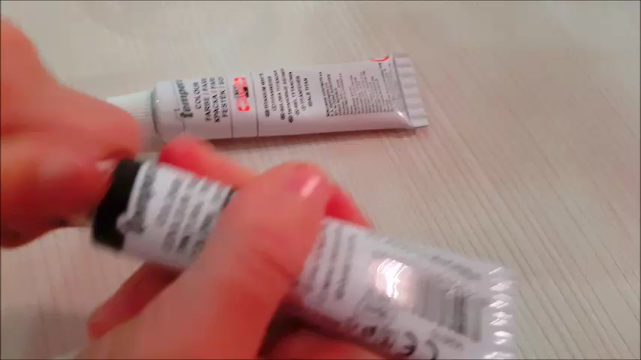

Slide 5


Slide 6
    grey

Slide 7


Slide 8
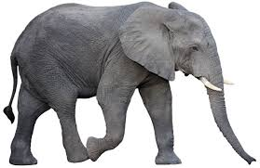

Slide 9
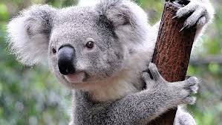

Slide 10
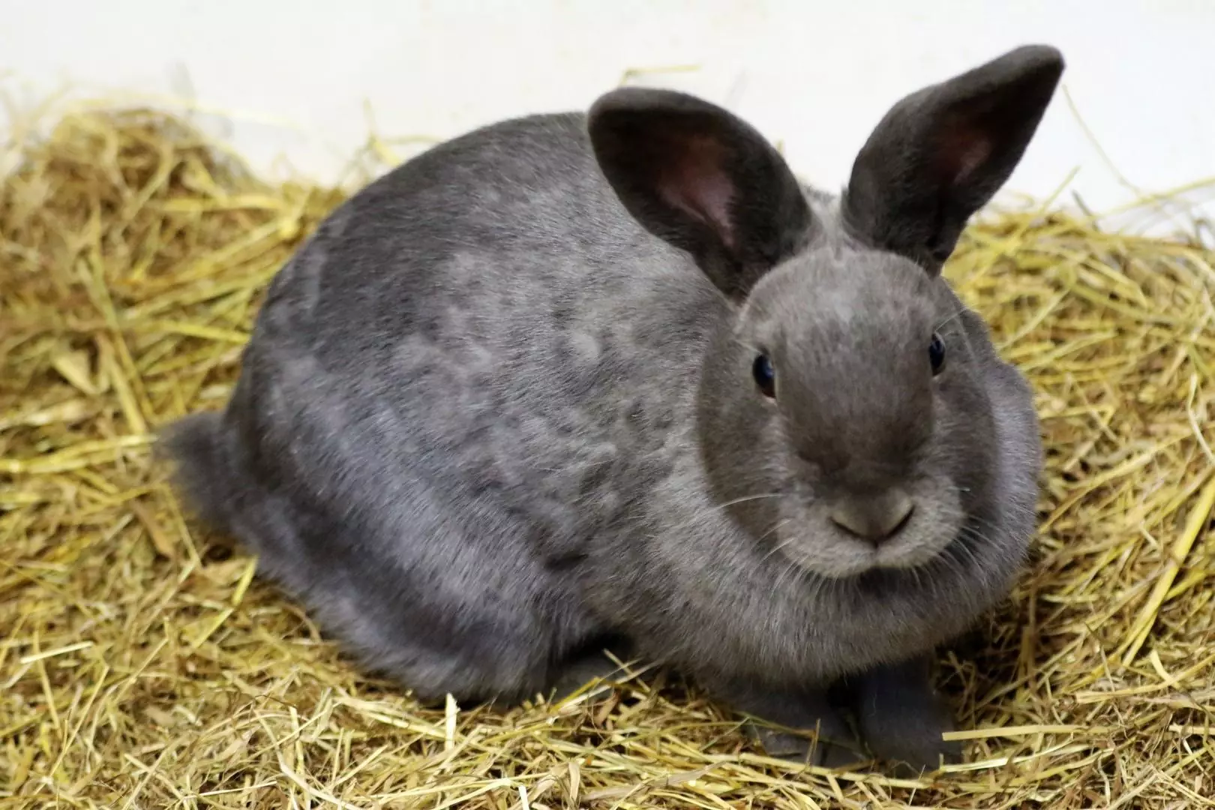

Slide 11
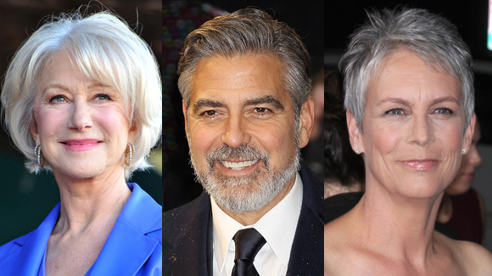

Slide 12
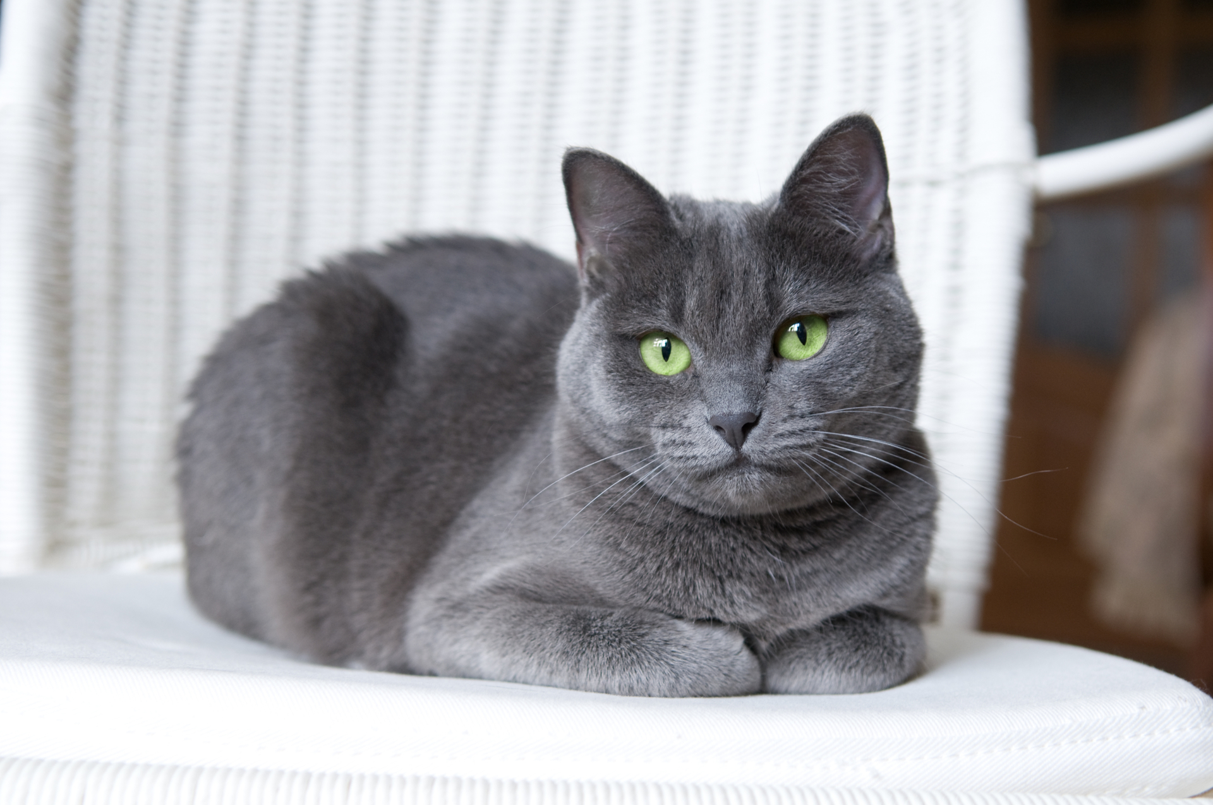

Slide 13
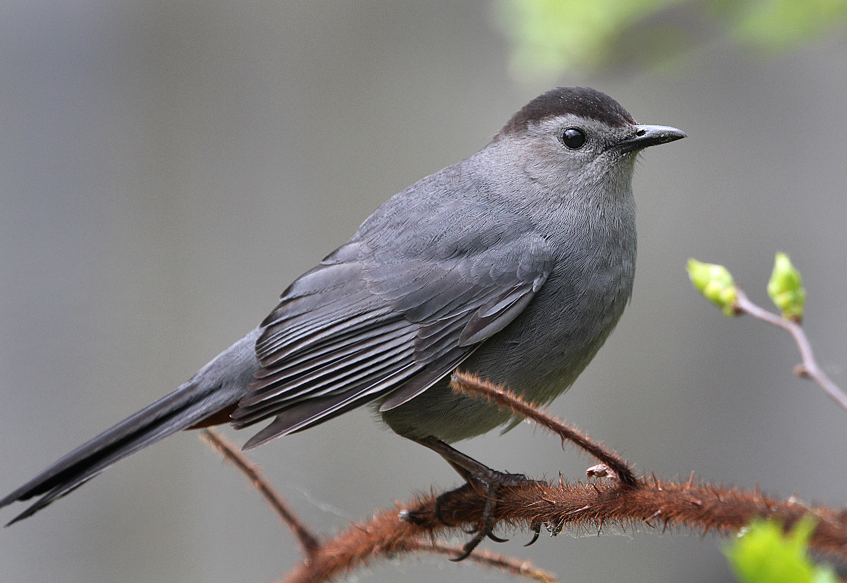

Slide 14


Slide 15
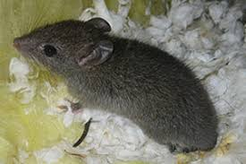

Slide 16


Slide 17
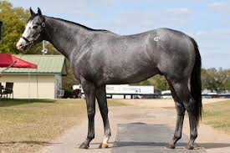

Slide 18
