Slide 1
Daily message
Today , we are going to use one less than .

Slide 2
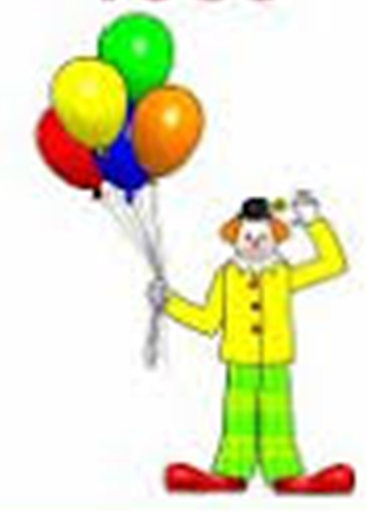



1
2

Slide 3
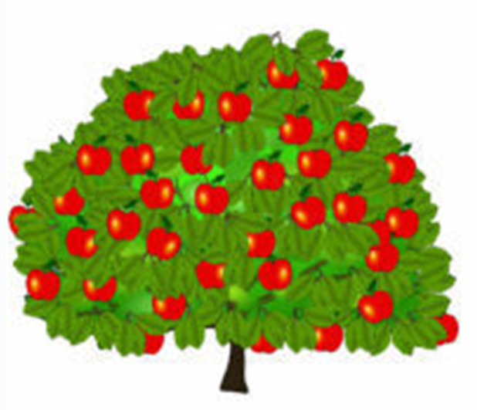
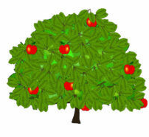
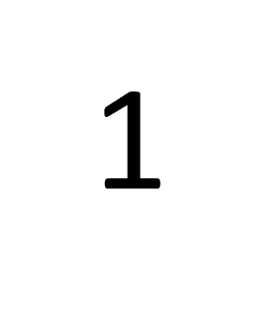
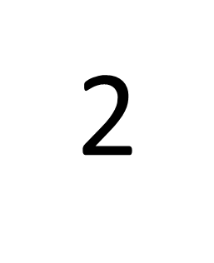

Slide 4
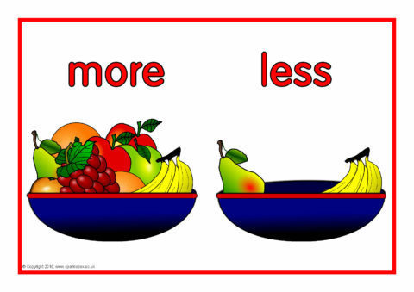

Slide 5



Slide 6



Slide 7




4
5

Slide 8
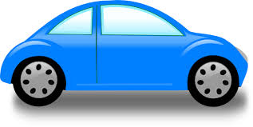

3
2

Slide 9




4
3

Slide 10
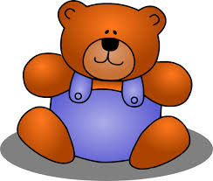

2
3

Slide 11
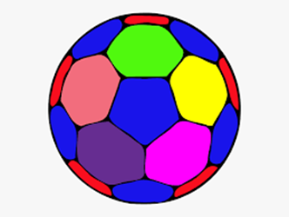


5
4

Slide 12
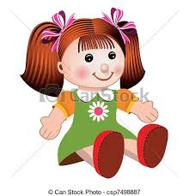
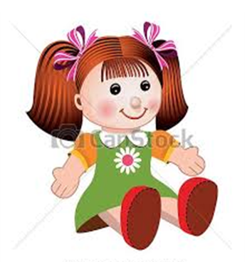

I
2

Slide 13
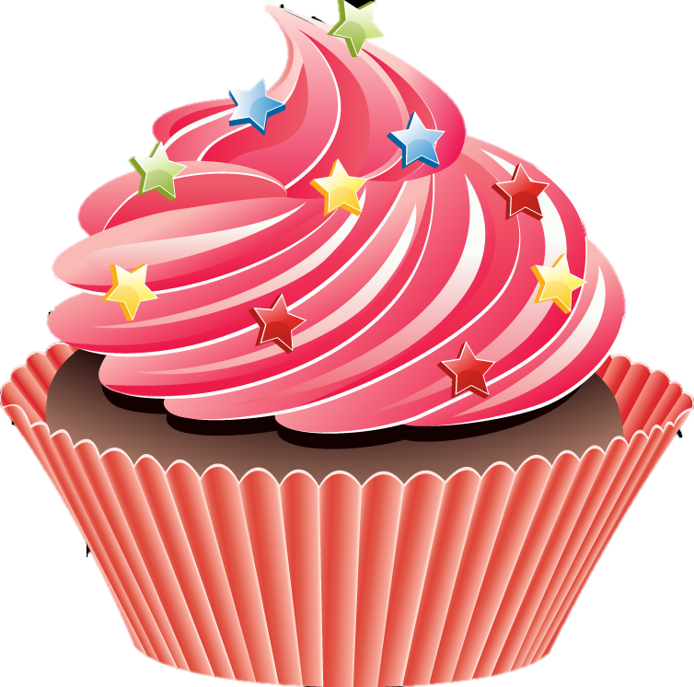

I
0

Slide 14
4
One less than 5 =
One less than 2 =
One less than 1 =
I
0

Slide 15
3
One less than 4 =
One less than 2 =
One less than 3 =
I
2

Slide 16
One less than 4 =
One less than 2 =
One less than 3 =
3
1
2

Slide 17
4
One less than 5 =
One less than 1 =
One less than 3 =
0
2

