Slide 1
Daily message
Today , we are going to use one less than .

Slide 2
1
2

Slide 3
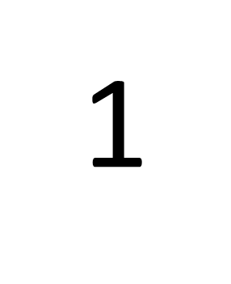
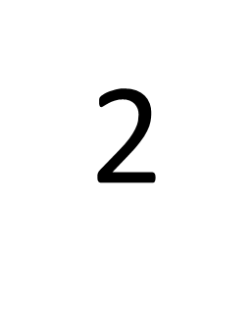

Slide 7
4
5

Slide 8
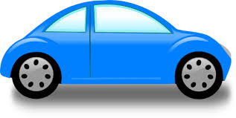
3
2

Slide 9
4
3

Slide 10
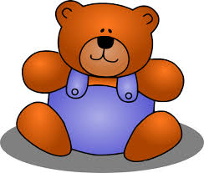
2
3

Slide 11
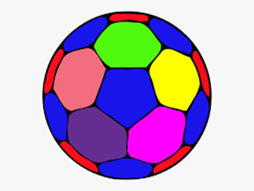
5
4

Slide 12
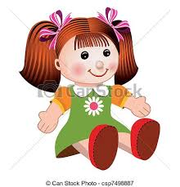
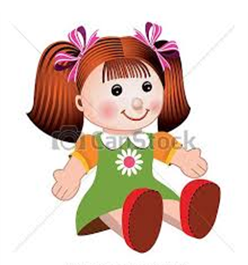
I
2

Slide 13
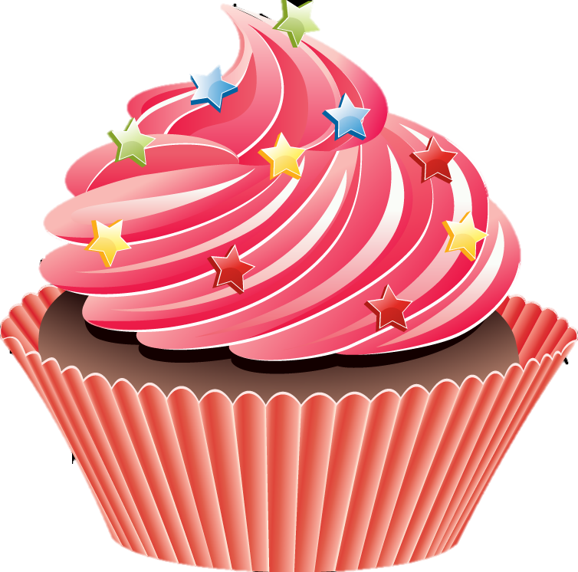
I
0

Slide 14
4
One less than 5 =
One less than 2 =
One less than 1 =
I
0

Slide 15
3
One less than 4 =
One less than 2 =
One less than 3 =
I
2

Slide 16
One less than 4 =
One less than 2 =
One less than 3 =
3
1
2

Slide 17
4
One less than 5 =
One less than 1 =
One less than 3 =
0
2

