Slide 1
Daily message
We are going to learn a new colour.

Slide 3
green
black
white

Slide 6
grey

Slide 15
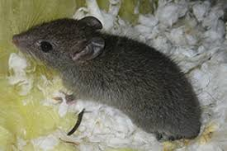

Slide 17
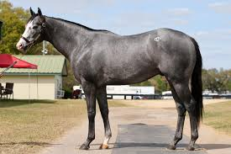

Slide 18
