Slide 1
Commas
Workbook page 31

Slide 2
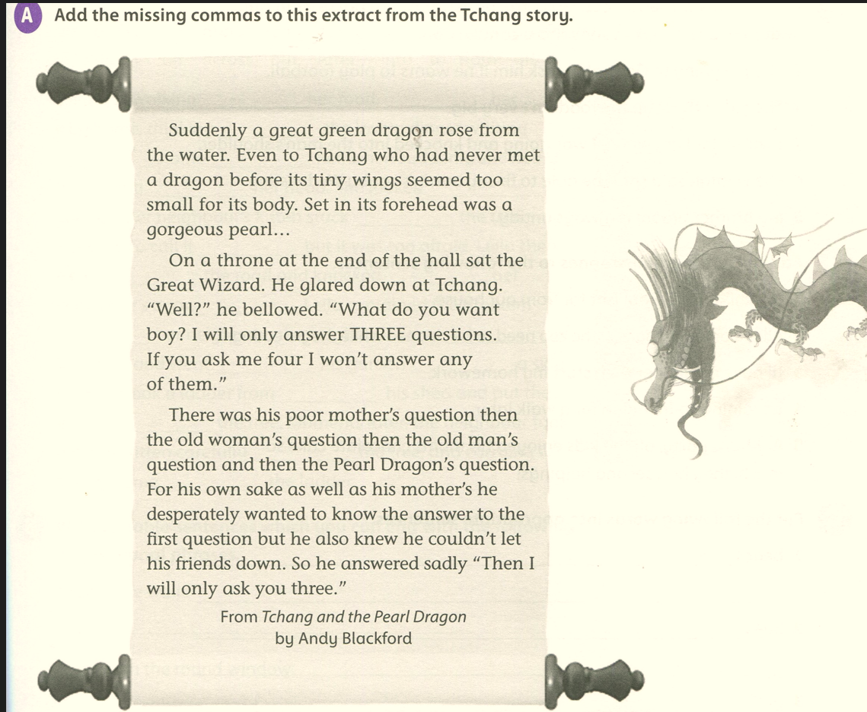
Workbook page 31

Slide 3
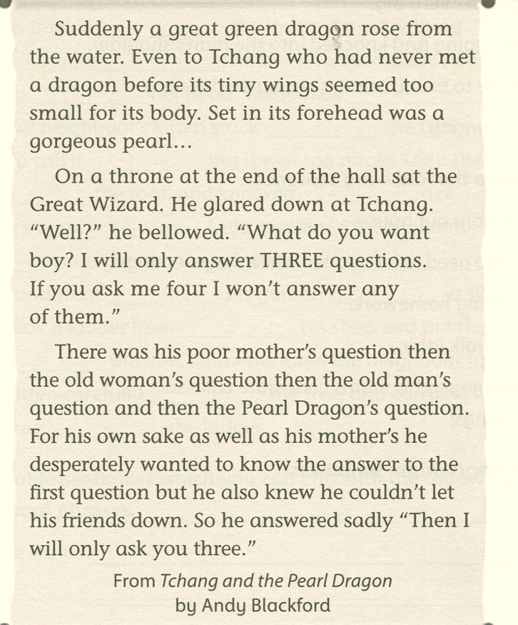
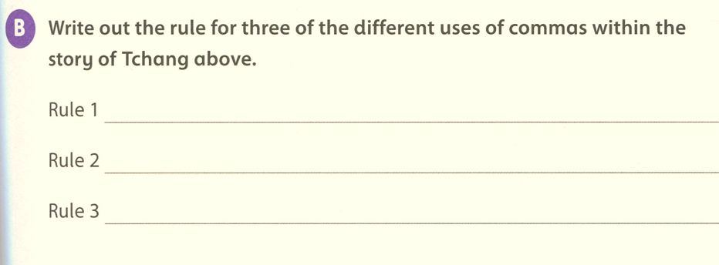
,
,
,
After a tag word
,
After a prepositional phrase
,
Before directly addressing someone.
,
Rule 4: To separate a main clause from a subordinate.
,
Rule 5: To list phrases
,
Rule 6: To separate a clause/phrase in the middle of the sentence.
,
,
,
Rule 7: before but
,
Rule 8: before speech marks
,

