Slide 1

Apostrophes

Slide 2
https://youtu.be/vc5quu-Ma7U
https://youtu.be/sEGPVtxesjM

Slide 3
https://create.kahoot.it/details/801b5335-a5ef-4d53-8f21-7bde8fb2cbd8
https://create.kahoot.it/details/4b207481-1736-4b4d-8211-b4b47e382479
https://create.kahoot.it/details/3ca096ec-0506-46d3-94ad-c554790ed33e
https://www.liveworksheets.com/worksheets/en/English_language/Contractions/Contractions_vt1238941vl
https://www.liveworksheets.com/worksheets/en/English_as_a_Second_Language_(ESL)/Possessives/Possessive_Nouns_vo436133ry

Slide 4

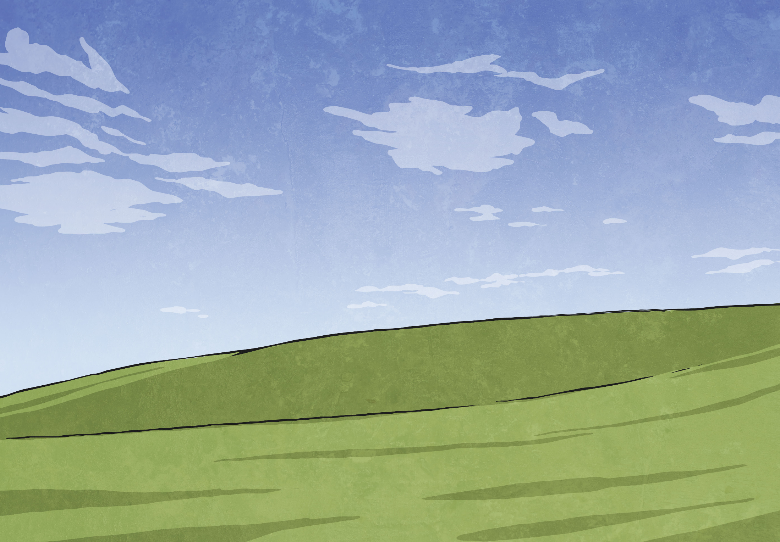
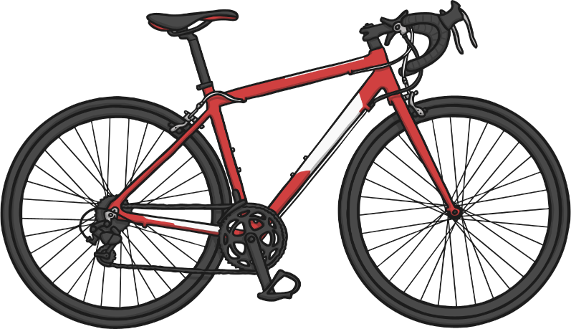
Showing Possession
Apostrophes can be used to show that something belongs to someone or something. This is called possession.
When we are talking about one thing we call this singular.
For example, a man or a bike.
When we need to say that something belongs to something singular, we put an apostrophe and then an ‘s’ at the end of the name that it belongs to.

Slide 5
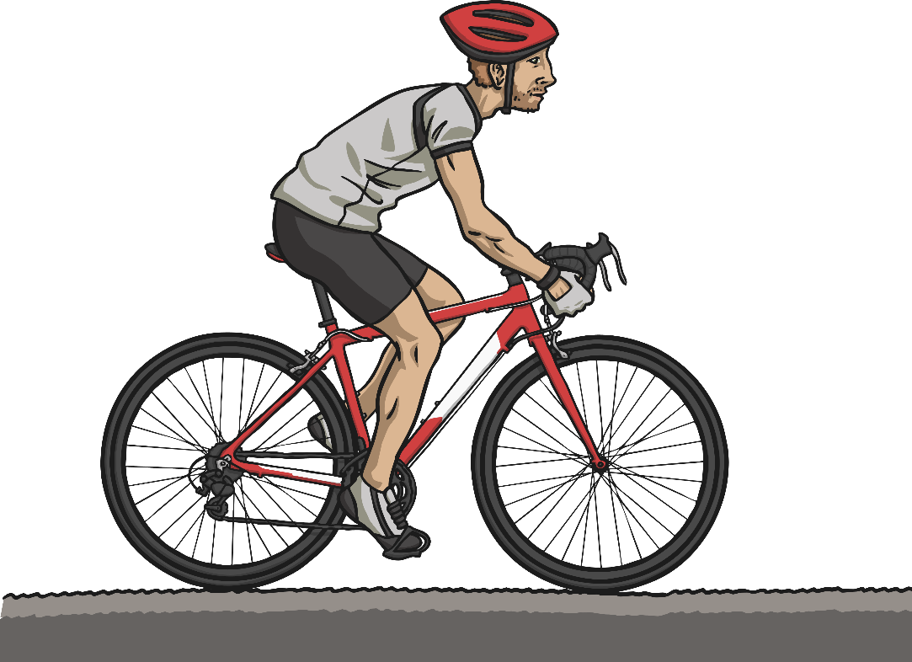
Showing Possession
Look at the examples below:
Common Noun:
The man’s bike.
Common Noun:
The bike’s handlebars were bent in the crash.
Proper Noun:
India’s national
flag has three horizontal stripes.
or

Slide 6
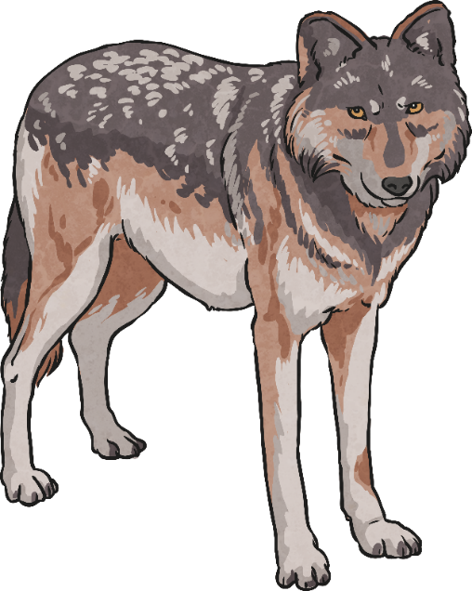

Showing Possession
When we are talking about more than one thing we call this plural.
For example, a pack of wolves or a group of countries.
If the noun is plural and ends
in –s, add only an apostrophe.
For example, the wolves’ prey was a deer.

Slide 7
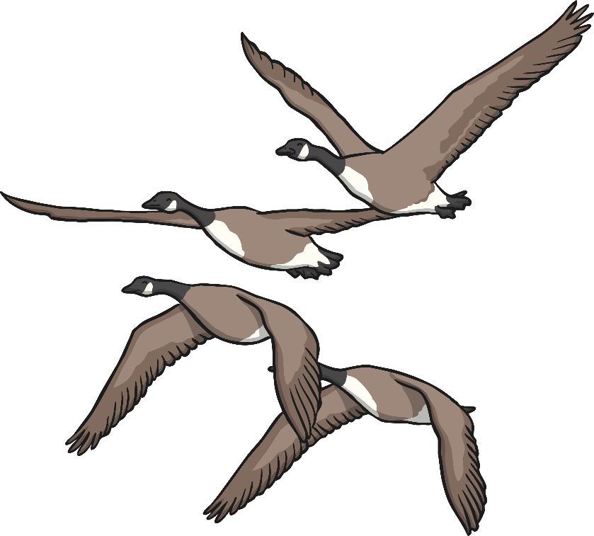
Showing Possession
If the noun is plural and does not end in -s, add –’s.
The children’s play is on Friday evening.
The geese’s flight in formation was amazing.

Slide 8
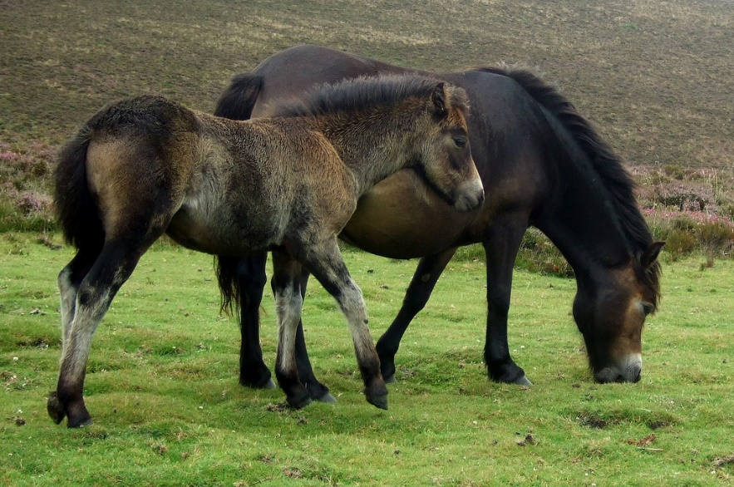
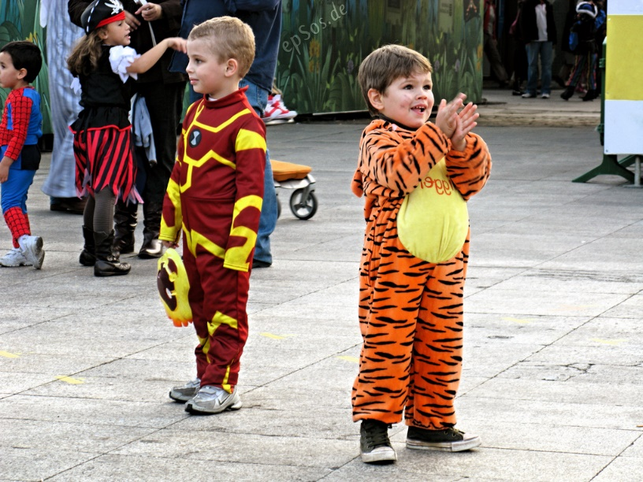
Showing Possession
However, plural nouns can be spelt using a variety of different letter endings.
If the noun ends with an ‘s’, we still show an apostrophe of possession but without adding another ‘s’ after it.
The boys’ fancy dress costumes were so good!
The ponies’ diet is mostly grass.
Photos courtesy of David Masters and epSos.de (@flickr.com) - granted under creative commons licence - attribution

Slide 9
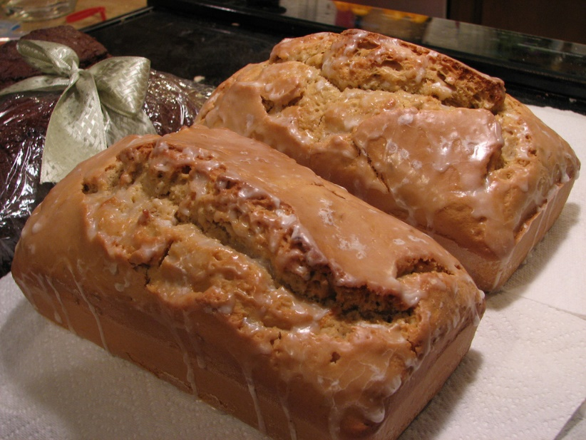
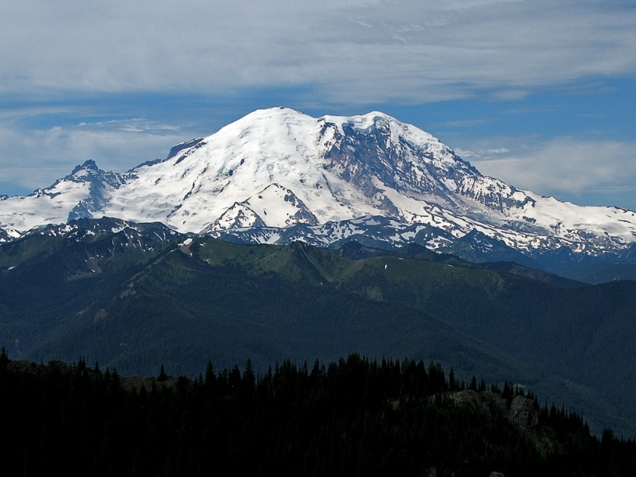
Showing Possession
More examples are shown below:
Two of the volcanoes’ summits are ahead.
The loaves’ icing is shiny.
Photos courtesy of anathema and pfly (@flickr.com) - granted under creative commons licence - attribution

Slide 10
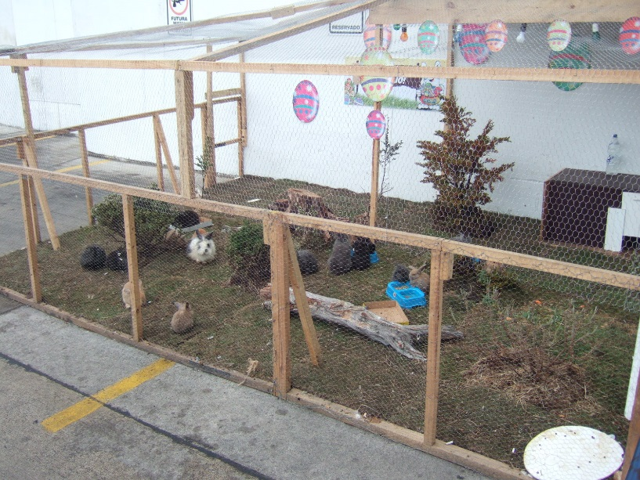
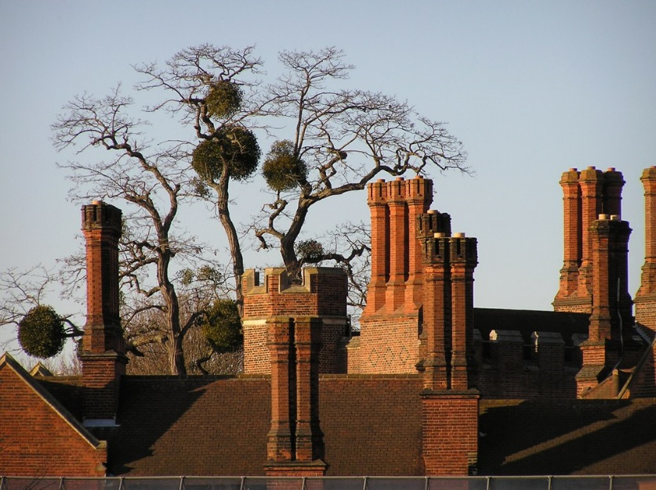
Showing Possession
More examples are shown below:
The houses’ chimneys are all made from brick.
The rabbits’ hutch is messy.
Photos courtesy of JohnSeb hughrocks (@flickr.com) - granted under creative commons licence - attribution

Slide 11

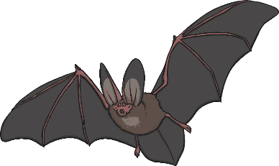

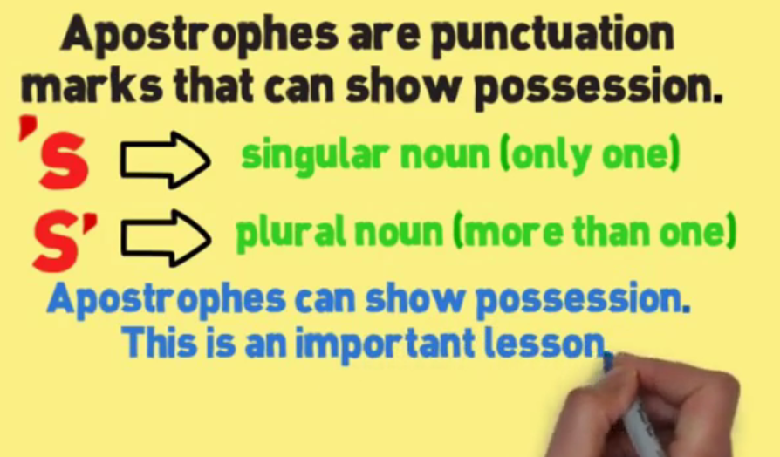


Showing Possession
Look at the following sentences and decide which one is correct.
Example A:
Through the trees, the bats’ noses glistened.
Example B:
Through the trees, the bat’s noses glistened.
Example C:
Through the trees, the bats nose’s glistened.
Watch the following short film to check your understanding:

Slide 12
Apostrophes (contractions)
We sometimes join two words together and miss out some letters. We call these words contractions.
(To contract means to shorten.)

Slide 13
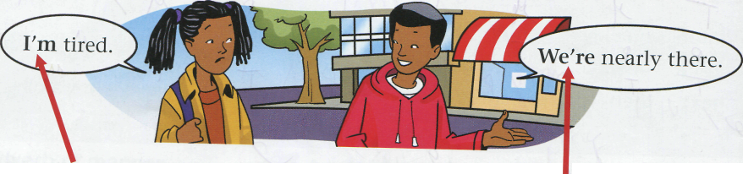
This is a contraction. I'm is short for I am.
This is a contraction. We're is short for we are.

Slide 14
Don’t
Didn’t
can’t
Couldn’t
Aren’t
Won’t
Do not
Did not
Can not
Could not
Are not
Will not

Slide 15
'm is short for
've is short for
's is short for
're is short for
'II is short for
'd is short for
am
have
Is or has
are
will
would or had

