Slide 1
Possessive apostrophes/
Contraction apostrophes
Student Book pages 64+65
Workbook page 32

Slide 2
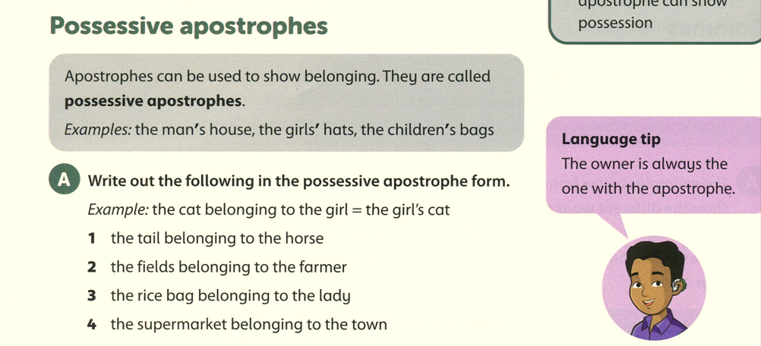
Student’s book page 64
The horse’s tail
The farmer’s fields
The lady’s rice bag.
The town’s supermarket.

Slide 3
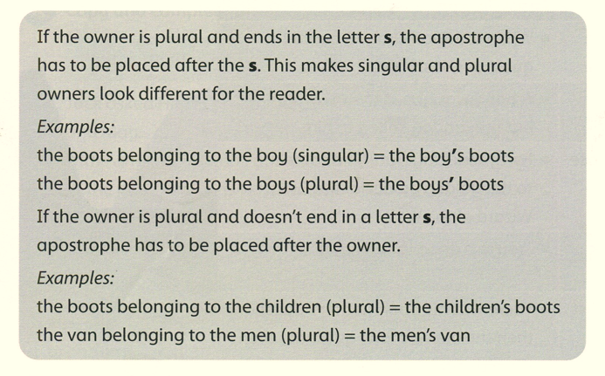

Slide 4
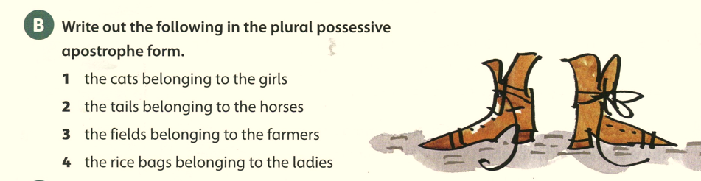
Student Book page 64
The girls’ cats
The horses’ tails
The farmers’ fields
The ladies’ rice bags

Slide 5
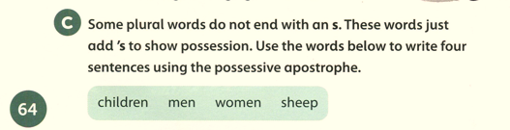
Student Book page 64 C
The children’s house is huge.
The men’s coffee was cold.
The women’s dresses were beautiful.
The sheep’s wool is fluffy.

Slide 6
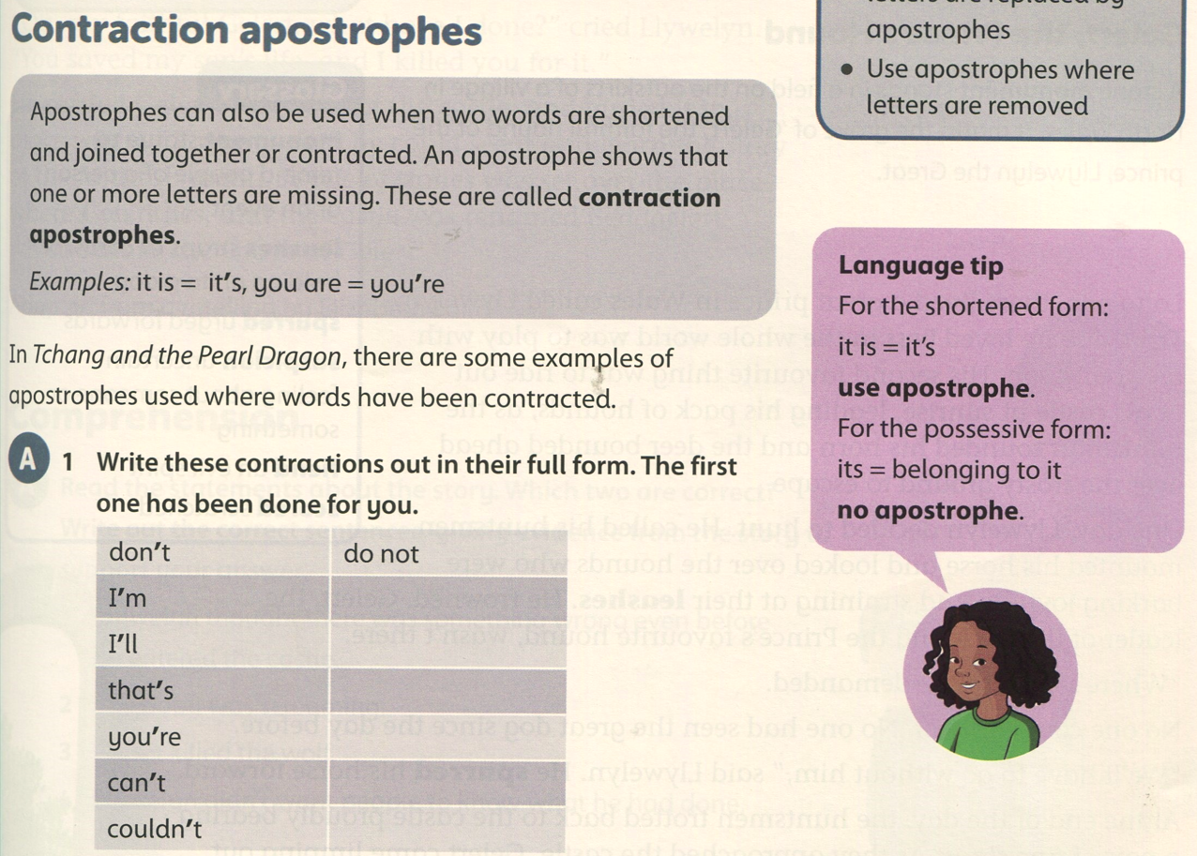
Student Book page 65
I am
I will
that is
you are
can not
could not

Slide 7
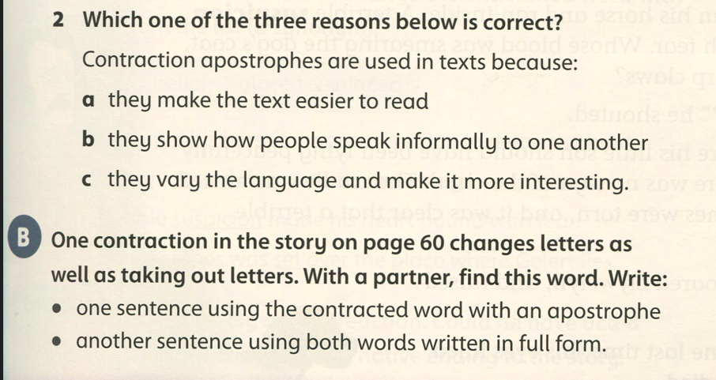
Student Book page 65

Slide 8
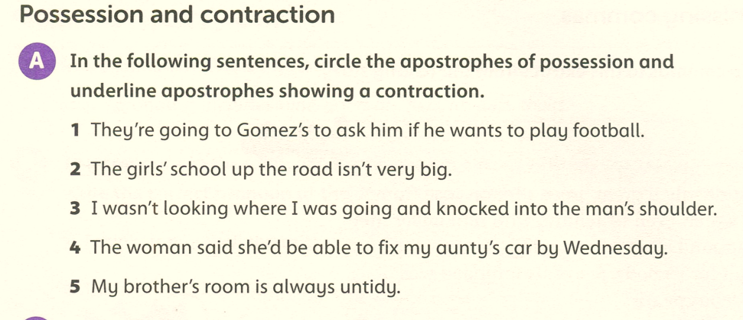
Workbook page 32

Slide 9
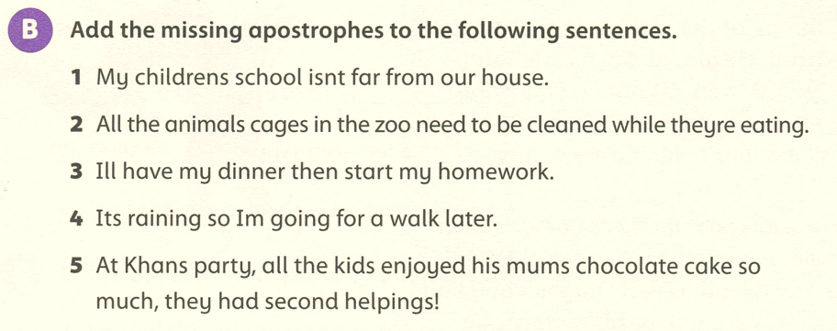
’
’
’
’
’
’
’
’
’

Slide 10
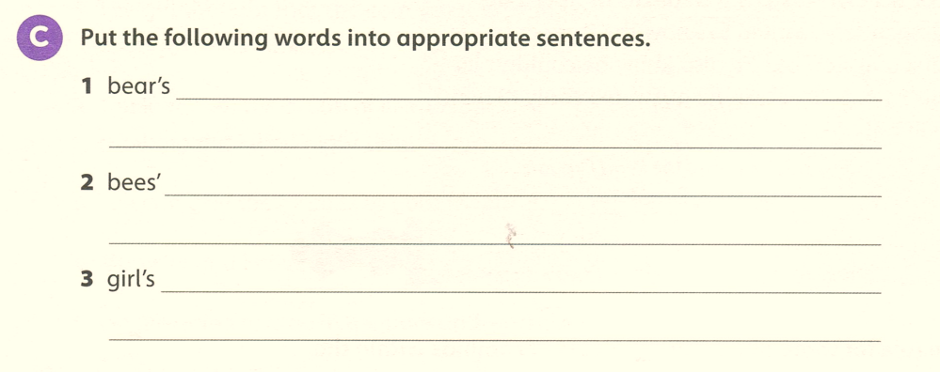
The bear’s paws were huge.
The bees’ home is called a hive.
The girl’s bedroom is very messy.

