Slide 1
Commas

Slide 2
When to use commas.

Slide 3
To separate the main clause from the subordinate clause
When the Pearl Dragon heard the question , it smiled.
Although she was tired , Salma went to the party.
After we had lunch, we were full.
After we had lunch, it began to rain.
After we had lunch,….

Slide 4
Before “ but”
Tchang was about to run away, but the dragon called to him.
Jim doesn’t like to go to the dentist, but he knows it’s important to go regularly.
She bought him a shirt, but he didn’t like it.

Slide 5
After a prepositional phrase or an adverbial phrase
On the far side of the river, Tchang thanked the dragon.
Forty-nine days later, he came to the golden palace of the Great Wizard of the West.

Slide 6
In the next lesson, we’ll learn all about the solar system.
Under the pile of clothes, we found his wallet.

Slide 7
After a small tag
“Oh, by the way.”
Naturally, Tchang said yes.

Slide 8
Yes, we can go outside to play.
No, you can’t go outside to play.
Wait, I didn’t mean to scare you.
However, you may not be satisfied with the results.
Certainly, I will read this book.

Slide 9
Before directly addressing someone.
“ You are a good lad, Tchang.”
“ What do you want, boy?”
Where are you going, mum?
Jack, are you leaving soon?

Slide 10
A list of Phrases
There was his mother’s question, then the old woman’s question, then the old man’s question.

Slide 11
She bought cups of sugar, jars of honey, and plates of spaghetti.

Slide 12
Student’s book page 63

Slide 13
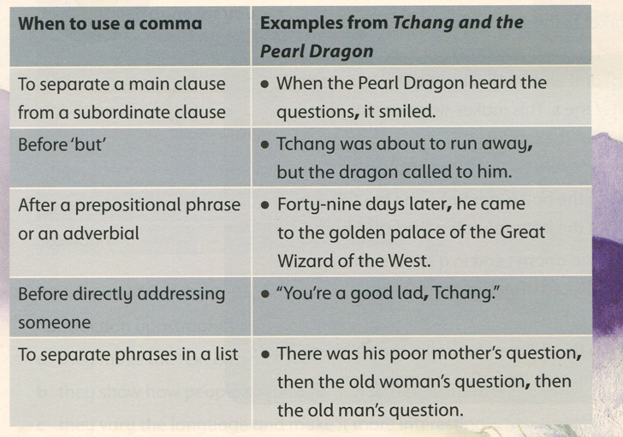
Student’s book page 63

Slide 14
Student’s book page 63

Slide 15
https://create.kahoot.it/details/b1222fdb-f67b-465f-a88f-fbba31bf37db
https://create.kahoot.it/share/commas/60dbdb48-9aeb-4324-9848-bc38af8f2fe9

