Slide 1
https://www.liveworksheets.com/c?a=s&g=3&s=%D8%B1%D9%8A%D8%A7%D8%B6%D9%8A%D8%A7%D8%AA&t=83zhayco05y&sr=n&ms=uz&l=ia&i=ussfudx&r=by&db=0&f=dzdtzdut&cd=p60gwdikj28ilodxppexnmfi2ngnzgnxzxg

Slide 2
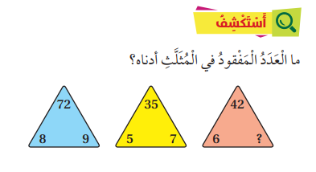
7

Slide 5
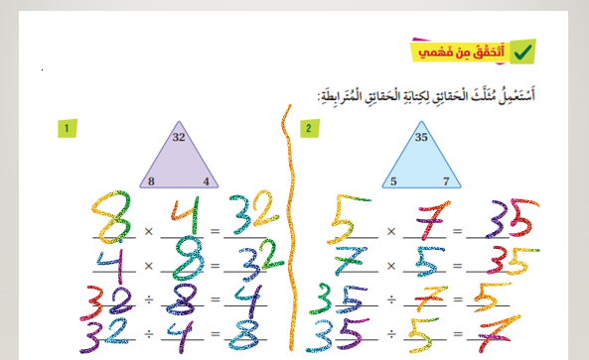

Slide 7
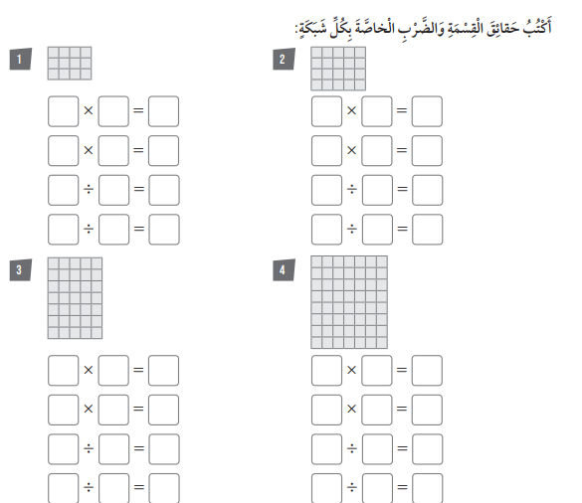
3
4
12
4
5
20
4
3
12
5
4
20
12
4
3
20
5
4
12
3
4
20
4
5
7
5
35
8
7
56
5
7
35
7
8
56
35
7
5
56
8
7
35
5
7
56
7
8

