Slide 1
Possessive apostrophes/ Contraction apostrophes
Student’s book pagess64+65
Workbook page 32

Slide 2
Student’s book page 64
The horse’s tail
The farmer’s fields
The lady’s rice bag.
The town’s supermarket.

Slide 4
Student’s book page 64
The girls’ cats
The horses’ tails
The farmers’ fields
The ladies’ rice bags

Slide 5
Student’s book page 64
The children’s house is huge.
The men’s coffee was cold.
The women’s dresses were beautiful.
The sheep’s wool is fluffy.

Slide 6
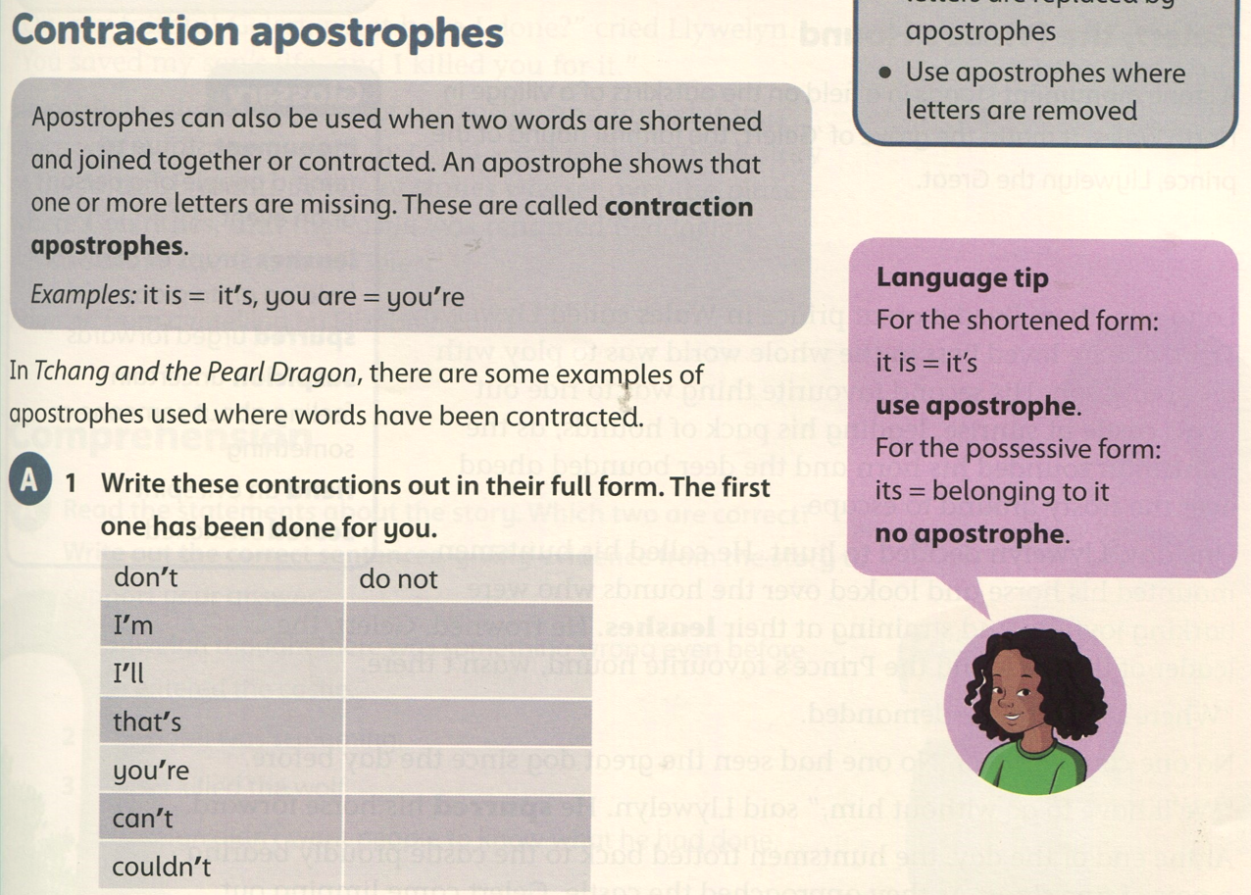
Student’s book page 65
I am
I will
that is
you are
can not
could not

Slide 7
Student’s book page 65
The word is “won’t” (line 25)

Slide 8
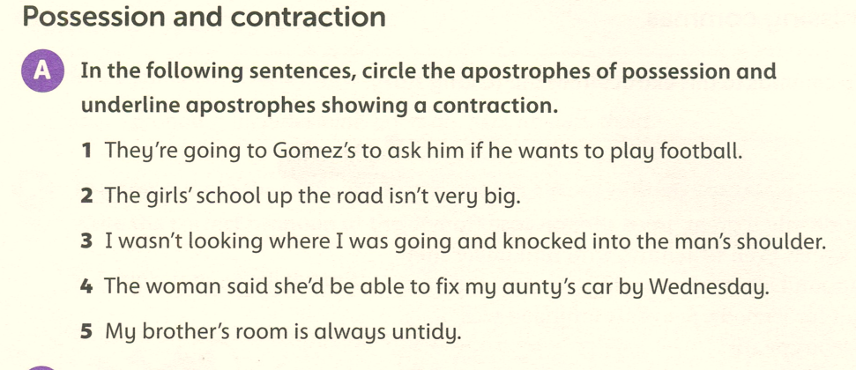

Slide 9
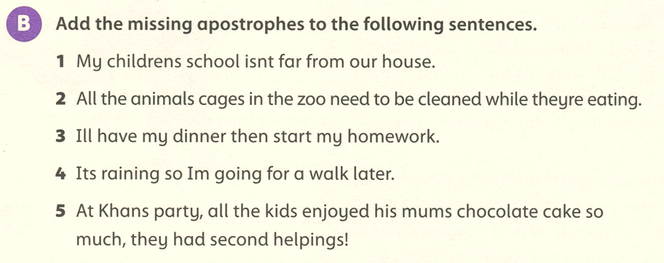
’
’
’
’
’
’
’
’
’

Slide 10
The bear’s paws were huge.
The bees’ home is called a hive.
The girl’s bedroom is very messy.

