Slide 1
Expressions
Chapter 2

Slide 2
Objectives:
Learn about constructing expressions.
Learn about expanding brackets.
Learn about factorizing expressions.
Learn about substituting into expressions.

Slide 3
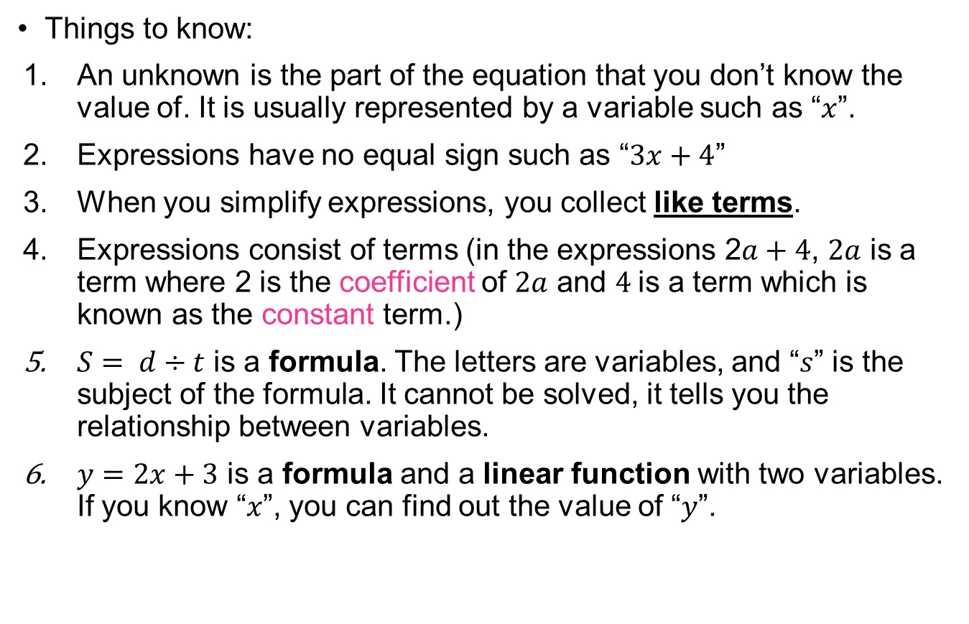
Expressions, formulae and equations:
Things to know:
An unknown is the part of the equation that you don’t know the value of. It is usually represented by a variable such as “$x$”.
Expressions have no equal sign such as “$3x+4$”
When you simplify expressions, you collect like terms.
Expressions consist of terms (in the expressions 2$a+4$, $2a$ is a term where 2 is the coefficient of $2a$ and $4$is a term which is known as the constant term.)
$S= d÷t$ is a formula. The letters are variables, and “$s$” is the subject of the formula. It cannot be solved, it tells you the relationship between variables.
$y=2x+3$ is a formula and a linear function with two variables. If you know “$x$”, you can find out the value of “$y$”.

Slide 4
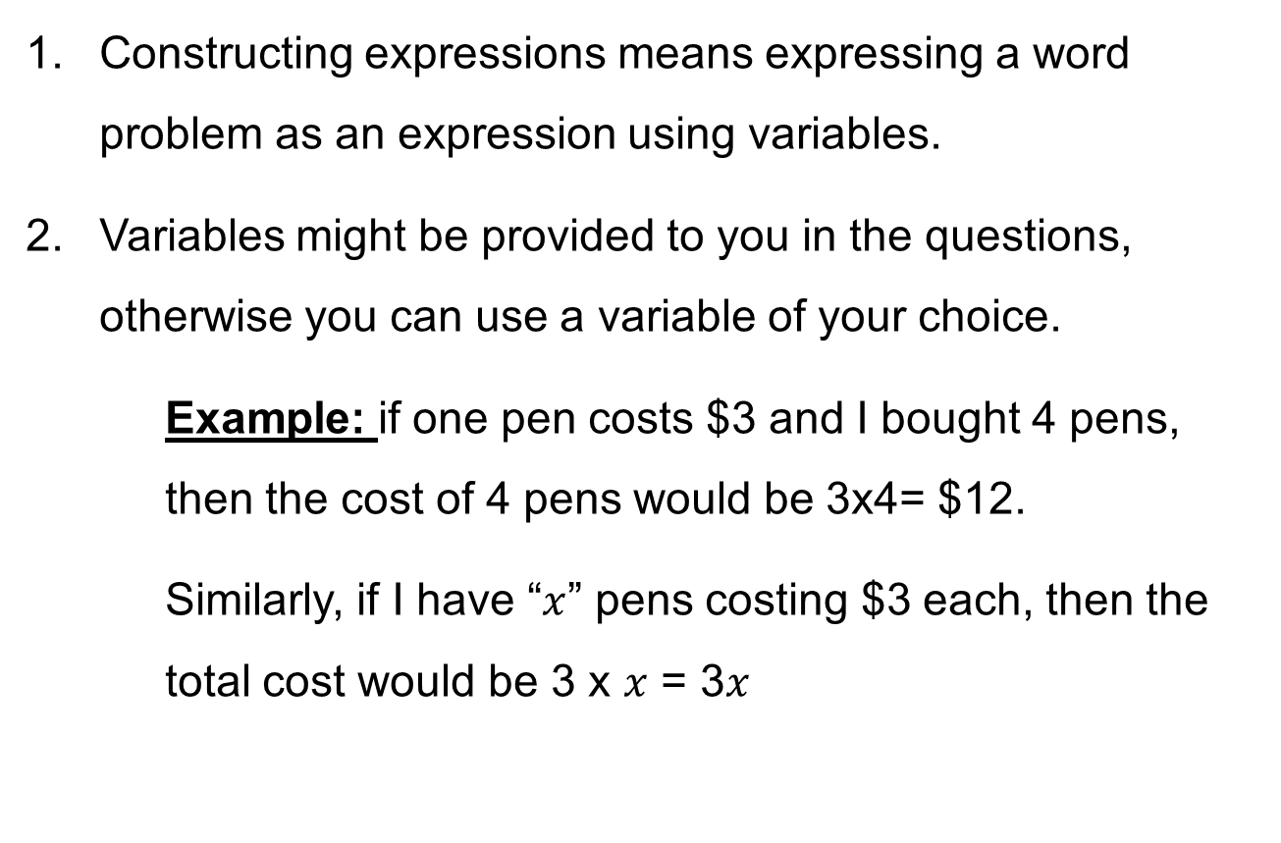
Constructing expressions
Constructing expressions means expressing a word problem as an expression using variables.
Variables might be provided to you in the questions, otherwise you can use a variable of your choice.
Example: if one pen costs $3 and I bought 4 pens, then the cost of 4 pens would be 3x4= $12.
Similarly, if I have “$x$” pens costing $3 each, then the total cost would be 3 x $x$ = 3$x$

Slide 5

P. 27 Ex. 2A:
  Q1
  Q2
  Q3 (c,d)
  Q4
  Q5
  Q6
  Q8
  Q9
  Q10
  Q11
  Q12 (a)
  Q14

Slide 6
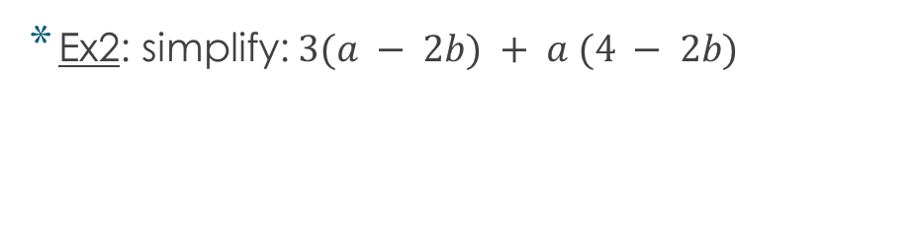
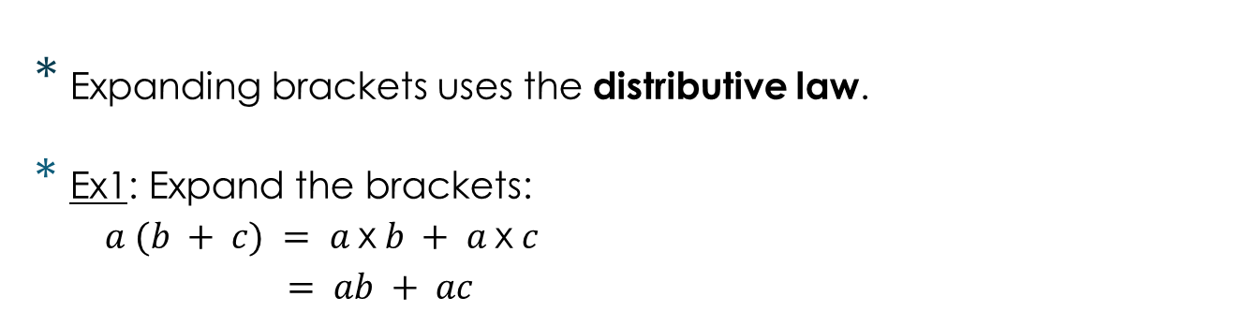
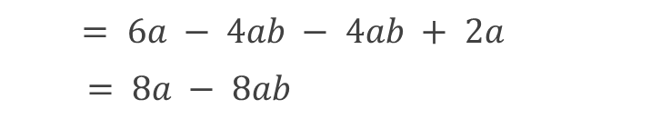
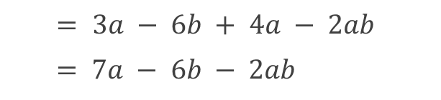
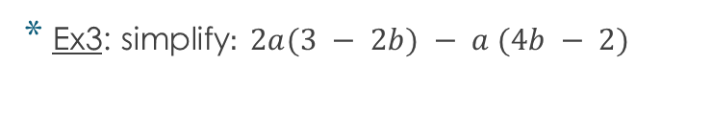
Expanding brackets:
Expanding brackets uses the distributive law.
Ex1: Expand the brackets:
  $a (b + c) = a$x$b + a$x$c$
  $= ab + ac$
Ex2: simplify: $3(a − 2b) + a (4 − 2b)$
$= 3a − 6b + 4a − 2ab$
$= 7a − 6b − 2ab$
Ex3: simplify$: 2a(3 − 2b) − a (4b − 2)$
$= 6a − 4ab − 4ab + 2a$
$= 8a − 8ab$
https://www.youtube.com/watch?v=v-6MShC82ow&t=405s

Slide 7
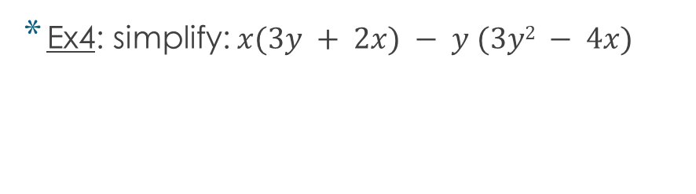



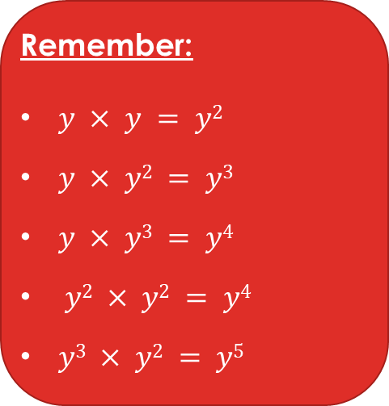
Ex4: simplify: $x(3y + 2x) − y (3y2 − 4x)$
$= 3xy + 2x2 − 3y3 + 4xy$
$= − 3y3 + 2x2 + 7xy$
Ex5: simplify: $3a2(a − 5b) − (6a2b − 4a3)$
$= 3a3 − 15a2b − 6a2b + 4a3$
$= 7a3 − 21a2b$
Remember:
$y × y = y2$
$y × y2 = y3$
$y × y3 = y4$
$y2 × y2 = y4$
$y3 × y2 = y5$

Slide 8
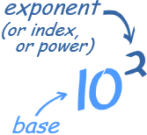
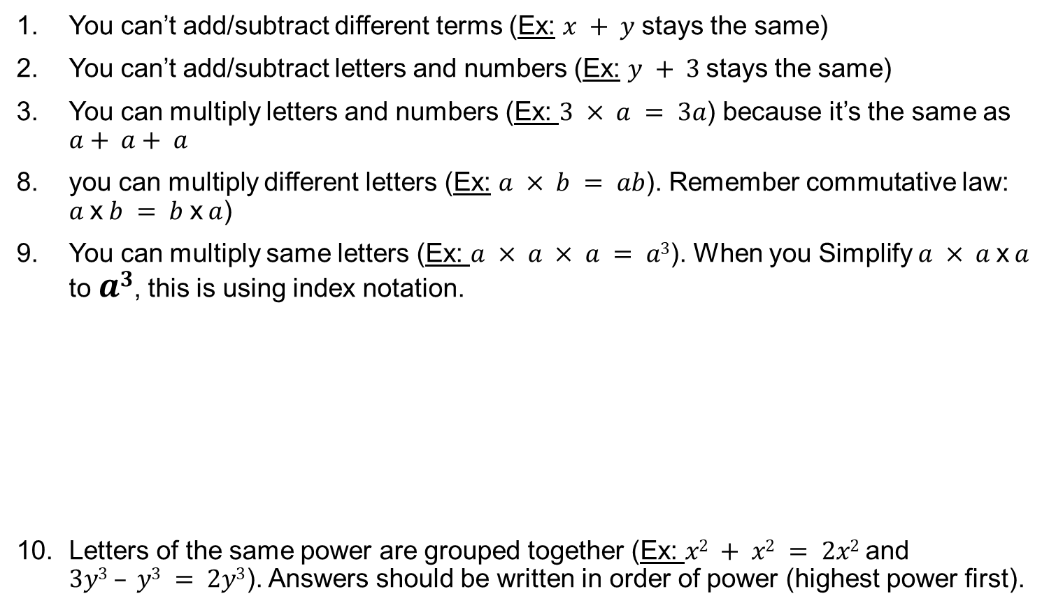
Things to remember when simplifying expressions:
You can’t add/subtract different terms (Ex: $x + y$stays the same)
You can’t add/subtract letters and numbers (Ex: $y + 3$stays the same)
You can multiply letters and numbers (Ex: $3 × a = 3a$) because it’s the same as $a+ a+ a$
you can multiply different letters (Ex: $a × b = ab$). Remember commutative law: $a$x$b = b$x$a$)
You can multiply same letters (Ex: $a × a × a = a3$). When you Simplify $a × a$x$a$ to $a3$, this is using index notation.
Letters of the same power are grouped together (Ex: $x2 + x2 = 2x2$and $3y3 – y3 = 2y3$). Answers should be written in order of power (highest power first).
a
Https://www.youtube.com/watch?v=yigRz8b9eL0

Slide 9
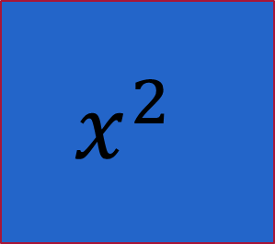

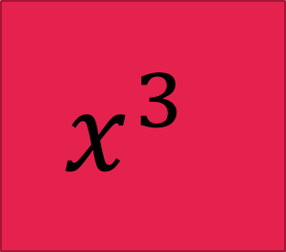
For variables with powers
$$x$$
$$x^{2}$$
$$x^{3}$$
Pretend that each power is a different color, you cannot mix colors together, only same color cards can be collected together.

Slide 10
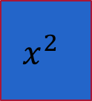
















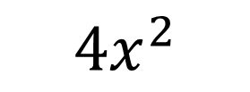


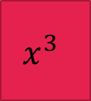



Examples:
$$x^{2}$$
$$x^{2}$$
$$x^{2}$$
$$x^{2}$$
$${4x}^{2}$$
$$x^{2}$$
$$x^{2}$$
$$x$$
$$x$$
$$x$$
$$x^{3}$$
$${x^{3}+2x}^{2}+3x$$
$$x^{3}$$
$$x^{3}$$
$$x^{3}$$
$$x^{3}$$
$$x^{3}$$
$$x^{3}$$
$$x$$
$$x$$
$$x^{2}$$
$$x^{2}$$
$$x^{2}$$
$${{6x}^{3}+3x}^{2}+2x$$

Slide 11











Simplify the examples below:
Ex 5:
$x2 + 2y + 2x2 + 3y$
Ex 1:
$a + b − 2a + 2b$
* Ex 2:
$$2a + b + 3 − 3b + 4$$
Ex 3:
$− 12m − 10n + 3n + 5m − 2n$
Ex 4:
$−2ab + 3 + 4a + 6ba − 7a − 3$
Always write terms in order of power (start with the highest power)
= $− a +3b$
= $3x^{2}$ $+5y$
Ex 6:
$2x3+ 2x2− 3x3 + 9x − 6x2$
= $2a −2b+7$
= $−x^{3}−4x^{2}+9x$
Ex 7:
$2x2y − 6xy − 3y2x + 6y2x + 5yx + 5x2y − 6x2$
= $−7m −9n$
= $7x^{2}y+3y^{2}x −6x^{2}−xy$
= $−3a+4ab$
Algebra Basics: Simplifying Polynomials - Math Antics - YouTube

Slide 12
P. 29 Ex. 2B:
  Q1 (b, d, e, g, I, j)
  Q2 (b,d)
  Q3
  Q4 (a)
  Q5 (a)
  Q6 (a, c,d)
  Q7
  Q8
  Q9
  Q10 (b, c)
  Q11 (a,b)
  Q12 (a,b,d,f,g,h)
  Q13 (a) *

Slide 13
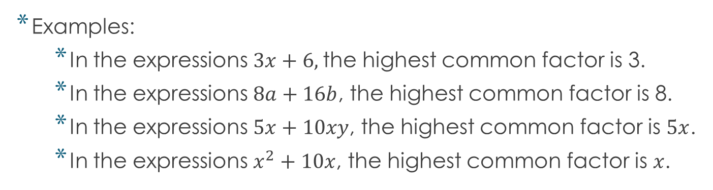
Factorizing expressions
The opposite of expanding brackets is to put an expressions into brackets. This is called factorizing.
You do this by putting the highest common factor of all of the terms outside the brackets.
Examples:
  In the expressions $3x+6,$the highest common factor is 3.
  In the expressions $8a+16b$, the highest common factor is 8.
  In the expressions $5x+10xy$, the highest common factor is $5x$.
  In the expressions $x^{2}+10x$, the highest common factor is $x$.
1) https://youtu.be/ctqviXu-mTE
2) Factoring Expressions Algebra - YouTube

Slide 14

When you find the common factor, you out it outside and work out what’s left by division.
Let’s see what happens to our previous examples when we do that.
You can check by expanding the expression again ☺
Examples:
  In the expressions $3x+6,$the highest common factor is 3.
  In the expressions $8a+16b$, the highest common factor is 8.
  In the expressions $5x+10xy$, the highest common factor is $5x$.
  In the expressions $x^{2}+10x$, the highest common factor is $x$.
After factorizing: $3(x+2)$
After factorizing: $8(a+2b)$
After factorizing: $5x(1+2y)$
After factorizing: $x(x+10)$

Slide 15
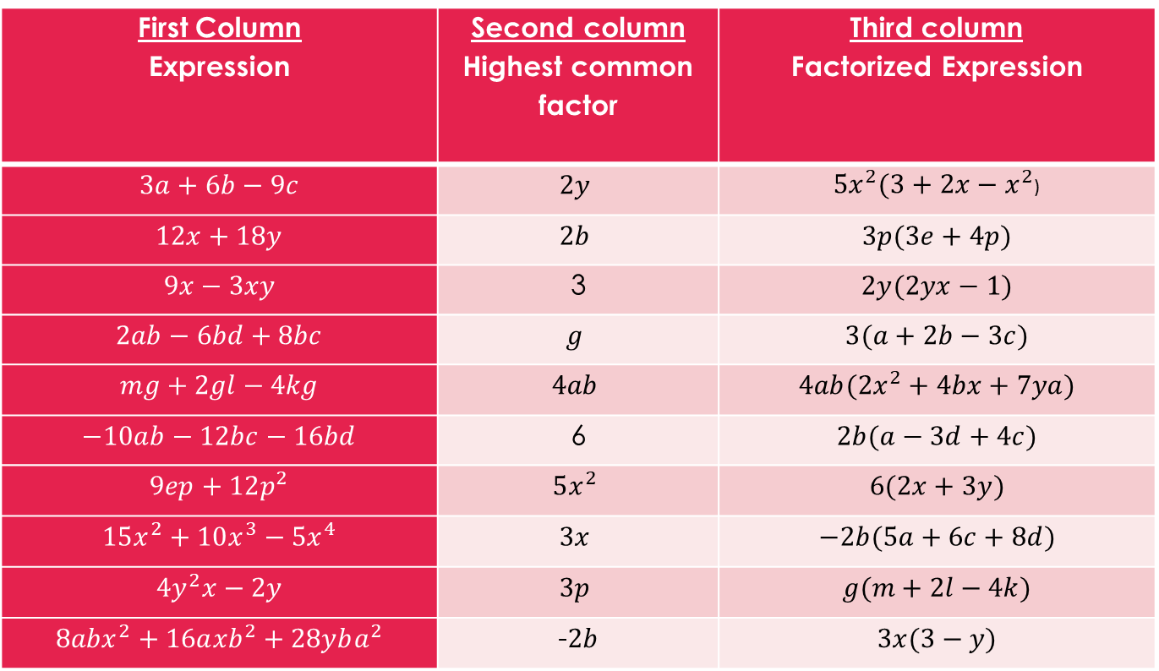
Activity Time
Match each expression from the first column, with its highest common factor from the second column and the factorized expression from the third column.
First Column Expression | Second column Highest common factor | Third column Factorized Expression
$$3a+6b−9c$$ | $$2y$$ | $5x^{2}(3+2x−x^{2}$)
$$12x+18y$$ | $$2b$$ | $$3p(3e+4p)$$
$$9x−3xy$$ | 3 | $$2y(2yx−1)$$
$$2ab−6bd+8bc$$ | $$g$$ | $$3(a+2b−3c)$$
$$mg+2gl−4kg$$ | $$4ab$$ | $${4ab(2x}^{2}+4bx+7ya)$$
$$−10ab−12bc−16bd$$ | 6 | $$2b(a−3d+4c)$$
$$9ep+12p^{2}$$ | $$5x^{2}$$ | $$6(2x+3y)$$
$$15x^{2}+10x^{3}−{5x}^{4}$$ | $$3x$$ | $$−2b(5a+6c+8d)$$
$${4y}^{2}x−2y$$ | $$3p$$ | $$g(m+2l−4k)$$
$${8abx}^{2}+16a{xb}^{2}+28yba^{2}$$ | -$2b$ | $$3x(3−y)$$

Slide 16
P. 31 Ex. 2C:
  Q1 (a,c,e,f,h)
  Q2 (b,c,d,f,g,h)
  Q3
  Q4
  Q6 (a,c,d,g,h,j,L)
  Q8 (a,c,d,f,g,h)
  Q10 (a,c,e,f)
  Q12 (a,d,f,g,h,i,j,L)
  Q13*
  Q14* (a,b,d,f,h)
  Q15 (b,d)

Slide 17
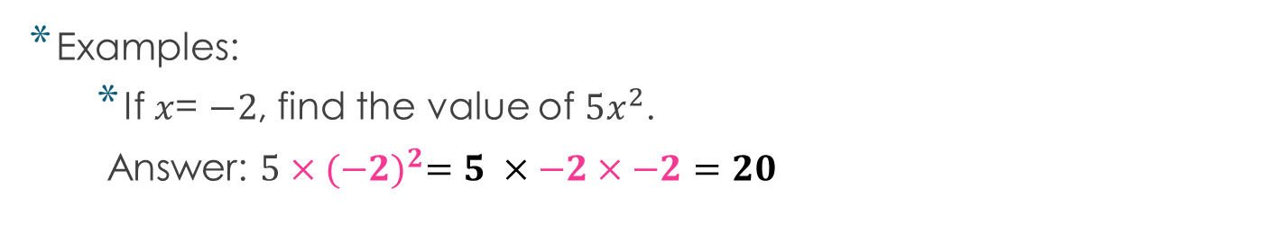
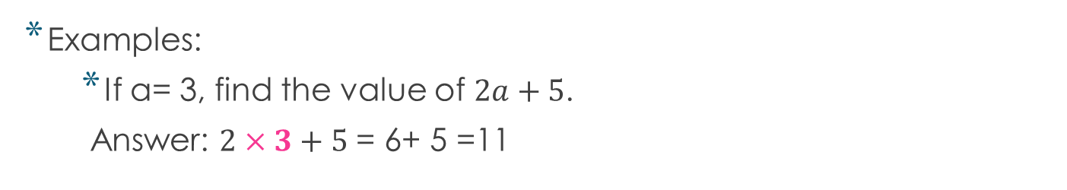
Substituting into expressions
The word substitute means replace. In expressions, variables are substituted with given integers.
Remember, you should always solves using BIDMAS.
Pay attention to signs.
Examples:
  If a= 3, find the value of $2a+5$.
  Answer: $2×3+5$ = 6+ 5 =11
Examples:
  If $x$= $−2$, find the value of $5x^{2}$.
  Answer: $5×({−2)}^{2}=5 ×−2×−2=20$
Algebra Substitution - GCSE Maths - YouTube

Slide 18
P. 33 Ex. 2D:
  Q1 (b,c,d,f,g)
  Q2 a,b,d,e,f,i,k,L)
  Q3 (d,e,f)
  Q4 (a,c,d,f,h)
  Q5 (a,d,e)
  Q6 (b,c,d)
  Q7
  Q9 (a)
  Q10 **
End of chapter 2 ☺

