Slide 1
Apostrophes Grammar Booklet
Page 31

Slide 2
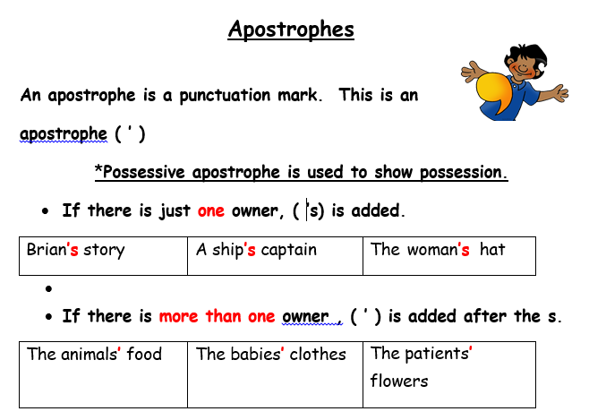

Slide 3
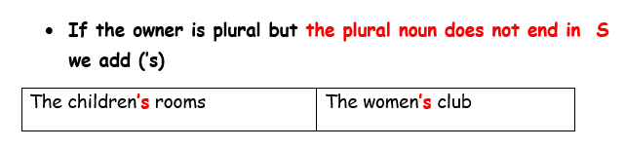

Slide 4
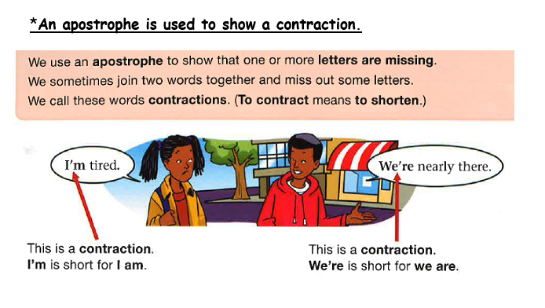

Slide 5
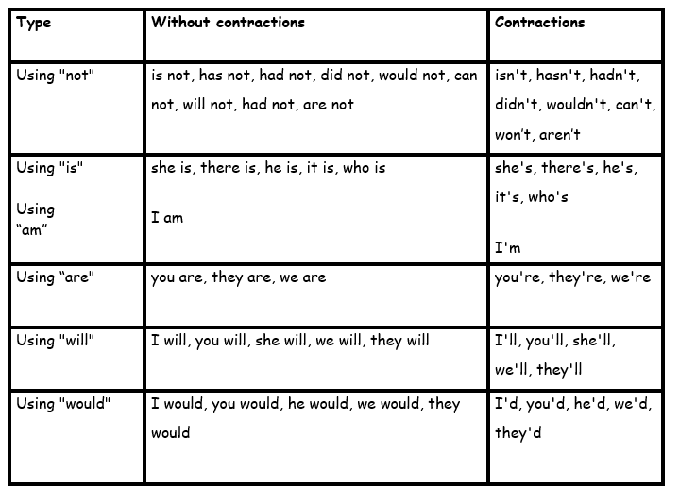

Slide 6
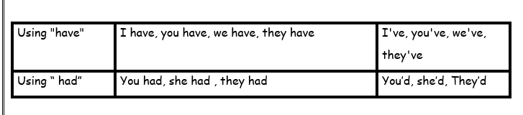

Slide 7
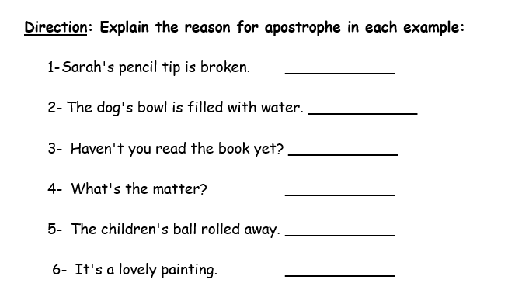
possession
possession
contraction
contraction
possession
contraction

Slide 8
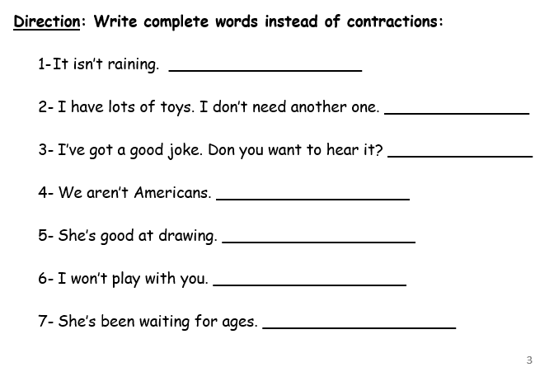
is not
do not
I have
are not
She is
will not
She has

Slide 9
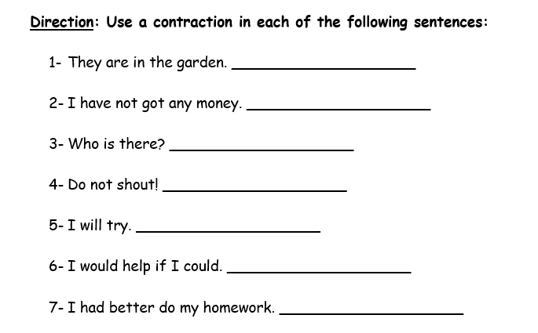
They’re
haven’t
Who’s
Don’t
I’ll
I’d
I’d

Slide 10
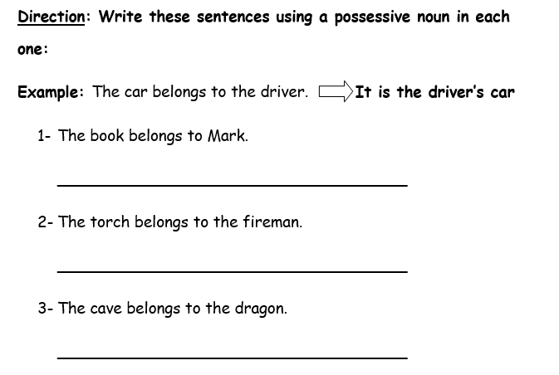
It is Mark’s book.
It is the fireman’s torch.
It is the dragon’s cave.

Slide 11
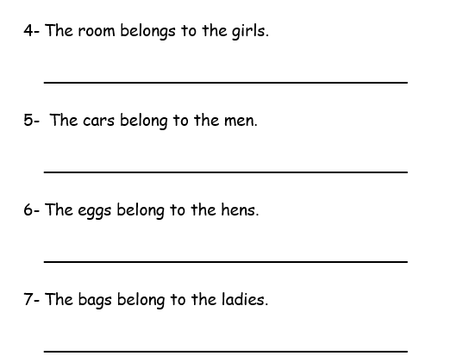
It is the girls’ room.
They are the men’s cars.
They are the hens’ eggs.
They are the ladies’ bags.

Slide 12
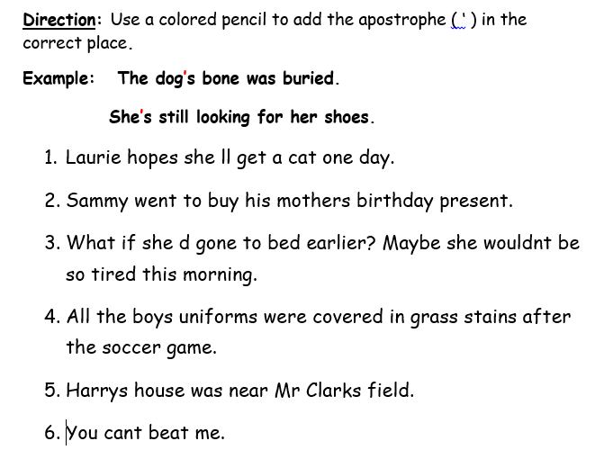
’
’
’
’
’
’
’
’

Slide 13




