Slide 2
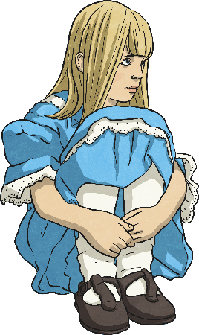
Features of a Play Script: Character List
Characters Alice In Wonderland
Alice
The main character – A young girl who is lost in Wonderland. Has a great imagination.
The Mad Hatter
As the name suggests, he is ‘crazy’. He gives out riddles, dresses fashionably and likes tea.
Hare
A friend of the Mad Hatter, thinks it is always time for afternoon tea, is also mad.
Dormouse
Incredibly sleepy friend of the Mad Hatter.
At the beginning of a play script, you’ll find a list of all the characters that are in the play.
Sometimes they will have a short description with them.
How might this help someone who wanted to perform the play?
This tells people what the characters are like before reading the play.
Why do you think this is?
This helps anyone who wants to perform the play know how many actors they need.

Slide 3
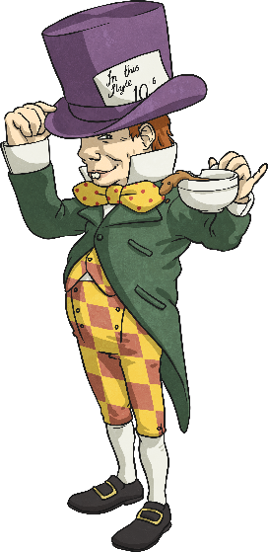
Features of a Play Script: Scene Number, Title and Setting Description
A bit like chapters in a book, the sections of a script are broken down into ‘scenes’. A new scene usually means a new setting.
Scene 7 – A Mad Tea Party
The Mad Hatter, Dormouse and Hare are sitting at a table having afternoon tea.
Just after the scene number and title is a short description of the setting. This tells you what the stage looks like.

Slide 4
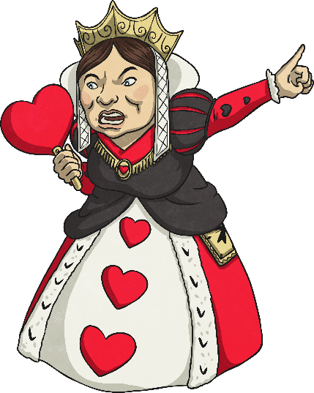
Features of a Play Script: Speaker Name, Colon and Dialogue
A colon always comes after the name.
Queen of Hearts:
Guards! Get her! Off with her head! Off with her head!
In a script, the name of the character who is speaking goes on the left.
After the colon is the dialogue (the words the character says).
How is this different to writing speech in a story?
No inverted commas!

Slide 5
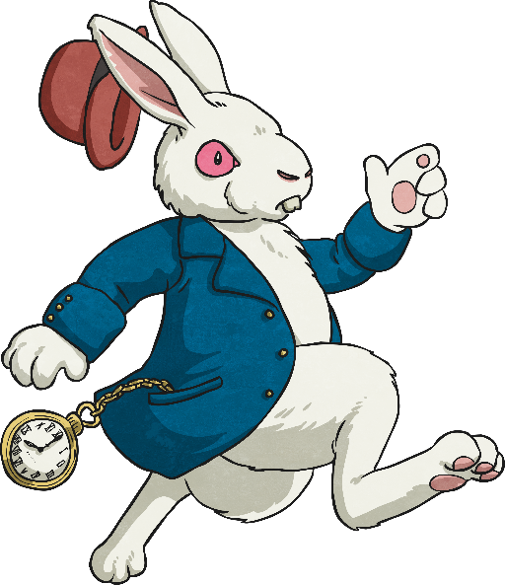
Features of a Play Script: Stage Directions
Words in brackets are stage directions. These are instructions to the actors so they know what their character should be doing.
White Rabbit:
Alice:
(anxiously, whilst rushing across the stage) I’m late! I’m late!
(confused) A talking rabbit? It can’t be…
Sometimes they tell the actor how to say their words.
The actors don’t say the stage directions.

Slide 6
Features of a Play Script: Stage Directions and Narrators
Some plays have a narrator to help set the scene for the audience, but lots of plays don’t.
Narrator:
Alice found herself in a strange room, inside was a small table. On top of it, sat a small, peculiar-looking bottle with a label on.
(Alice looks around, confused, then goes over to the table and studies the bottle.)
Stage directions can be given to any character, not just the ones speaking. They are always written in present tense.

Slide 7
Can you find the play script features in the text here?
Scene number and title
Scene 7 – A Mad Tea Party
The Mad Hatter, Dormouse and Hare are sitting at a table having afternoon tea.
Lost and lonely, Alice continued towards the sound. She didn’t know what to expect when she reached a clearing…
(Alice enters the scene, stage left)
(starts for a moment, pauses and a broad grin appears across his face. He gets up out of his chair and walks across the table towards Alice)
(exasperated)
(gasps and throws his hands against his head)
You’re absolutely Alice, I’d know you anywhere.
(to the rest of the characters at the table)
I’d know him anywhere!
(Dormouse and Hare laugh manically)
Well, as you can see we’re still having tea.
You’re terribly late you know… naughty.
I’m incredibly intrigued.
Narrator:
Mad Hatter:
Dormouse:
Hare:
Mad hatter:
Alice:
Setting description
Speaker’s name, followed by a colon (:)
It’s you.
No it’s not! Hare brought us the wrong Alice!
It’s the wrong Alice!
Stage directions in brackets
Speech – without inverted commas!
click the different features to show the answers
Present tense

