Slide 1



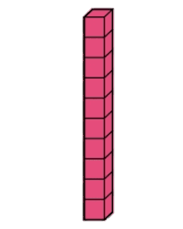


Slide 5

13 11 12

Slide 6

12 11 10

Slide 7

10 12 13

Slide 8


13 11 12

Slide 9

13 11 10

Slide 10

13 11 12

Slide 11


10 12 13

Slide 12


11 12 13

Slide 13
10 __ 12 __

Slide 14
__ 11__ 13

Slide 15
__ 11 12 __

