Slide 5
13 11 12

Slide 6
12 11 10

Slide 7
10 12 13

Slide 8
13 11 12

Slide 9
13 11 10

Slide 10
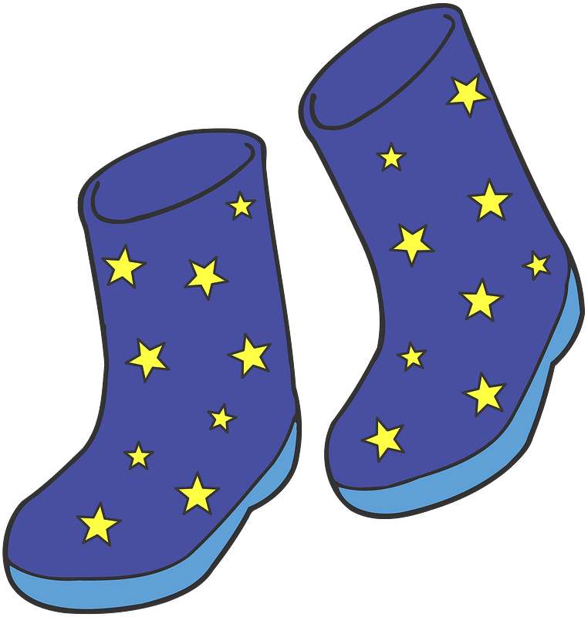
13 11 12

Slide 11
10 12 13

Slide 12
11 12 13

Slide 13
13 11 12

Slide 14
10 11 12

Slide 15
10 __ 12 __

Slide 16
12 __ 14

Slide 17
__ 11__ 13

Slide 18
__ 11 12 __

Slide 19
__ 10 __12

Slide 20
__ 12 __14

