Slide 1
Nouns Grade 2

Slide 2
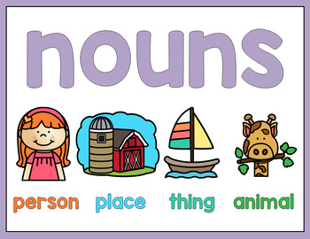

Slide 3
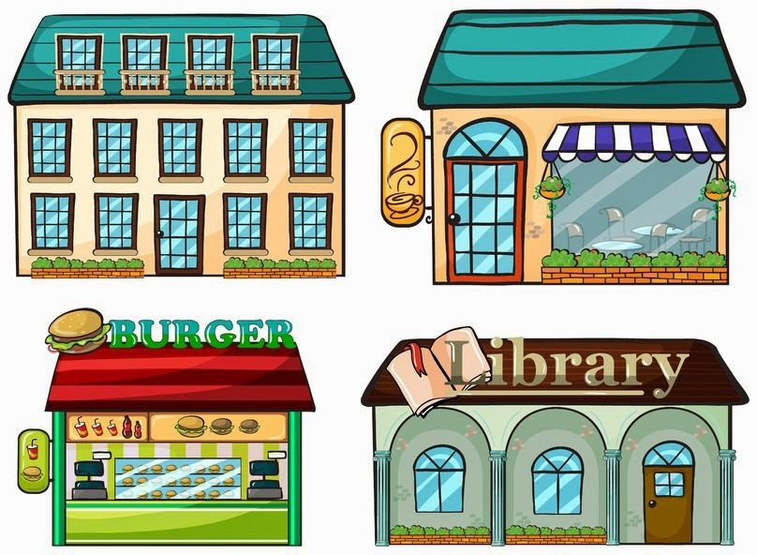
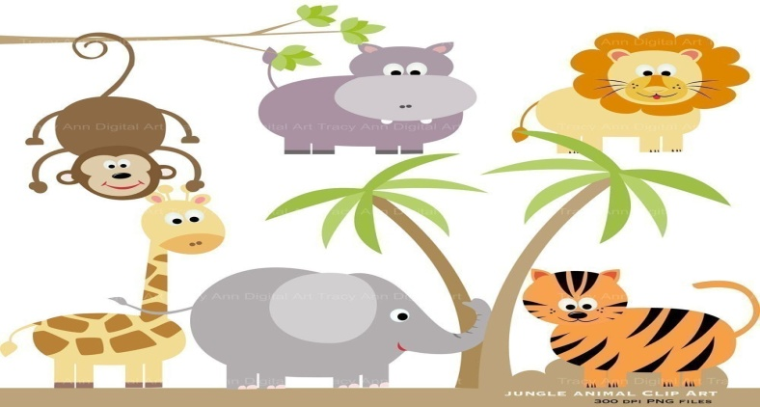
Nouns are
Names of people Names of places
Names of things Names of animals

Slide 4
Nouns that names people
sister
mom
doctor
Ramez
teacher

Slide 5
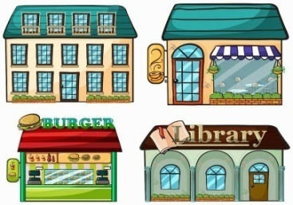
Nouns that names places
school
house
zoo
garden

Slide 6
Nouns that names things
pen
ball
tables
book
chair

Slide 7
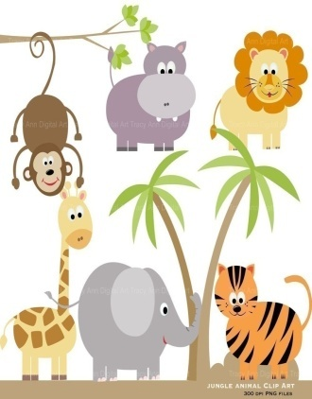
Nouns that names animals
cat
frog
horse
dog

Slide 8
House is a name of
Place?
People?

Slide 9
Which noun is a name of an animal?
mat
hat
cat

