Slide 1
https://wordwall.net/ar/resource/14060205

Slide 7
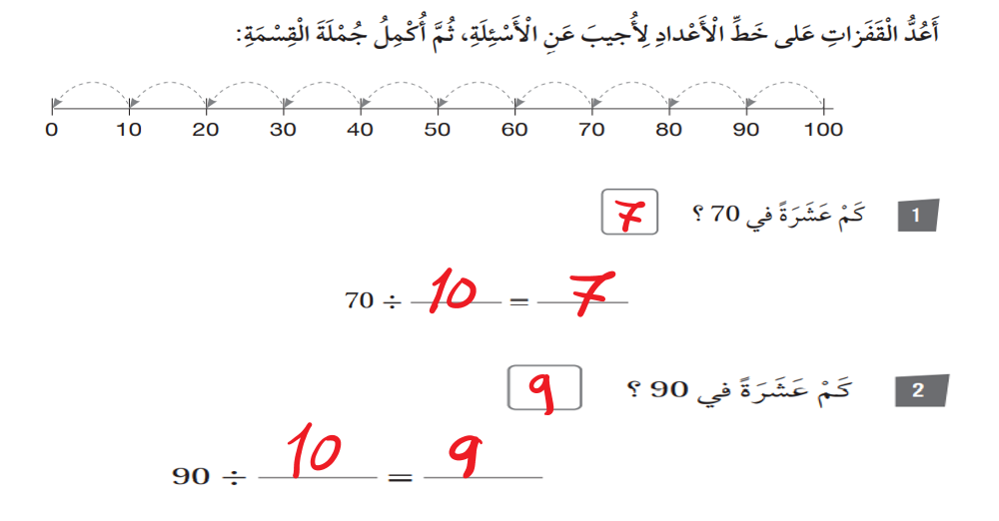

Slide 8
