Slide 1
Disclaimer
We hope you find the information on our website and resources useful.
Animations
This resource has been designed with animations to make it as fun and engaging as possible. To view the content in the correct formatting, please view the PowerPoint in ‘slide show mode’. This takes you from desktop to presentation mode. If you view the slides out of ‘slide show mode’, you may find that some of the text and images overlap each other and/or are difficult to read.
To enter slide show mode, go to the slide show menu tab and select either from beginning or from current slide.
You may wish to delete this slide before beginning the presentation.

Slide 3
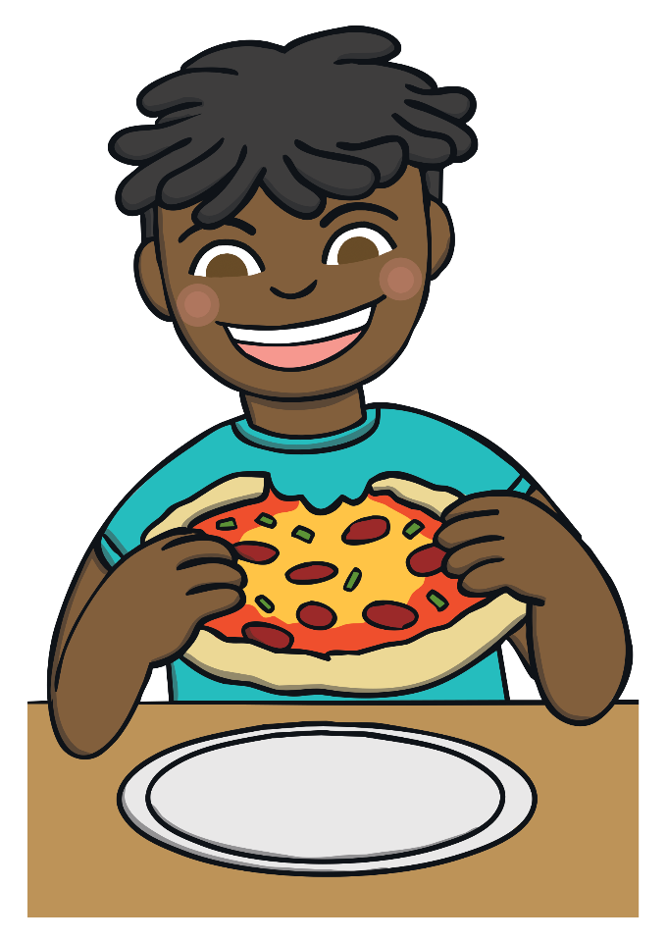
I have one son. likes pizza.
He
She
He
They

Slide 4
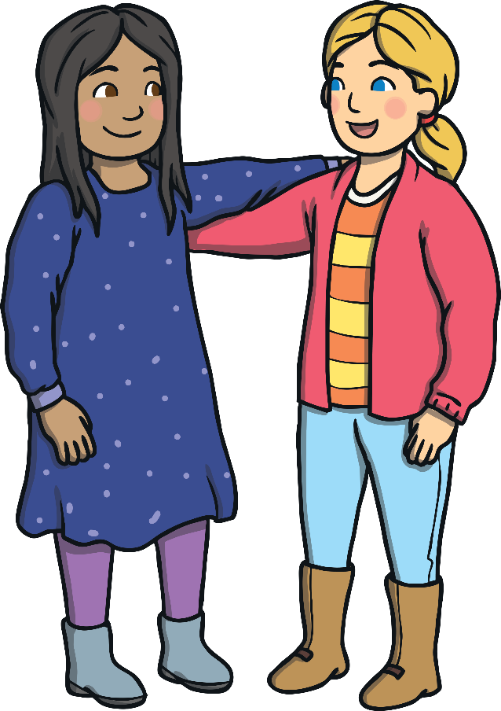
My friend and I are so happy because are going on holiday!
we
they
you
we

Slide 5
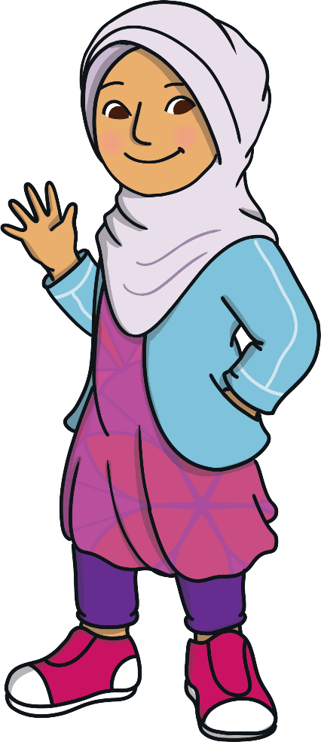
Hi Lucy! How are ?
you
I
you
they

Slide 6
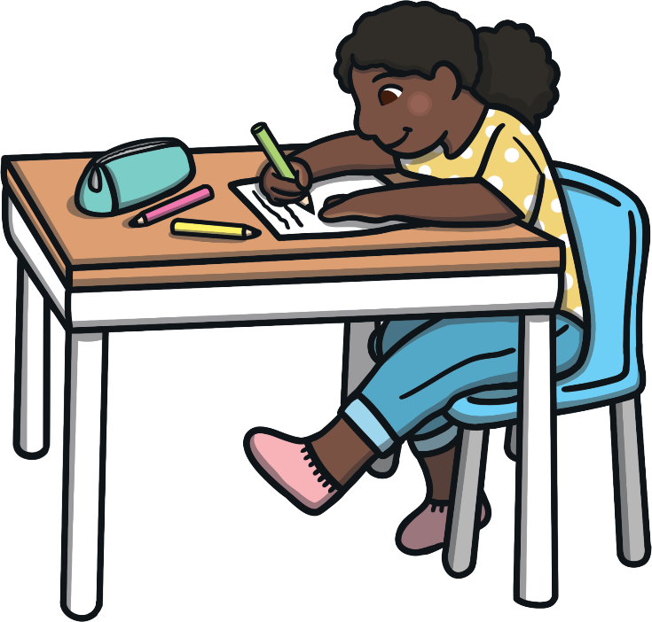
My sister is studying all day because has an exam tomorrow.
she
she
we
they

Slide 7
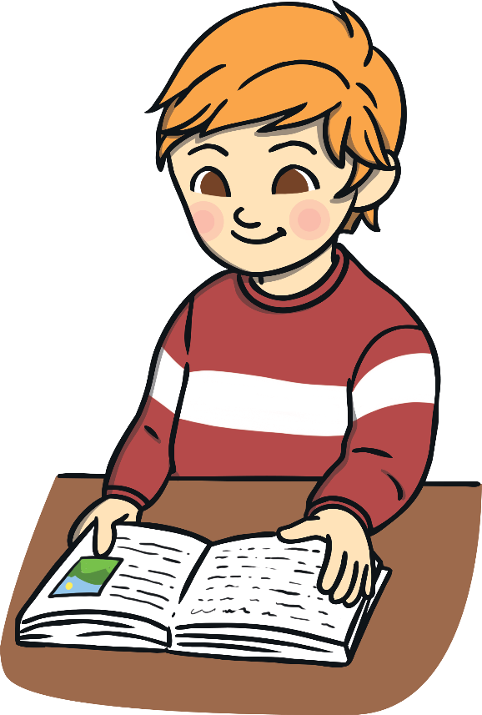
is the best book I’ve ever read!
It
He
It
They

Slide 8
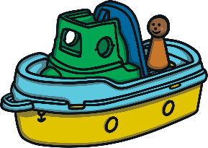
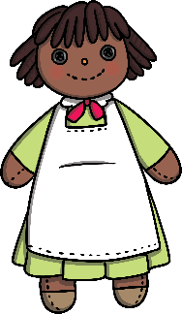
Where are my toys? are in the garden.
They
We
It
They

Slide 9
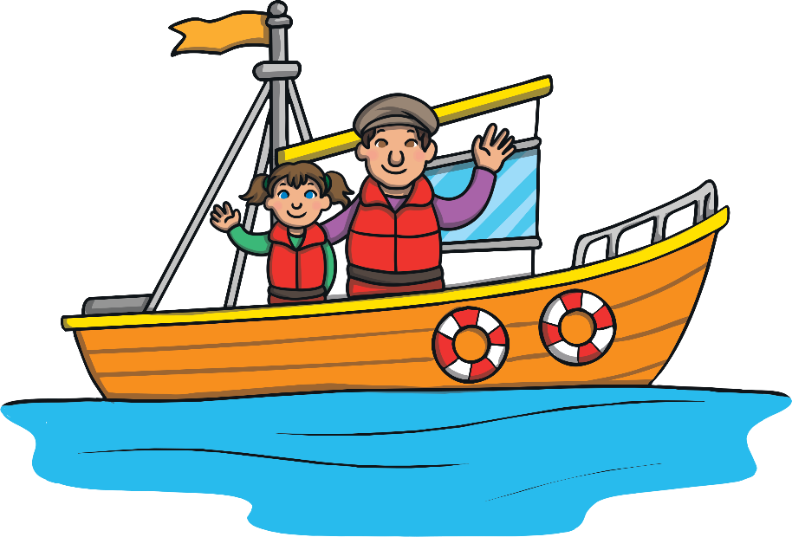
My grandfather loves sailing. lives on a boat.
He
She
We
He

Slide 10
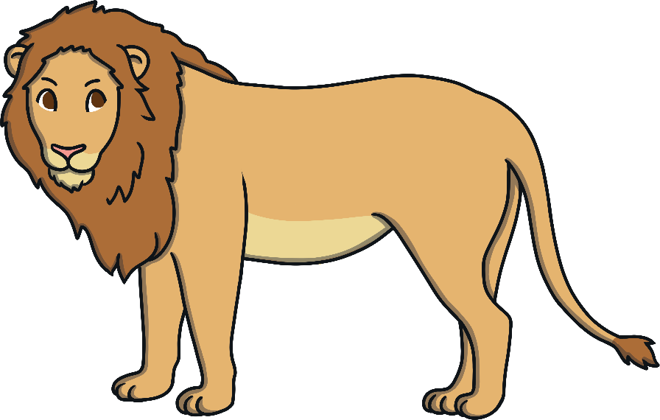
The lion roared loudly. scared me.
It
They
It
You

Slide 11
Mum and I are really cold. are going to drink some hot chocolate.
We
We
They
She

Slide 12
Did you speak to the manager? What did say?
they
you
we
they

Slide 13
Would like some ice cream?
you
it
you
we

Slide 14
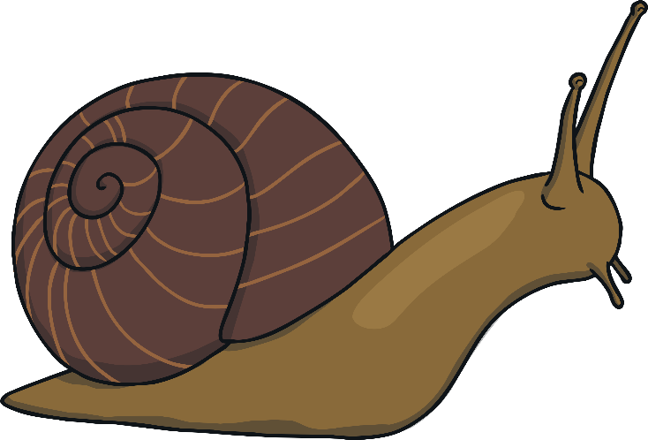
looks like a snail!
It
They
You
It

Slide 15
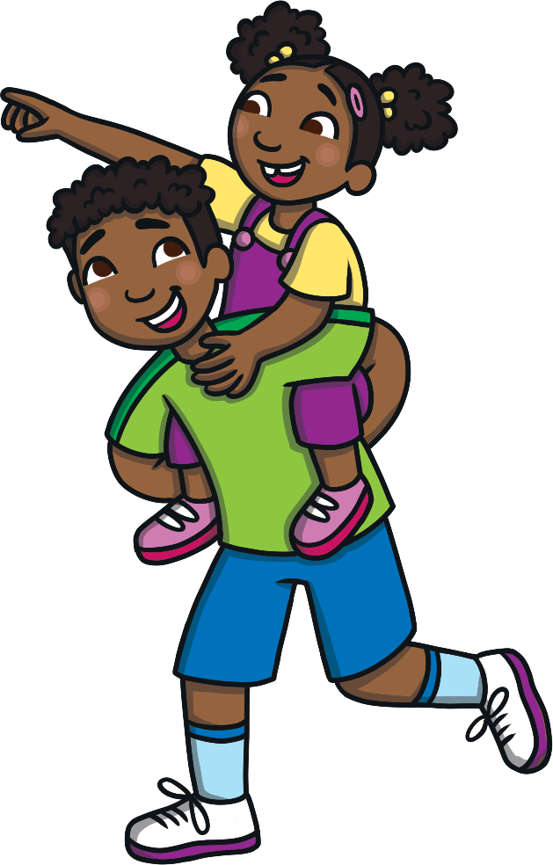
Have you met my brother? is very funny.
He
He
They
She

Slide 16
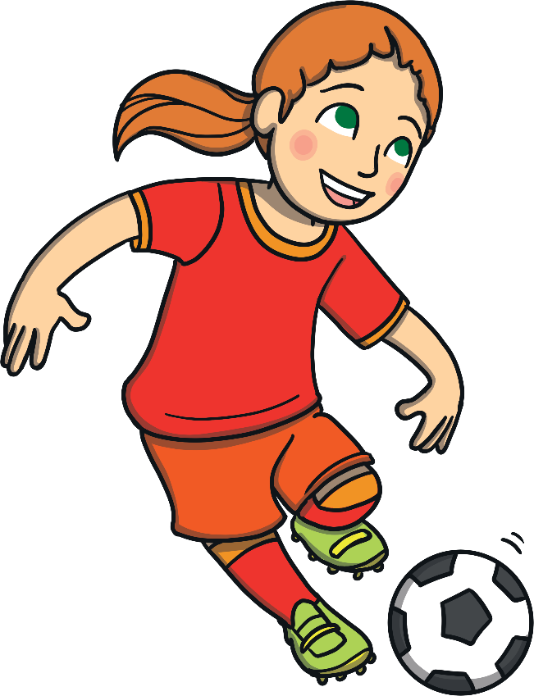
Becky is amazing! is the best girl on our football team.
She
We
He
She

Slide 17
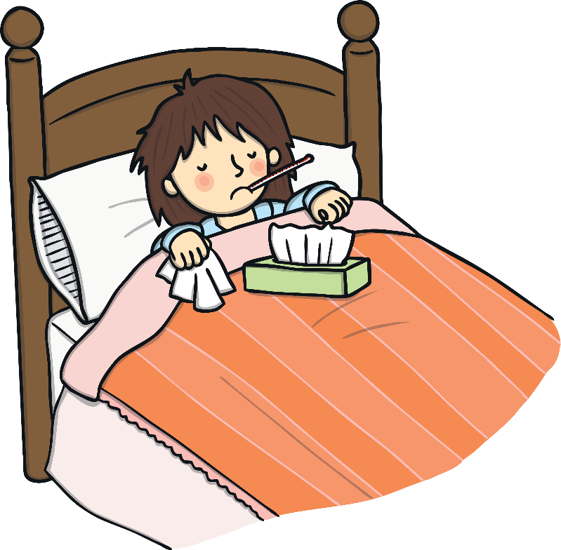
Are you okay? look really sick.
You
You
We
They

