Slide 2
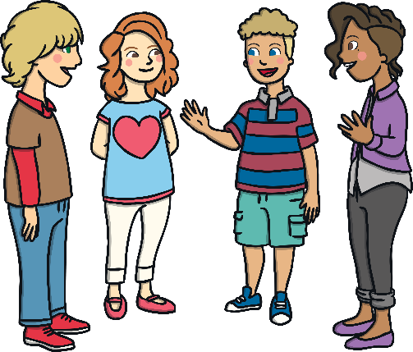
Warm Up Questions
Do you have any hobbies?
What do you like to do on the weekend?
What do you like to during school holidays?
What do you not like doing on the weekend?
What did you do last weekend?

Slide 3
Going to
We use ‘going to’ to make sentences about our future plans or intentions.
(subject + to be + going to + verb)
I | am | going to | visit | the zoo tomorrow.
Tomorrow | I | am | going to | visit | the zoo.
They | are | going to | play | chess on the weekend
On the weekend | they | are | going to | play | chess.

Slide 4
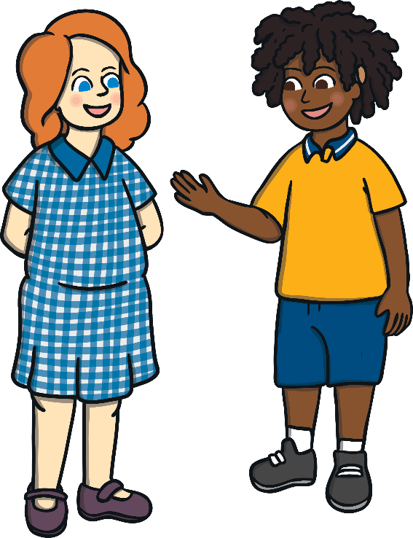
Example Conversation
Practise reading the conversation.
What are you going to do tomorrow?
I’m going to play basketball with my cousin.
What are you doing tomorrow?
I’m going to buy a new bicycle with my mum.
Have fun!
You too!

Slide 5
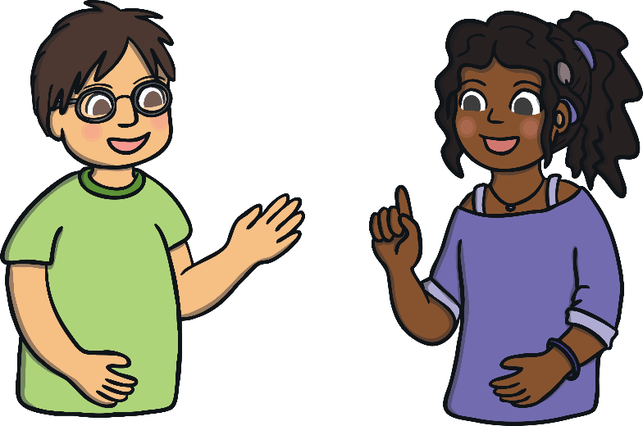
Example Conversation
Practise reading the conversation.
What are you going to do during the summer holiday?
I’m going to stay with my Grandma.
What about you?
I'm going to go camping with my family in France.
That sounds fun, have a good time!
You too!

Slide 6
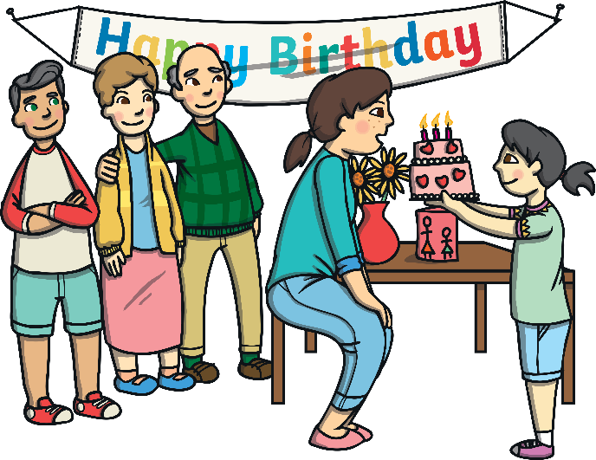
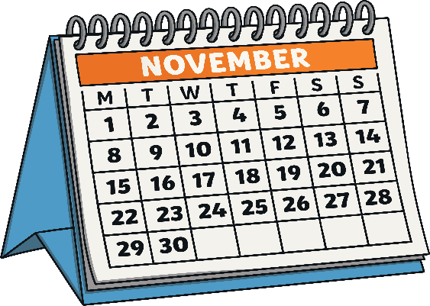
What are they going to do?
Can you make a ‘going to’ sentence with these images?
Amy
go to a birthday party
next week.
Amy is going to go to a birthday party next week.
Next week, amy is going to a birthday party.

Slide 7
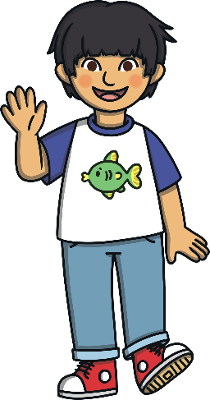
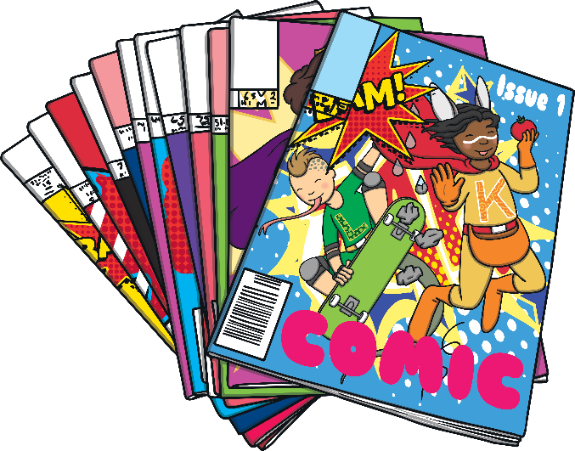
What are they going to do?
Can you make a ‘going to’ sentence with these images?
Amy
read comic books
tomorrow.
Amy is going to a read comic books tomorrow.
Tomorrow, Amy is going to read comic books.

Slide 8
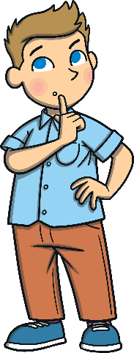
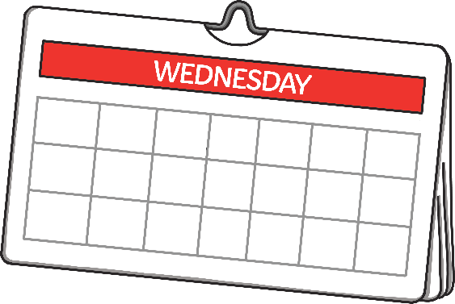
What are they going to do?
Can you make a ‘going to’ sentence with these images?
Stevie
go hiking
on Wednesday.
Stevie is going hiking on Wednesday.
On Wednesday, Stevie is going hiking.

