Slide 1
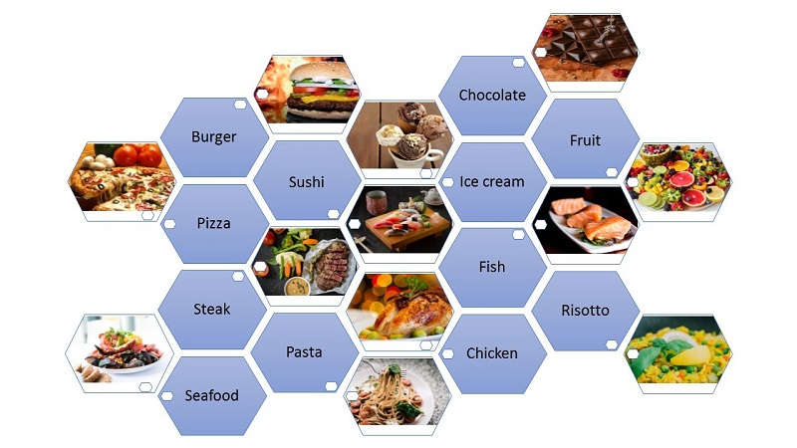
Day: Thursday Date: 10/3/2022
A Delicious Meal I Had

Slide 2
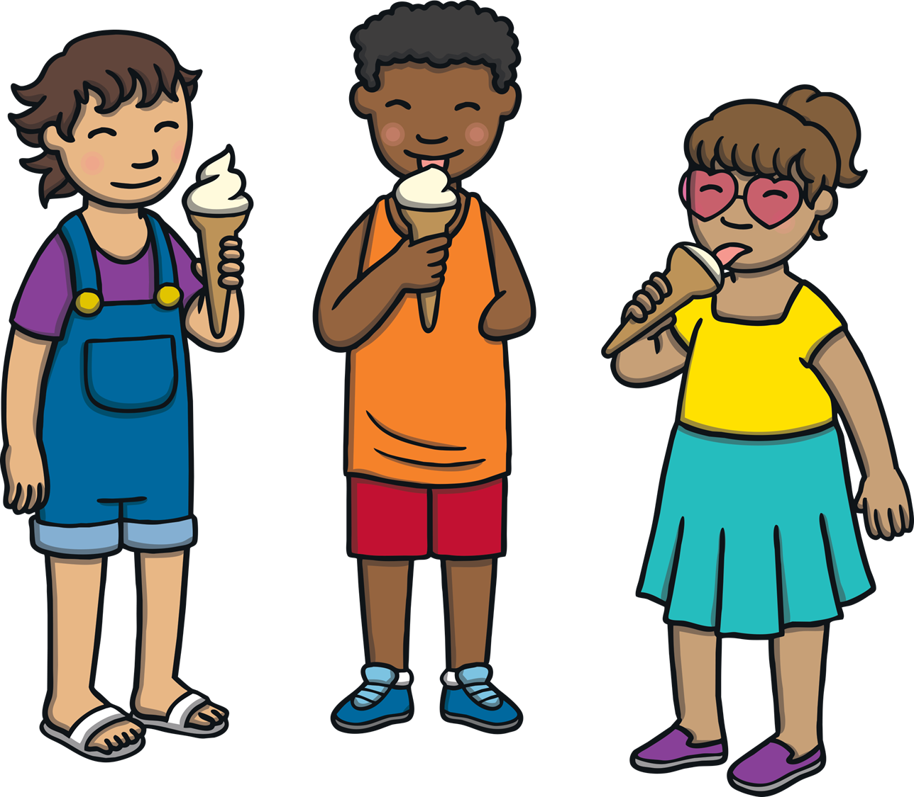
Think!
What is your favourite meal?
Where did you have it?
When did you have it?
Who made it for you?
Carefully choose descriptive words that bring out a vivid picture of the delicious meal you had.
Describe what emotions and feelings you have while eating this food.
Organize your writing correctly.

Slide 3
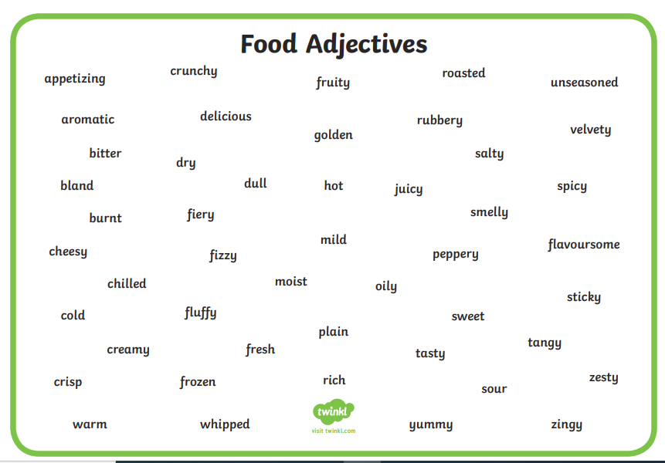



Slide 4
How to write a short paragraph about
a delicious meal you had:

Slide 5
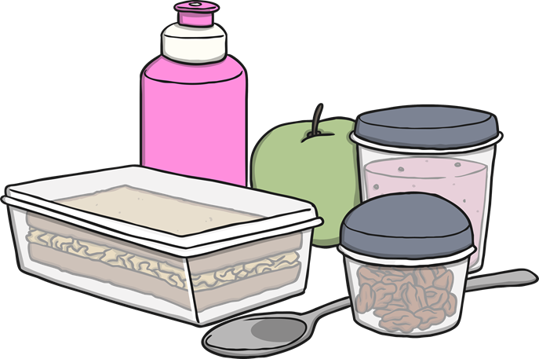
Step 1:
What was the occasion you had this meal on? Where did you have this meal?
Your birthday
Your friend’s birthday
A wedding party
A family lunch/dinner
A gathering at your aunt’s/uncle’s house………
A Lunch at a famous restaurant
A Christmas dinner

Slide 6
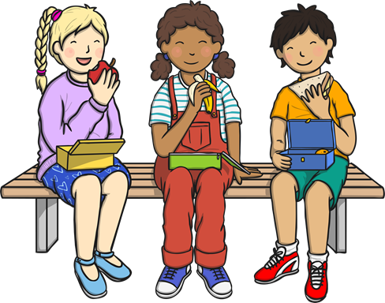
Step 2:
Who made this meal?
Your mum
Your friend’s mum
Your grandmother/ aunt
A famous chef

Slide 7

Step 3:
What was served?
Vegetables
Salad
Sandwiches
Mansaf
Use interesting adjectives :
elegant, breakfast /lunch/dinner
delicious, mouth watering, yummy,
flavoursome, appetizing, wonderful, Creamy,
crispy, crunchy, juicy, enjoyable, savoury, tasty…

Slide 8

Step 4:
What did you have for dessert?
  Ice cream
  A Cake: Apple cake, cheese cake, chocolate cake/
  Cupcakes
  Cookies
  A Pie
  Fruit salad
  Jello
Use interesting adjectives :
delicious, mouth watering, yummy, appetizing, flavoursome,wonderful, creamy, crispy, crunchy, juicy, enjoyable, savoury, tasty…..

Slide 9
Step 5:
When are you having the same meal again?
Next month,
Next week,
At the weekend,
For my mum’s birthday,

Slide 10
A Delicious Meal I had
For my friend’s birthday, his mom made us a yummy lunch. She served enjoyable and yummy hotdog sandwiches, a tasty salad, and crunchy fried potatoes. For dessert, we had a tasty cheesecake, creamy strawberry ice cream with chocolate syrup on top.
I am making the same meal for my brother on his birthday next week.

