Slide 1
Unit 11: Ratio and proportion
Proportion

Slide 2
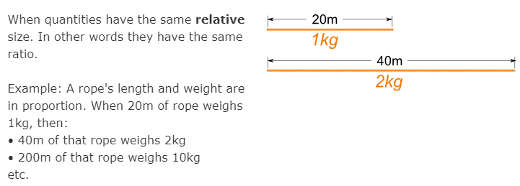
What is proportion?
Proportion says that two ratios (or fractions) are equal.

Slide 3
Sharing in a given ratio
Ratios show the relationship between two values.
They may be in direct proportion and increase as the other increases, or they can be in inverse proportion; as one increases the other decreases.
A ratio can also be used to share a quantity into parts.

Slide 4
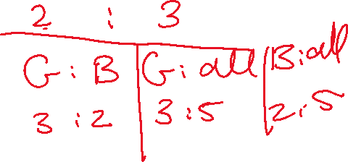
Example
Rebecca and Amy share £280 in the ratio 5:2.
How much money will they each receive?
The answer:
1. Add up the ratio to find the total number of parts:
5 + 2 = 7 parts
2. Divide the total amount by the number of parts:
£280 ÷ 7 = £40
Each part is worth £40
3. Multiply by the ratio to find each person’s share:
5 × £40 = £200 (Rebecca's share)
2 × £40 = £80 (Amy’s share)
4. Check these add up to the original amount:
£200 + £80 = £280

Slide 5
So, to share in a given ratio you have to follow these steps:
Add up the ratio to find the total number of parts
Divide the total amount by the number of parts
Multiply by the ratio to find each person's share
Check these add up to the original amount.

Slide 6
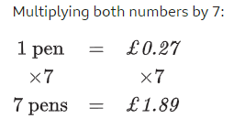
Unitary method
Proportion calculations can be used to calculate values when one relationship is known.
Example: 8 pens cost £2.16. Calculate how much 7 pens cost.
The answer:
To find out the cost of one item use the unitary method - divide the cost by how many items have been bought. Any amount can be calculated when the value of 1 is known.
8 pens cost £2.16.
Dividing both numbers by 8
Then:

Slide 7
Sometimes you will be given one of the proportions and you will have to work out the other proportion or the total amount.
Example:
The ratio of girls to boys in a class is 6:5
There are 18 girls.
How many boys are there?
The answer:
Girls : Boys
6 : 5
18 : ??
5 x 3 = 15
So, there are 15 boys in this class.
x3
x3

Slide 8
P.184, Ex 11C
Q1 to 11

