Slide 1
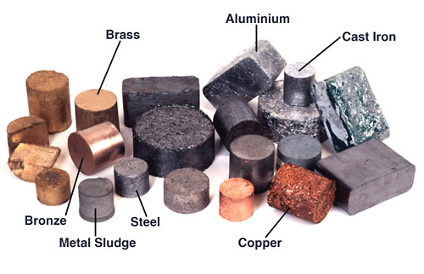
Properties of metals

Slide 2
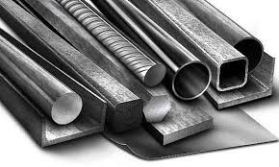
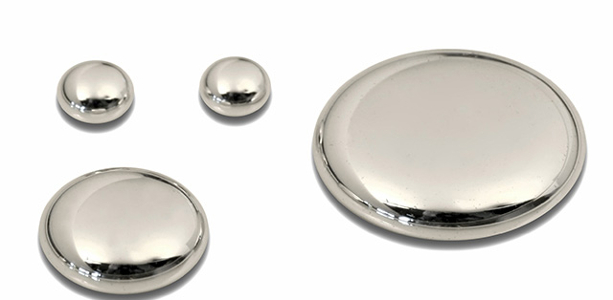
Properties of metals
Metals are solid at room temperature , except for mercury .
Mercury

Slide 3
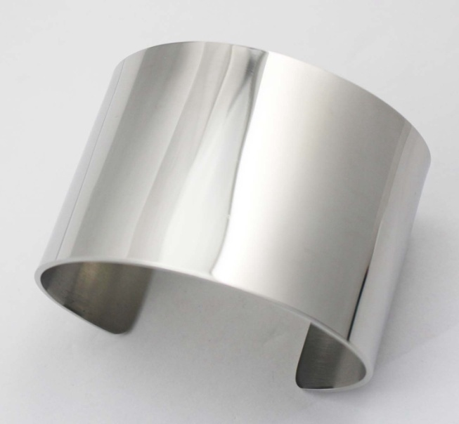
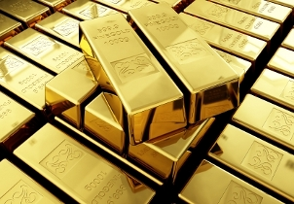
Properties of metals
Metals have luster , this means they are shiny .

Slide 4
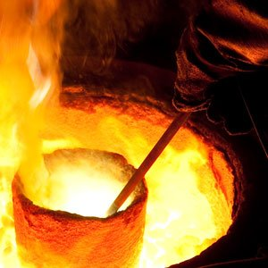
Properties of metals
Metals have a high melting and boiling point .

Slide 5
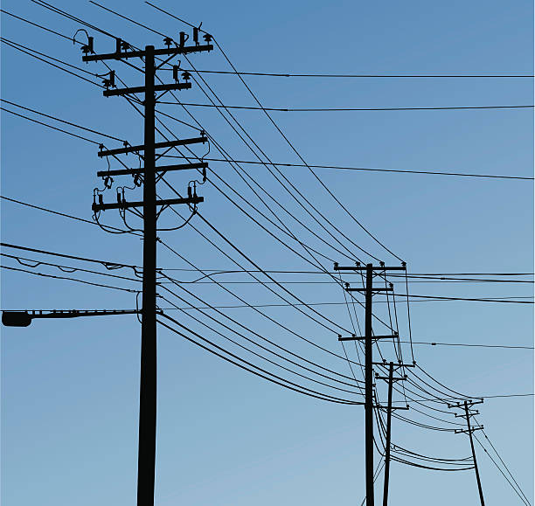
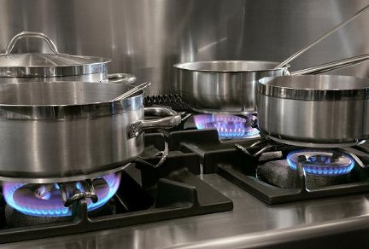
Properties of metals
Metals are good conductors of heat and electricity .

Slide 6
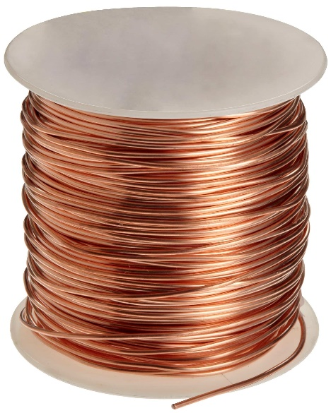
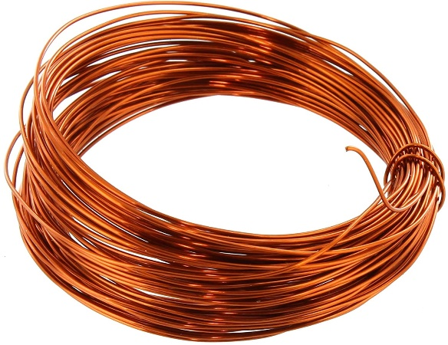
Properties of metals
Ductility ;
metals are ductile – they can be pulled out to make wires.

Slide 7
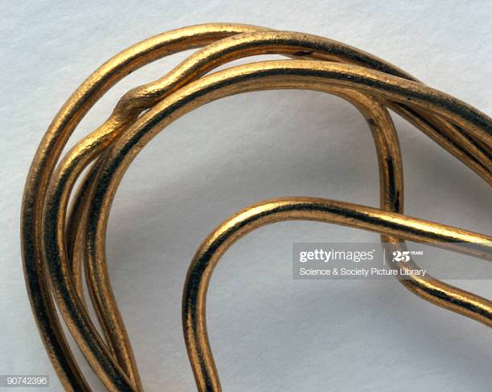
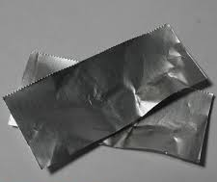
Properties of metals
Malleable ;
metals can be hammered into shape without breaking .

Slide 8
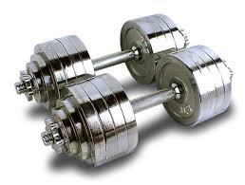
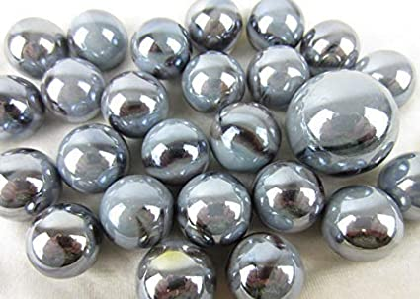
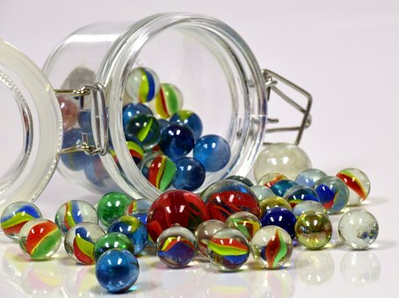
Properties of metals
Density ; how massive something is for its volume.
metals are very dense .

Slide 9

Properties of metals
Other properties ;
Metals are sonorous - metals make sound when they are hit.
Metals are strong – big forces are needed to break them.
metals are hard – it is not easy to scratch them.

Slide 10
Metals
- Physical properties of metals :
Have Luster – shiny .
Good conductors – ( heat and electricity move through them easily ) .
Malleable – Can be hammered into a different shape .
Ductile - can be pulled out to make wires.
High density – Heavy for their size .
Metals are solid , except for mercury .
Metals have a high melting and boiling point .

Slide 11
Properties of non-metals

Slide 12
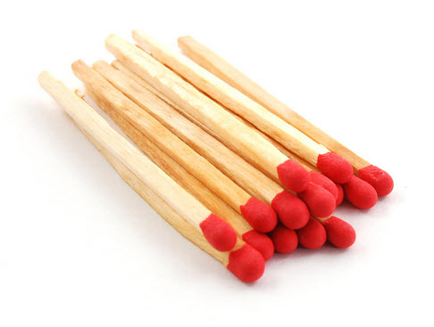
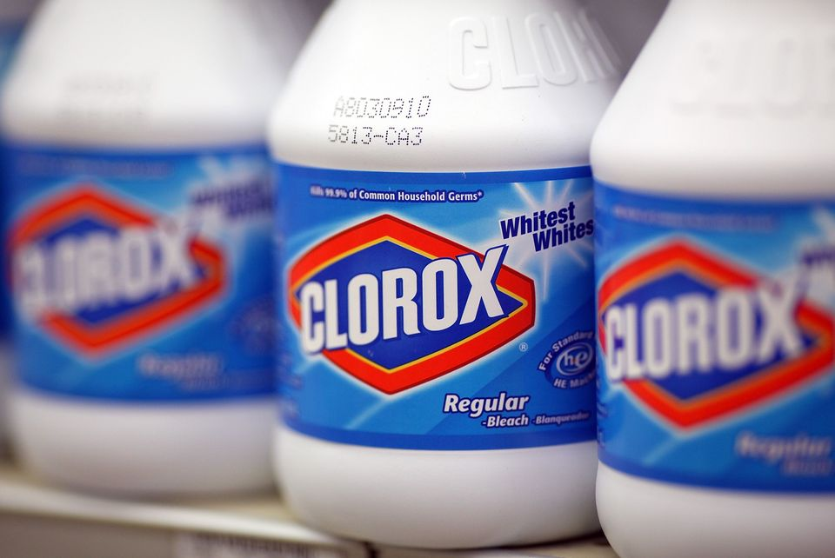
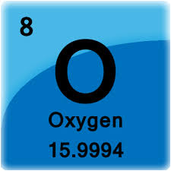
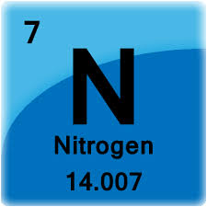
Examples of non-metal
Phosphorus
Chlorine

Slide 13
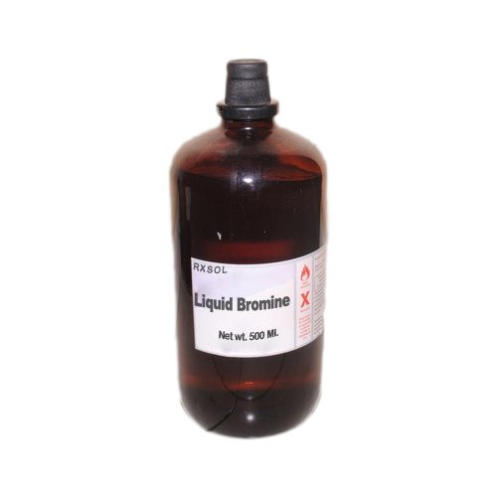
Properties of non-metals
Non-metals could be solid , liquid or gas . but most non-metals are gases, at room temperature.
Gases: N, H, O
Solids: C, S
Liquid: Br

Slide 14
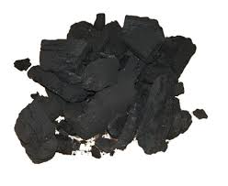
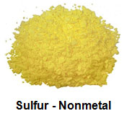
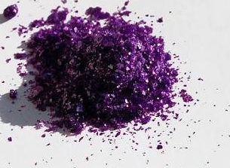
Properties of non-metals
Non-metals do not have luster ; they are Dull .
Exception: Iodine
Carbon
Sulfur
Iodine

Slide 15
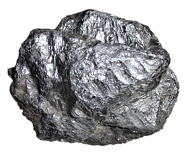
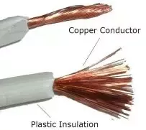

Properties of non-metals
They are poor conductors of heat and electricity .
Exception: Graphite conducts electricity

Slide 16
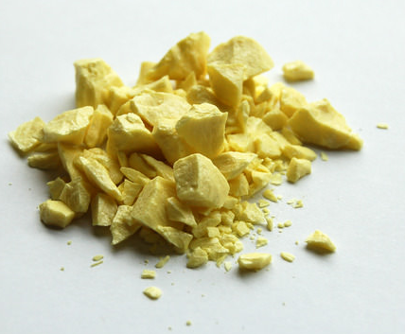
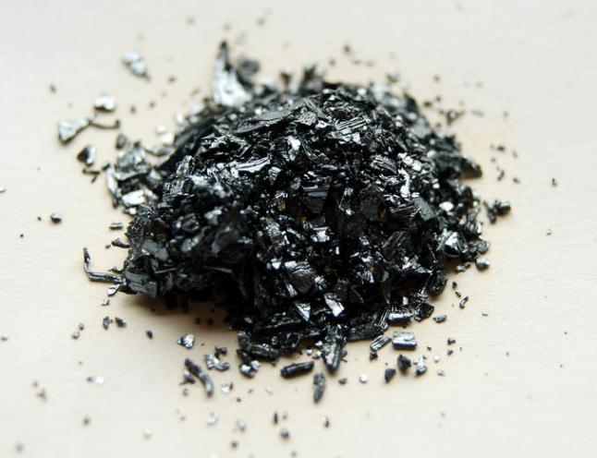
Properties of non-metals
Non-metals are brittle so they break easily .

Slide 17
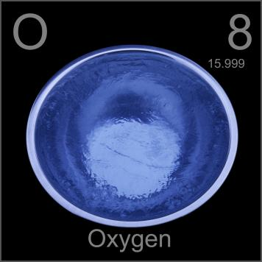
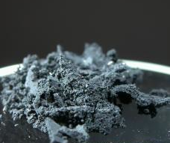
Properties of non-metals
Non-metals have:
Low melting and boiling point .
Low density.

Slide 18
Non-Metals
- Physical properties of non-metals :
Dull – not shiny .
Non-conductors – ( heat and electricity do not move through them easily ) .
Brittle – break easily .
Low density .
Low melting and boiling point .
Non-metals could be solid , liquid or gas . but most non-metals are gases, at room temperature .

Slide 19
Properties of Metalloids

Slide 20
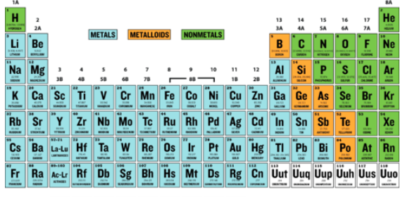
Properties of metalloids
A metalloid is an element that has properties that are intermediate between those of metals and nonmetals. Metalloids can also be called semi-metals.
On the periodic table, the elements colored orange, which generally border the stair-step line, are considered to be metalloids.

Slide 21
Properties of metalloids
Metalloids are solids that could be shiny or dull .
They conduct electricity and heat better than nonmetals but not as well as metals .

Slide 22
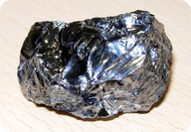
Examples of metalloids
Silicon is a typical metalloid.
It has luster like a metal, but is brittle like a nonmetal. Its electrical conductivity is in between that of a metal and a nonmetal.

Slide 23
Videos
https://www.youtube.com/watch?v=BowQcGw9IYk&t=8s
https://www.youtube.com/watch?v=dpyfCuXVSkg

