Slide 1
Daily message
Today, we are going to learn number words .

Slide 2
Numbers 11-15

Slide 3
Lets count from 0 to 50

Slide 4
Lets count backwards from 10 to 0 10-9-8-7-6-5-4-3-2-2-1-0

Slide 5
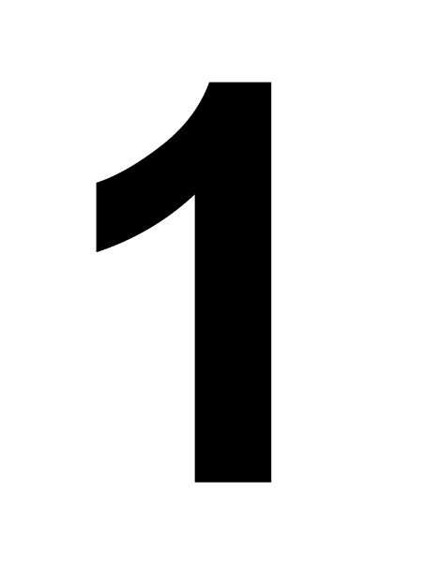
10

Slide 6
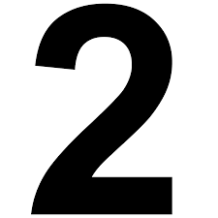
10

Slide 7
10

Slide 8
10

Slide 9
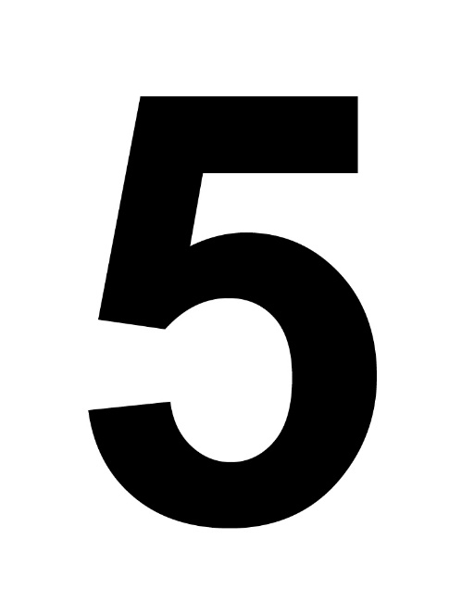
10

Slide 10
eleven
11

Slide 11
twelve
12

Slide 12
thirteen
13

Slide 13
fourteen
14

Slide 14
fifteen
15

Slide 15
twelve fifteen

Slide 16
thirteen twelve

Slide 17
fourteen fifteen

Slide 18
eleven fifteen

Slide 19
thirteen fourteen

Slide 20
eleven twelve

Slide 21
fifteen thirteen

Slide 22
fifteen fourteen

Slide 23
thirteen twelve

Slide 24
twelve fourteen

Slide 25
fifteen eleven

Slide 26
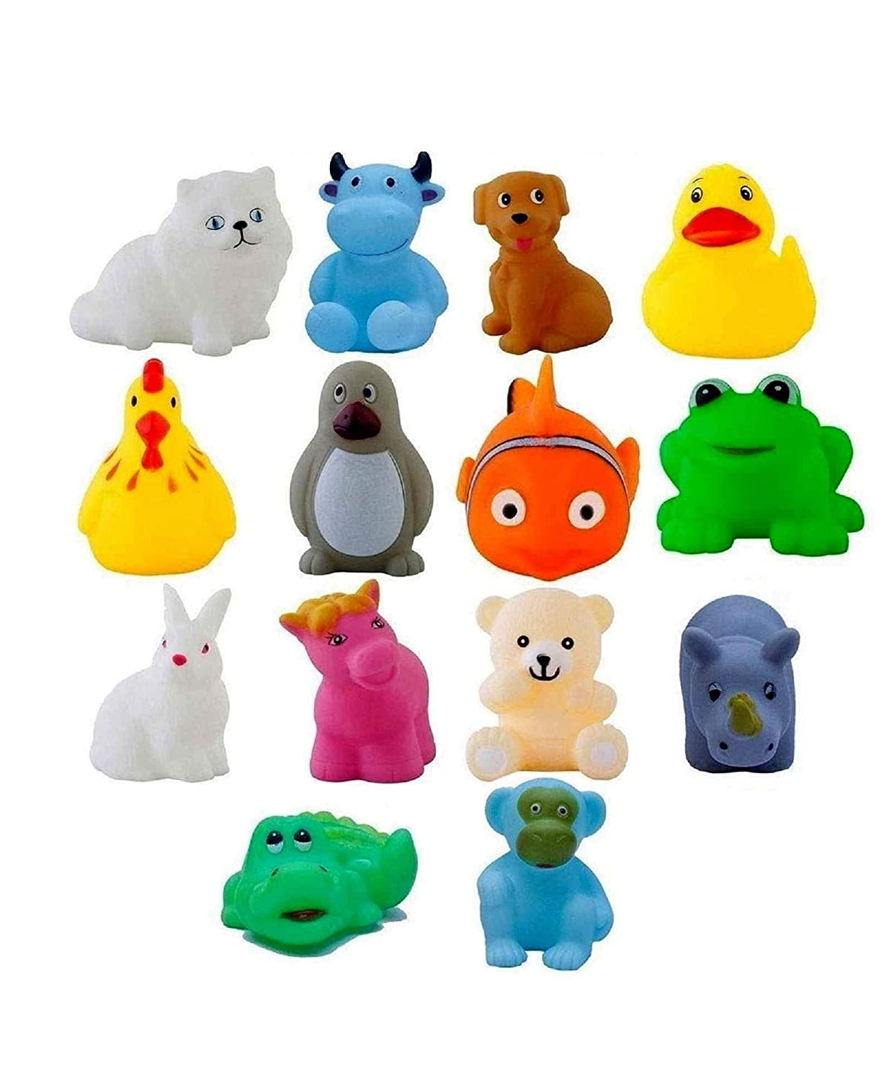
fourteen twelve

Slide 27
thirteen fifteen

Slide 28
fourteen twelve

