Slide 1
Daily message
Today, we are going to learn number words .

Slide 2
Numbers 11-15

Slide 3
Lets count from 0 to 50

Slide 4
Lets count backwards from 10 to 0
10-9-8-7-6-5-4-3-2-2-1-0

Slide 5
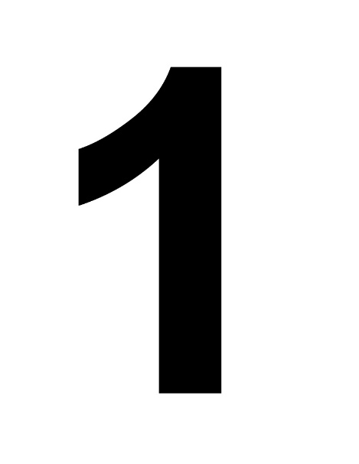

10

Slide 6

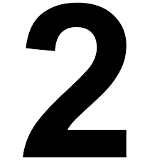
10

Slide 7


10

Slide 8


10

Slide 9

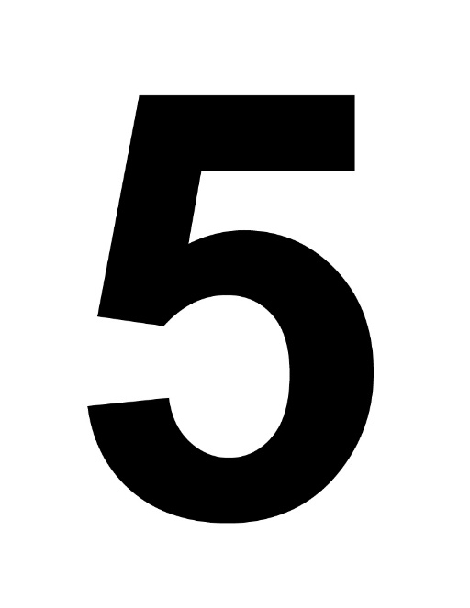
10

Slide 10
eleven
11

Slide 11
twelve
12

Slide 12
thirteen
13

Slide 13
fourteen
14

Slide 14
fifteen
15

Slide 15
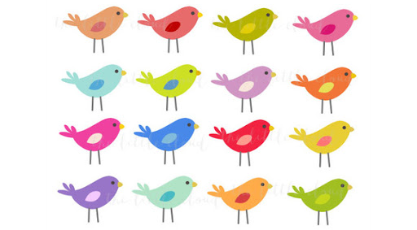
twelve fifteen

Slide 16
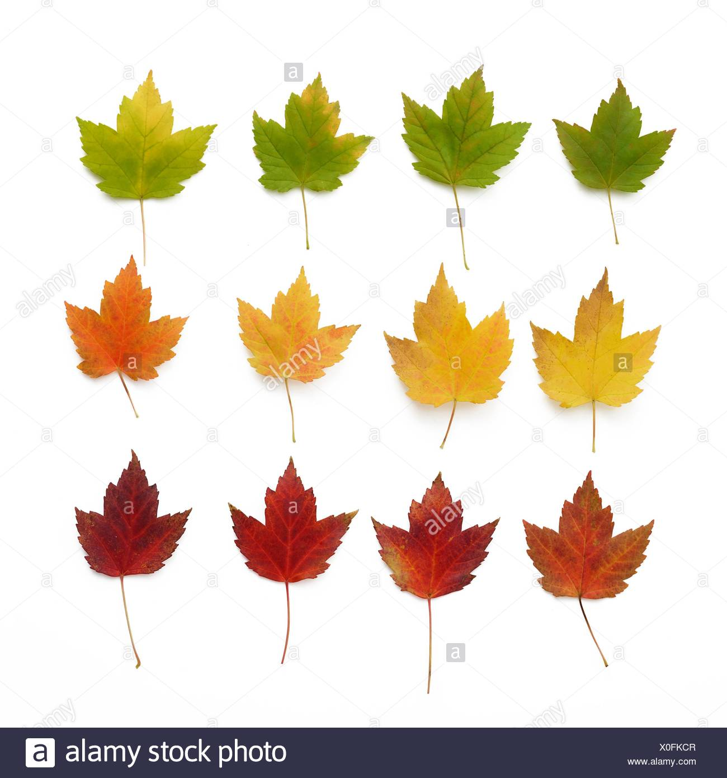
thirteen twelve

Slide 17

fourteen fifteen

Slide 18
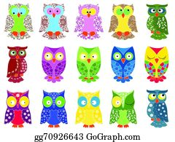
eleven fifteen

Slide 19

thirteen fourteen

Slide 20
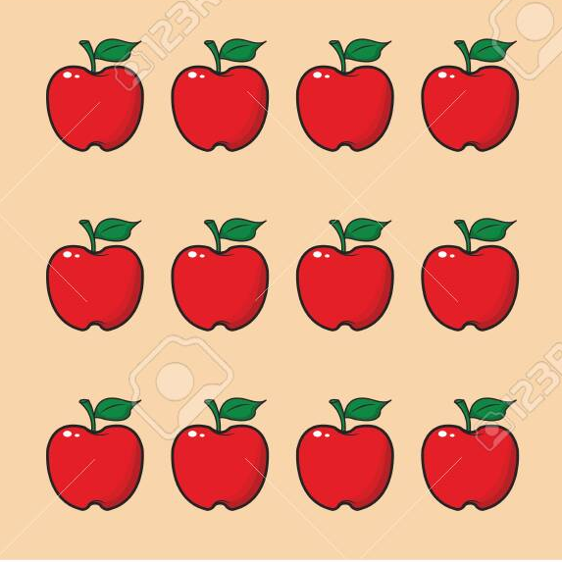
eleven twelve

Slide 21

fifteen thirteen

Slide 22
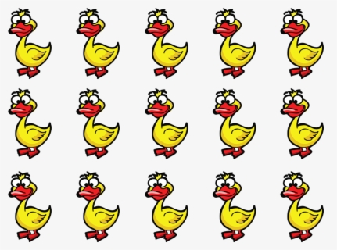
fifteen fourteen

Slide 23
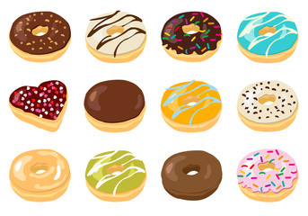
thirteen twelve

Slide 24
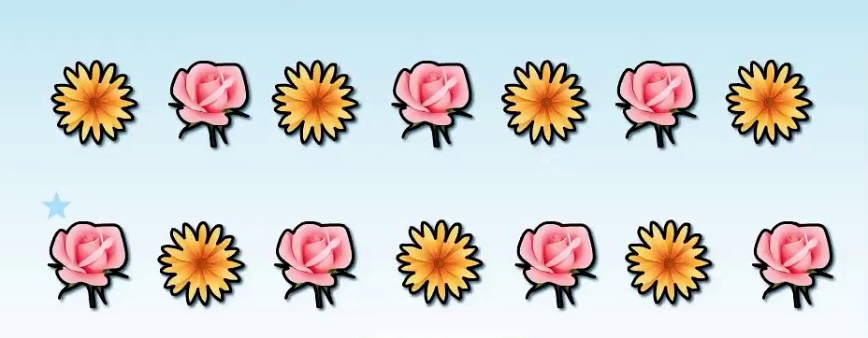
twelve fourteen

Slide 25
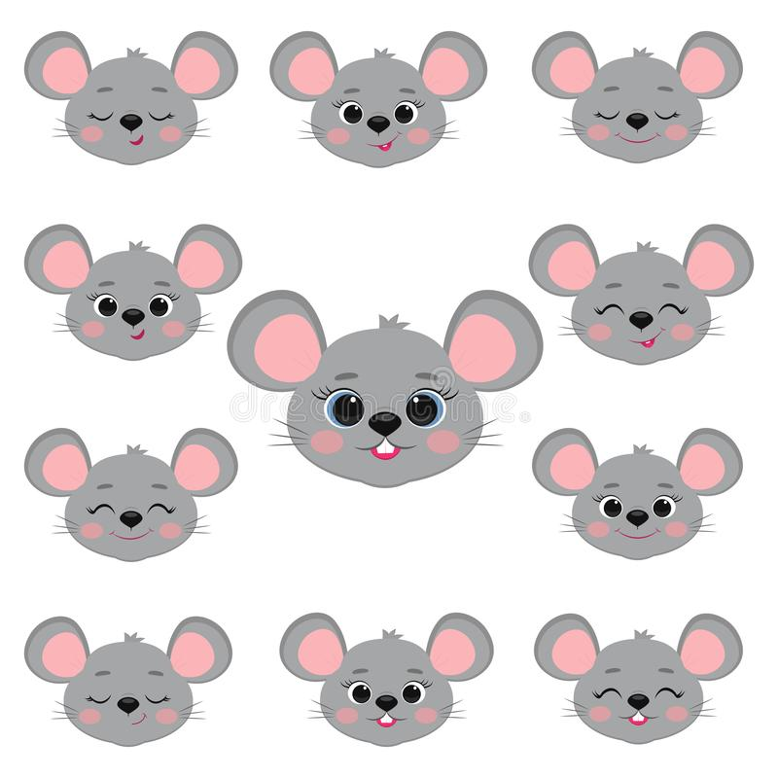
fifteen eleven

Slide 26
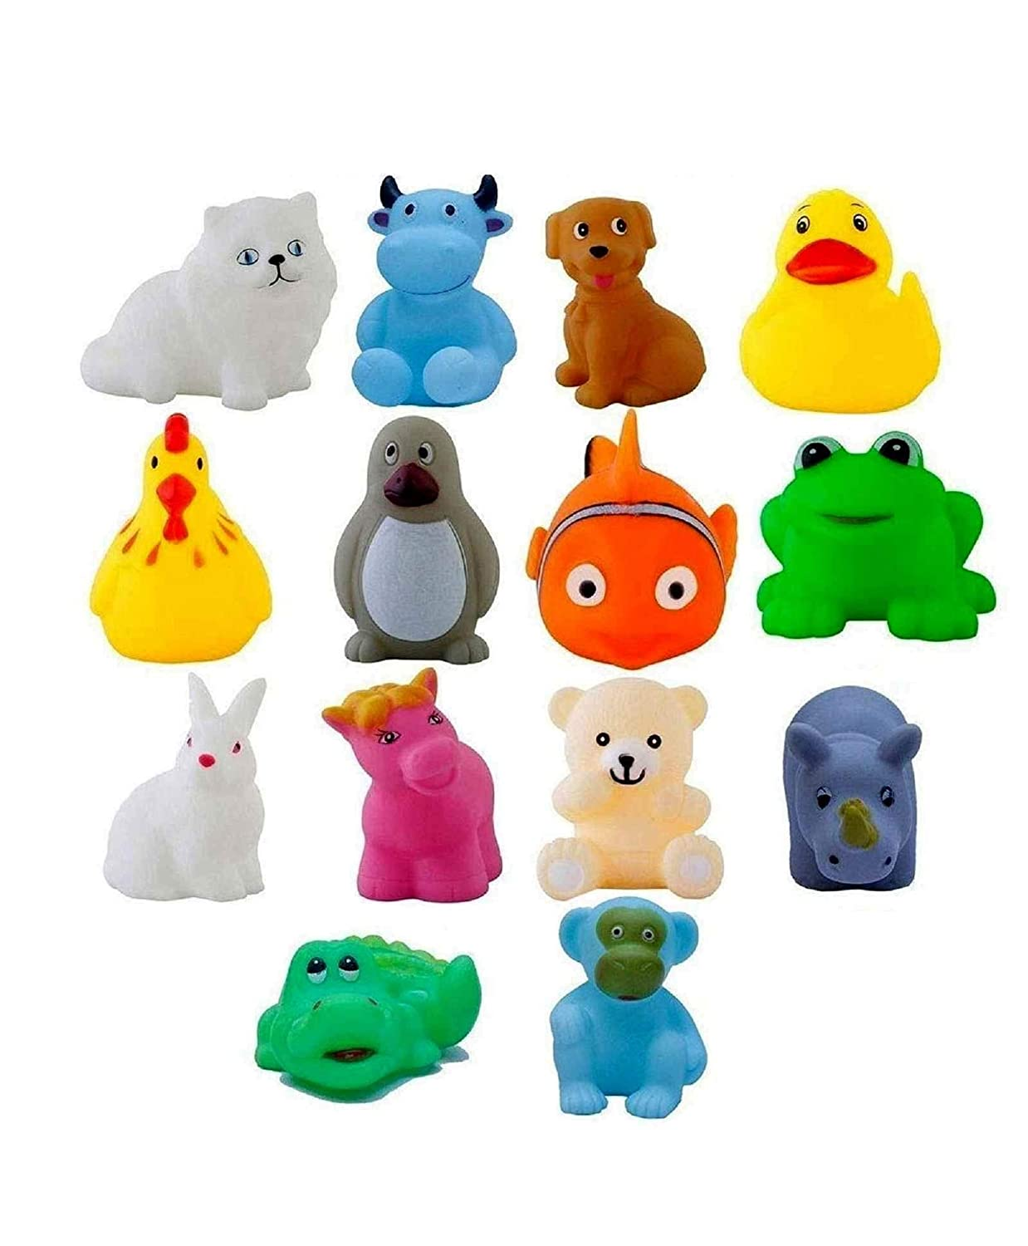
fourteen twelve

Slide 27
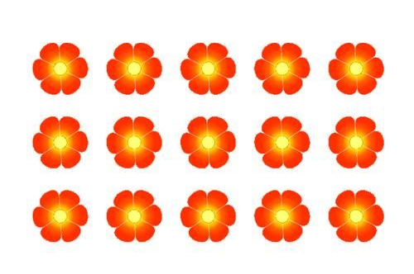
thirteen fifteen

Slide 28
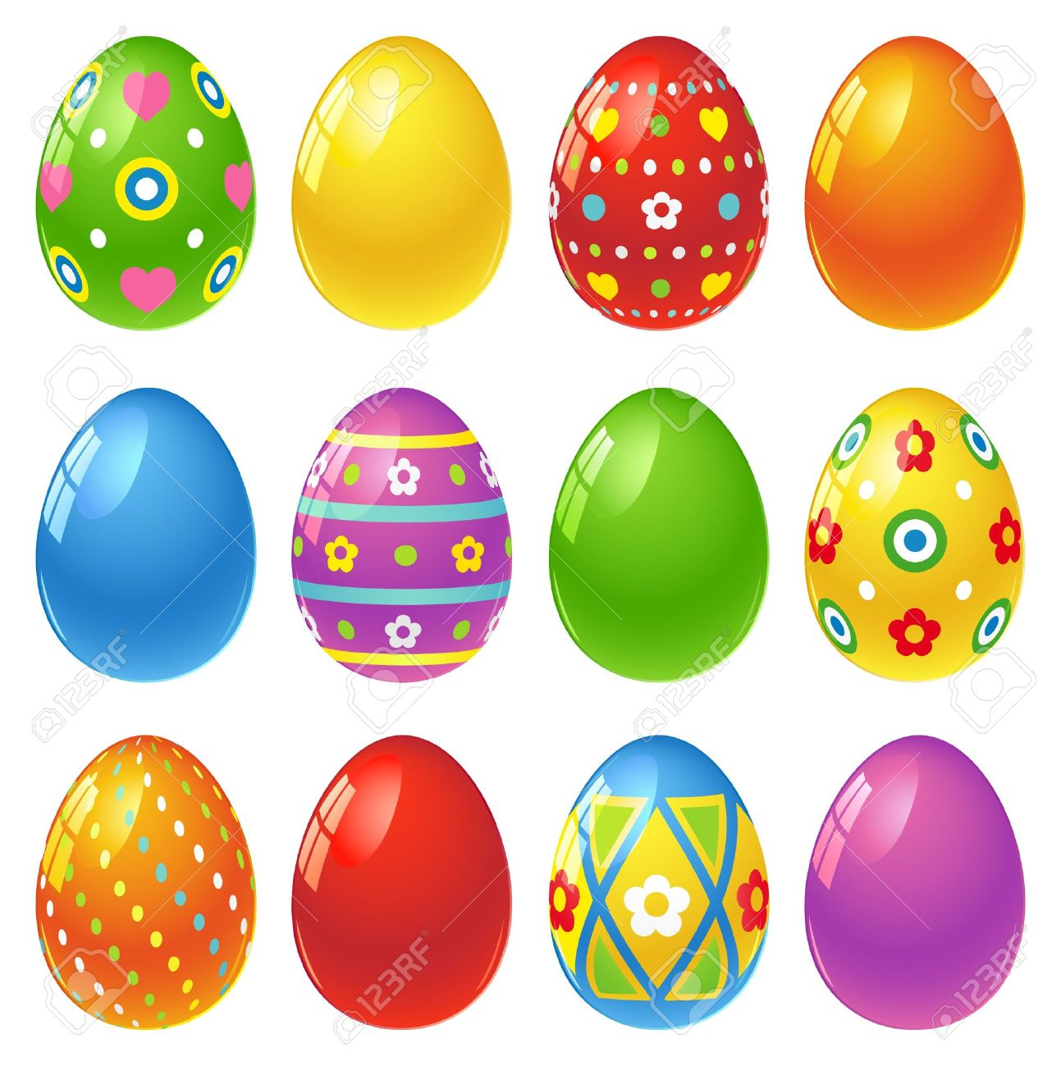
fourteen twelve

