Slide 1
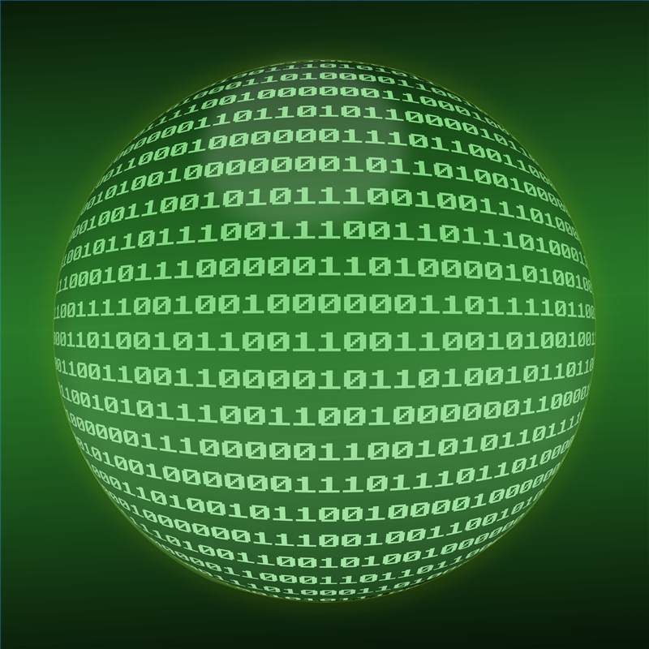
Digital Data

Slide 2
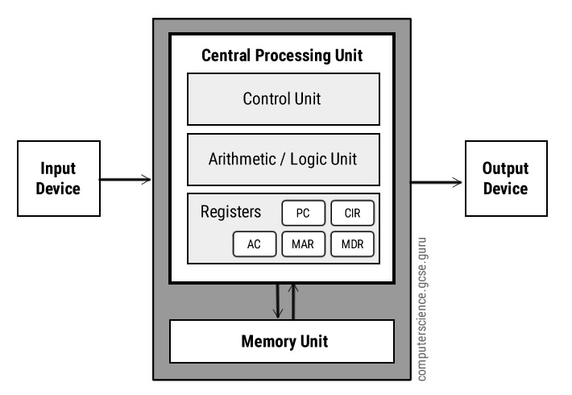

Slide 3
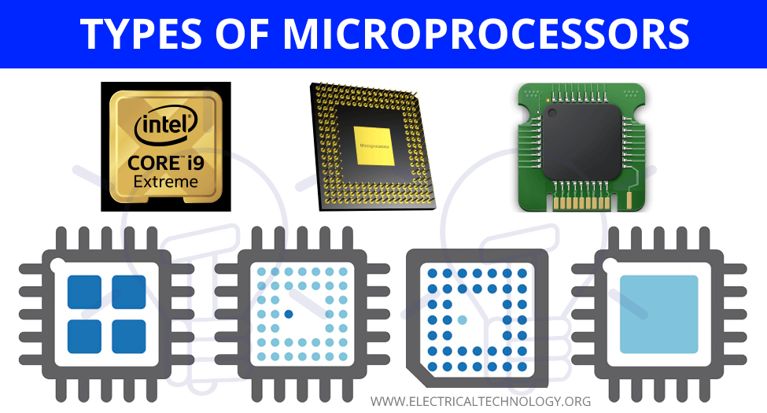
Microprocessor :
Computers are powered by microprocessors.
The microprocessor is the “brain” of a computer .
A microprocessor is made up of millions of tiny electronic switches.
A switch can either be on or off .
https://www.youtube.com/watch?v=wgbV6DLVezo

Slide 4
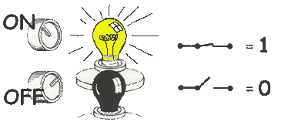
A computer stores and processes data in a simple format because it only understands these two states On and off .
https://www.youtube.com/watch?v=glMcMhkPqvg

Slide 5
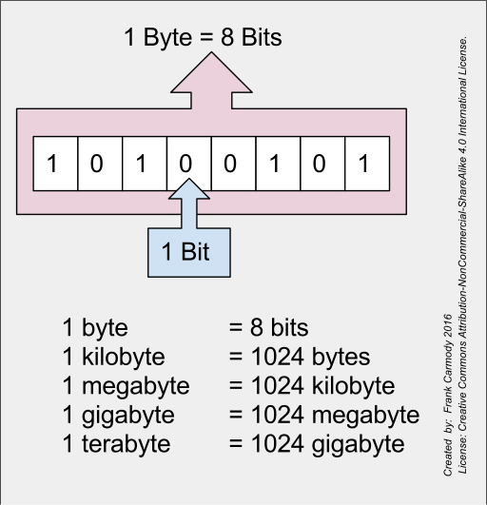
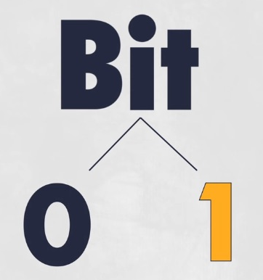
Binary system
The binary system only uses zero and one to represent data .
Eight bits is called a byte .
A computer uses binary to store text, images, video or audio.

Slide 6
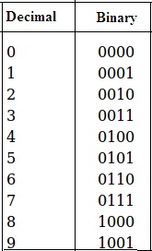
Binary vs. Decimal
The decimal number system uses 10 digits (0 to 9)
The binary number uses two digits (0 and 1)
https://www.youtube.com/watch?v=2Z03p3yhGmk&t=36s

Slide 7
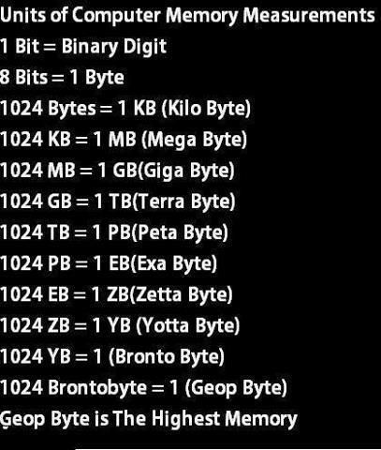
Measuring computer memory

