Slide 1
Understand Page 60 Ex. B and C

Slide 2
1. A mask is any kind of covering for the face.

Slide 3
2. The ancient Greeks used masks to help actors’ voices carry over large outdoor theaters.

Slide 4
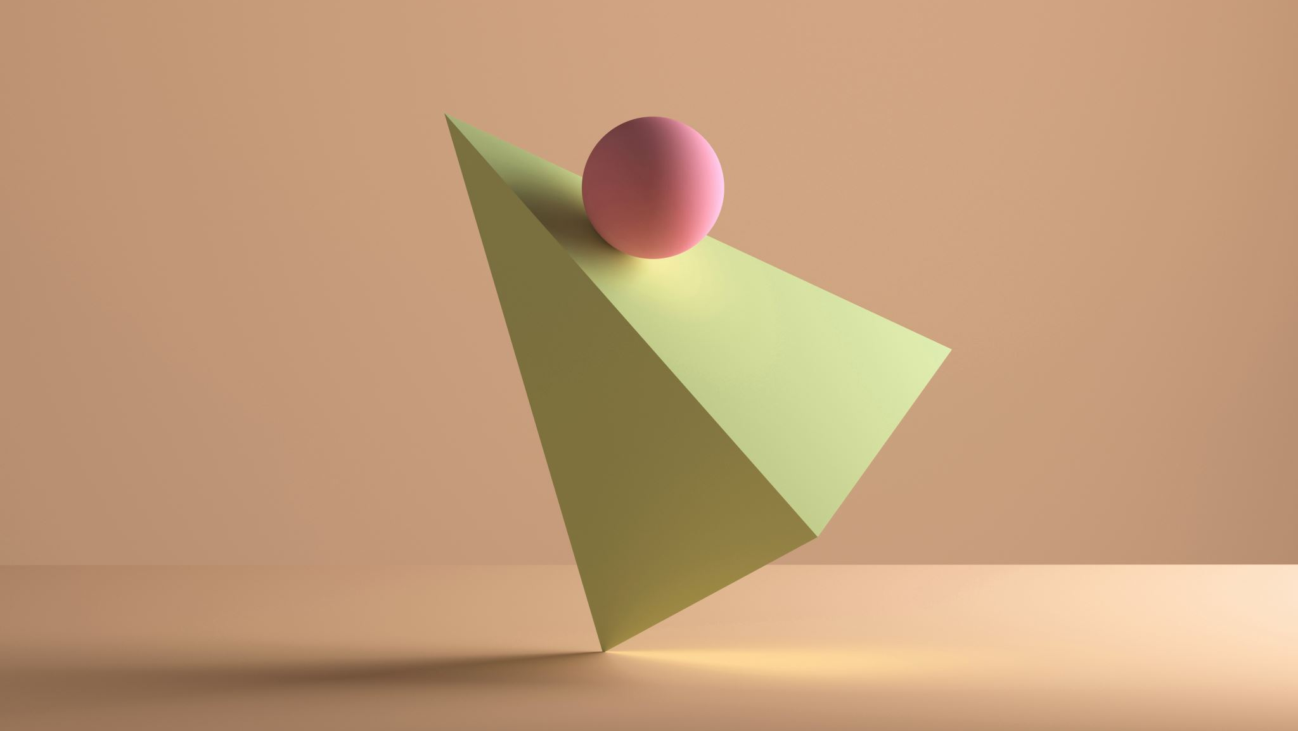
3. When a doctor wears a mask, it protects the doctor and the patient.

Slide 5
4. Welders wear masks to shield their eyes from bright light.

Slide 6
5. Three sports that use masks are: fencing, baseball, and American football.

Slide 7
6. Ceremonial masks are used in different countries in different ways: Celebrating the weather and rice in Africa, celebrating the new year in China and at Venice Carnival in Italy.

Slide 8
7. The four different categories of masks are: in hospital, at sporting events, parties, and the theater.

Slide 9
8. A mask can tell me about a person’s job sports they play, or about the history and the celebrations of a culture.

Slide 10
Ex. C Page 60

Slide 11
1. I show enthusiasm when I like something.

Slide 12
2. Hilarious can be another word for ridiculous.

Slide 13
3. Germs can make you feel sick.

Slide 14
4. Cut it so that each person will get a slice.

Slide 15
5. It would be old.

Slide 16
6. Surgeons perform operations.

