Slide 1
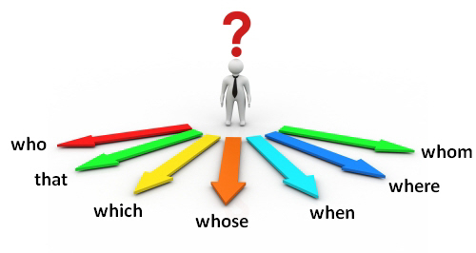
Relative Pronouns

Slide 2
The difference between Defining and Non-Defining Relative clauses https://www.youtube.com/watch?v=7AfKYUwlClo
Gameshow
Oxford book Explanation https://www.youtube.com/watch?v=-JLmXIcIEvQ
What is a Relative Pronoun and how to use it? (who, that) this one https://www.youtube.com/watch?v=uwOPABZ9TZw
Game show https://www.youtube.com/watch?v=bpYTihB4bqc

Slide 3
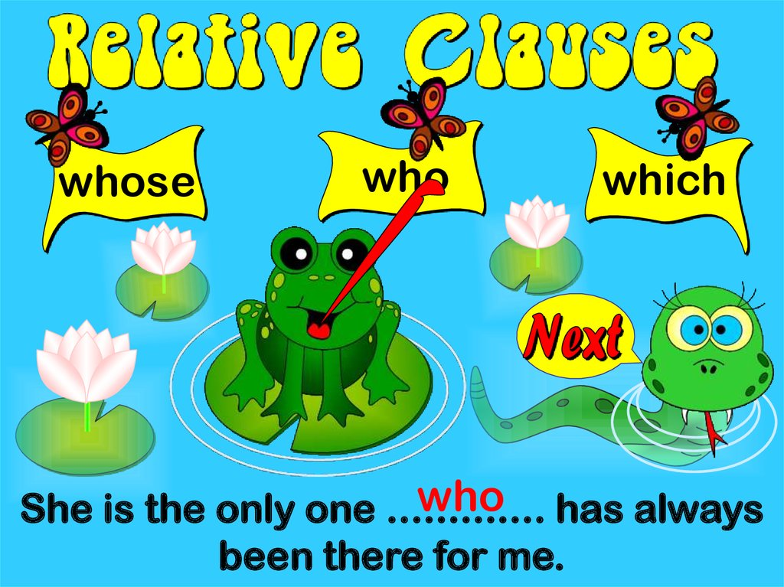
(Who, whom, which, whose, that) introduce relative clauses .
Defining Relative clauses for people, give important information about the noun in the sentence.
The man who lives in the flat above is an actor.

Slide 4

We use who , that to refer to people.
I know a man. He is a lawyer.
I know a man who/ that is a lawyer.

Slide 5
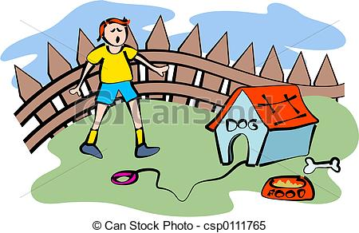
We use which , that to refer to objects or animals.
The dog is mine. It ran away.
The dog which/ that ran away is mine.

Slide 6
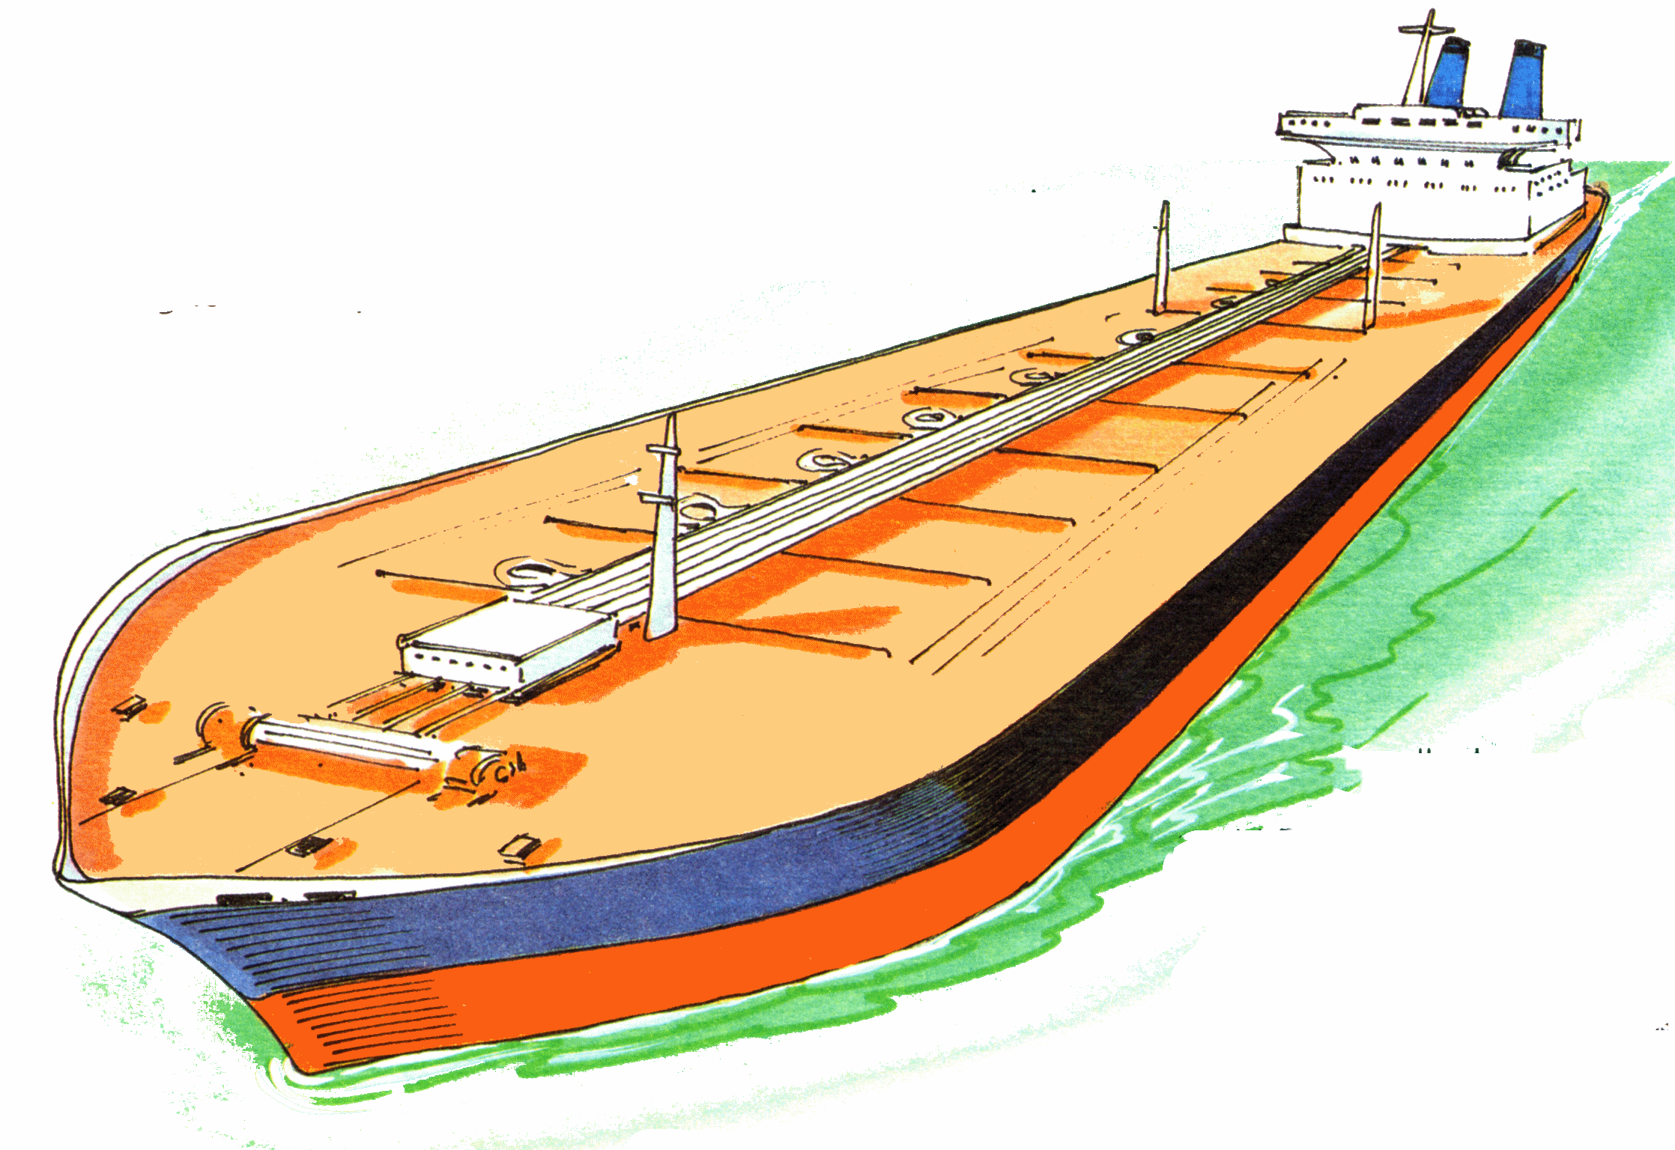
We usually avoid using prepositions before relative pronouns.
She is a woman in who teaches me math.X

Slide 7

A relative pronoun is not used with another pronoun( I, you, me, him, etc.)
I know a girl who works in a library.
(NOT) I know a girl who she works in a library. X

Slide 8


Slide 9

Picasso was an artist. He collected masks.
……………………………………………………………..

Slide 10

Here’s the man. He directed the play.
……………………………………………………………………..

Slide 11

Sara is a student. She went to my school.
…………………………………………………………………….

Slide 12

Mr. Sami is a man. He bought my car.
………………………………………………………………..

Slide 13
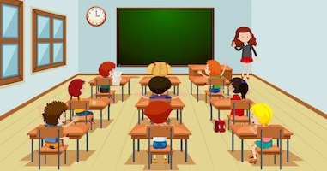
That’s the girl. She joined our class this year.
……………………………………………………………………

Slide 14
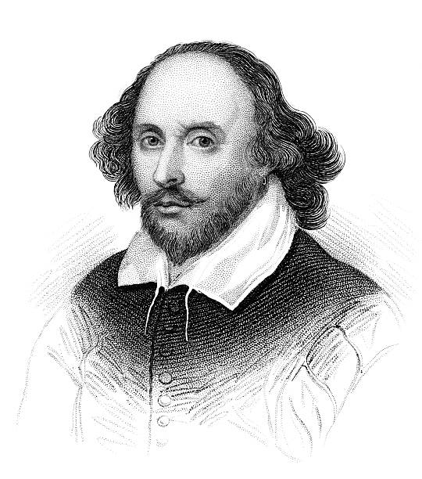
Shakespeare is a playwright. He wrote Hamlet.
……………………………………………………………………….

Slide 15
