Slide 1
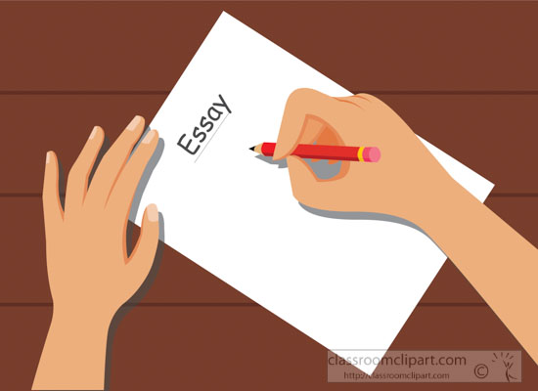
For and Against Essays

Slide 2
For and against writing essays follow a certain format:

Slide 3
Body
b) a main body in which the points for and against along with your justifications, examples or reasons are presented in separate paragraphs.

Slide 4
Conclusion
c) a conclusion or a closing paragraph in which you state your opinion.
Note: Opinion words (I think, I believe, In my opinion, etc.) can only be used in the closing paragraph where you give your opinion on the topic.

Slide 5
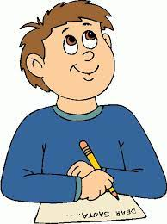
Before you start writing, you should know your audience:

Slide 6
Who will read your writing? Who do you need to convince?

Slide 7
The audience may be your friends, your teacher, your parents, your principal, the readers of a newspaper or the President of the United States! Will you be graded? On What? Should you be casual or professional?

Slide 8
• Before you start writing your essay you should make a list of the points for and against. • Do not use informal style (e.g. short forms, colloquial language, etc.) or strong language to express your opinion (e.g. I know…, etc.). Express your opinion in a non-emotional way.

Slide 9
The Great Introduction…
What makes a good introduction?
It grabs or “hooks” the reader’s attention by using one or more of the following strategies:
A quotation
An interesting fact or statistic
A question
It tells how the writing will be organized.
The author’s position is clearly stated in a thesis statement.

Slide 10
Good strategies used in introductions:
Questioning
The writer asks thought-provoking questions to capture the reader’s interest.
Interesting fact or statistic
The writer gives an interesting piece of information to grab the reader’s attention.

Slide 11
You Could Start with a Riddle:
Get your reader’s attention with a challenging thought.
“What is plain, and boring? What makes all students in a school building look the same and lose their individuality? If you guessed UNIFORMS, you are correct!”

Slide 12
You Could Begin with a Strong Statement:
Example:
Fast food consumption has risen 500 percent since 1970 and today reaches nearly every part of society, including some public school cafeterias.

Slide 13
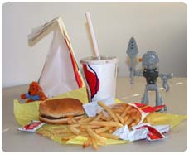
You Could Open with an interesting fact:
Example:
“Did you know that a typical child needs 2,000 calories for an entire day and Burger King’s Whopper with triple cheese has 1,230 calories?”

Slide 14
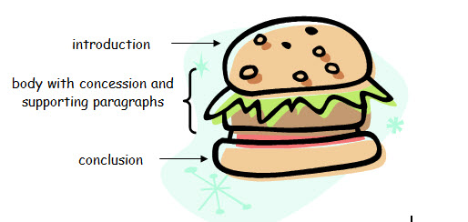
A main Body

Slide 15
A main Body

Slide 16
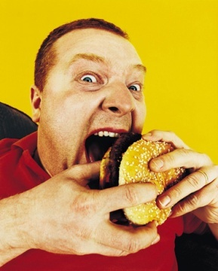
Conclude or End Your Essay…
What makes an good conclusion?
Last paragraph summarizes your main point and mention your point of view.
The last paragraph wraps up the writing and gives the reader something to think about.

Slide 17
Useful expressions and linking words/phrases
• To add more points to the same topic: in addition (to this), furthermore, moreover, besides, apart from, what is more, as well as, not to mention (the fact) that, also, not only … but also/as well, both … and, There is another side to the issue/question/argument of…

Slide 18
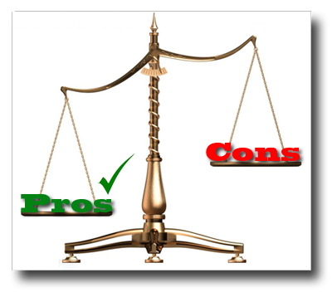
Useful expressions and linking words/phrases
• To make contrasting points: on the other hand, however, still, yet, but, nonetheless, nevertheless, even so, it may be said/argued/claimed that,…
While it is true to say that…, in fact… While/Although …, it cannot be denied that…

Slide 19
Useful expressions and linking words/phrases: Conclusion expressing opinion directly
In conclusion, On balance, All things considered, Taking everything into account/consideration, To conclude, To sum up, All in all,
…………………………… it is my belief/opinion that … ………………………….. I (firmly) believe/feel/think that … …………………………… I am convinced that … …………………………… I am inclined to believe that … …………………………… I (do not) agree that/with …

Slide 20
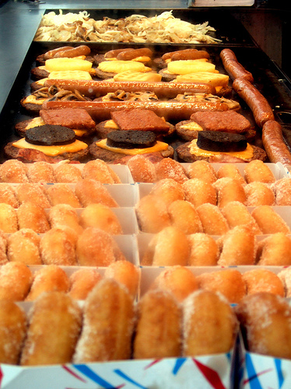
Don’t Forget…
Make sure to read over your work and edit for mechanics and spelling.
Write neatly!
Include detail and great vocabulary.
Follow proper format: Proper heading and skip lines!
Walsh Publishing Co. 2009

Slide 21
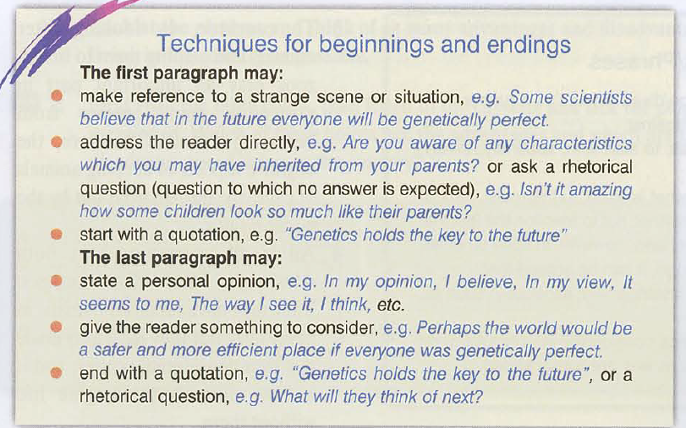

Slide 22
Model

Slide 25
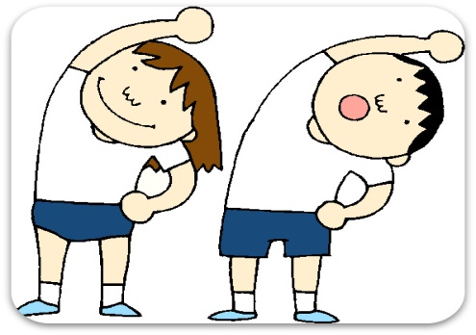
You have just seen the following advertisement
The effects of keeping fit on our lives- give us your views on both the good and bad sides.
Write your article for the magazine.
(Use at least 5 of the following words in your argument. ( junk food, nutrient, insomnia, heart attack, health , disease, obesity )

