Slide 1
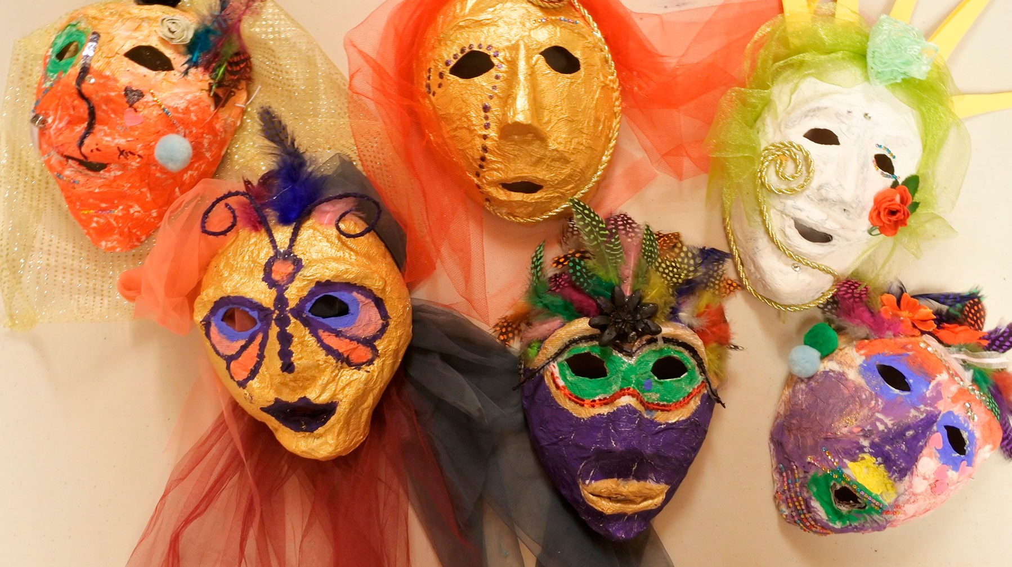
Uncovering Masks

Slide 2
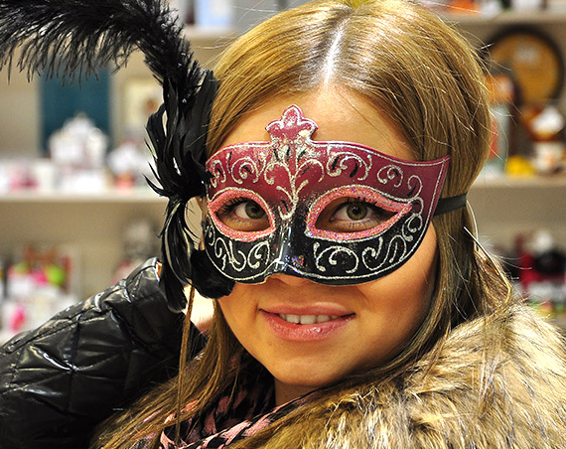
What kinds of masks have you seen people wear?

Slide 3
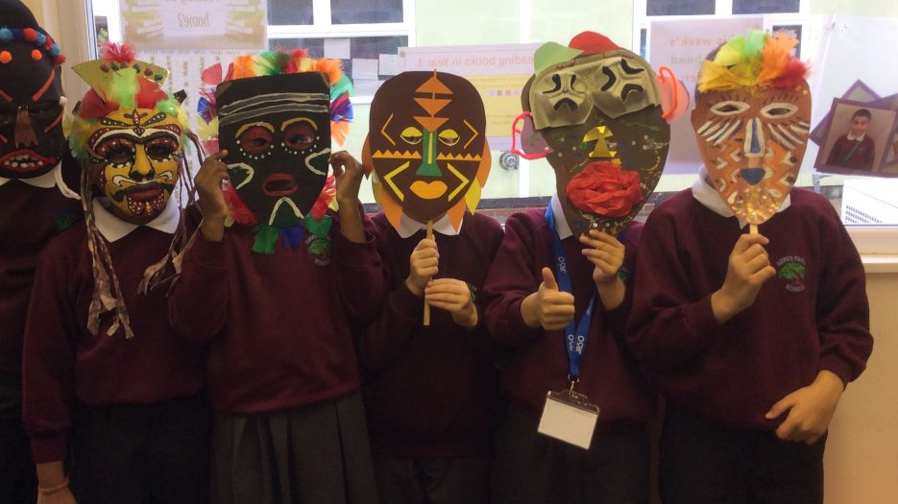
How are masks used for entertainment?

Slide 4
What are some other uses for masks?

Slide 5
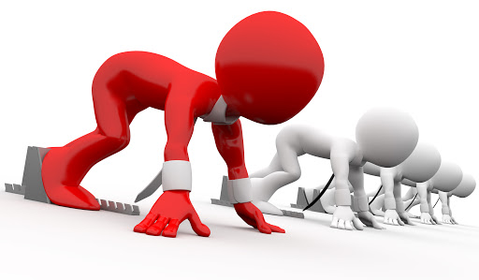
Get Ready page 56 Ex. A

Slide 6
Listen and say the words covering/ disguise/ entertainment/ essential/ urgent/ lifesaver/ shield/ safeguard/ crucial/ performer/ elaborate/ central/ basic

Slide 7
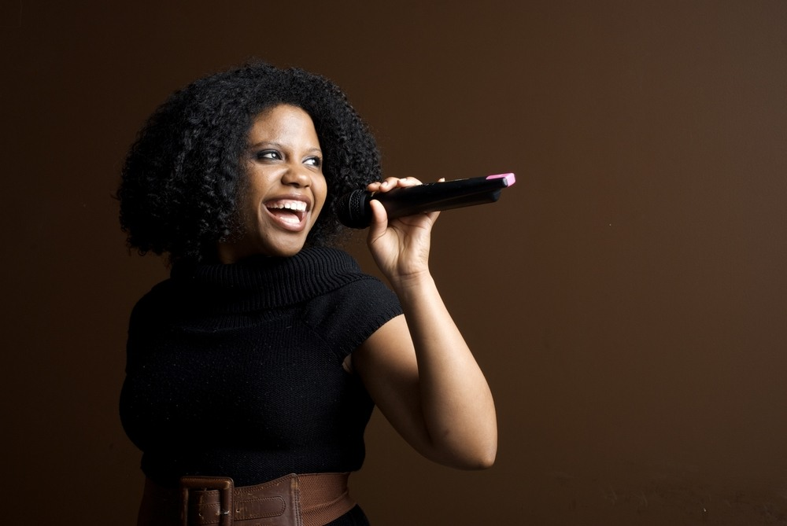
covering/ disguise/ entertainment/ essential/ urgent/ lifesaver/ shield/ safeguard/ crucial/ performer/ elaborate/ central/ basic

Slide 8
Performer/ noun a person who performs in front of an audience. The performers tell the story through song and dance...

Slide 9
covering/ disguise/ entertainment/ essential/ urgent/ lifesaver/ shield/ safeguard/ crucial/ performer/ elaborate/ central/ basic.

Slide 10
Urgent/ adj very important and needing attention immediately. He's got to sign that paper - will you tell him it's urgent?

Slide 11
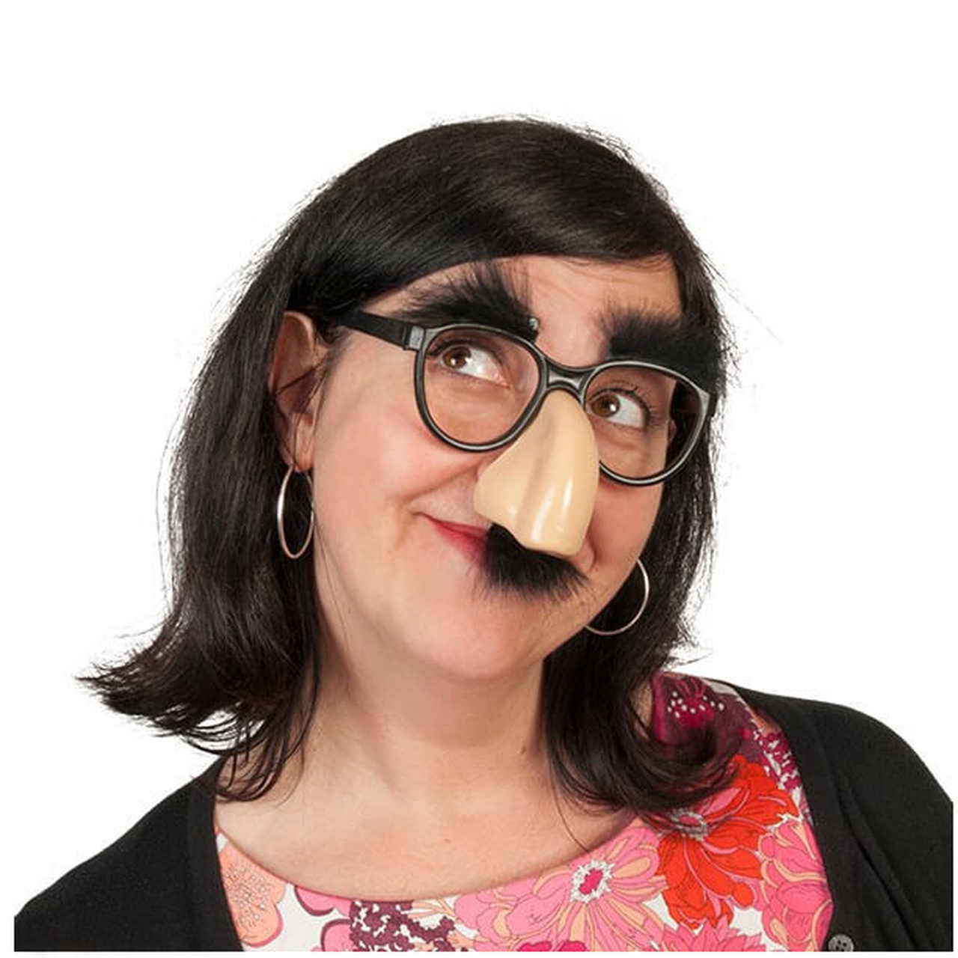
covering/ disguise/ entertainment/ essential/ urgent/ lifesaver/ shield/ safeguard/ crucial/ performer/ elaborate/ central/ basic.

Slide 12
Disguise/ noun noun, a thing that you wear or use to change your appearance so that no one recognize you. He disguised himself by wearing a false beard.

Slide 13
covering/ disguise/ entertainment/ essential/ urgent/ lifesaver/ shield/ safeguard/ crucial/ performer/ elaborate/ central/ basic.

Slide 14
Crucial/ adj extremely important or necessary. Her work has been crucial to the project's success.

Slide 15
covering/ disguise/ entertainment/ essential/ urgent/ lifesaver/ shield/ safeguard/ crucial/ performer/ elaborate/ central/ basic.

Slide 16
Safeguard/ verb to protect something from harm The disk has built-in safeguards to prevent certain errors.

Slide 17
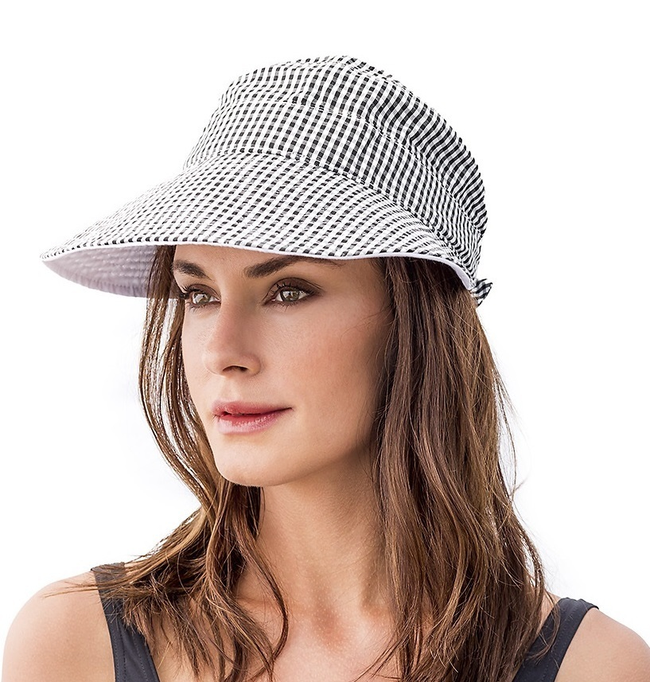
covering/ disguise/ entertainment/ essential/ urgent/ lifesaver/ shield/ safeguard/ crucial/ performer/ elaborate/ central/ basic.

Slide 18
Shield/ verb to protect someone or something from danger or damage. She held her hand above her eyes to shield them from the sun.

Slide 19
covering/ disguise/ entertainment/ essential/ urgent/ lifesaver/ shield/ safeguard/ crucial/ performer/ elaborate/ central/ basic.

Slide 20
Elaborate Done or made very carefully / very complicated That seems a very elaborate way of recording the information - do you really need all of those details?

Slide 21
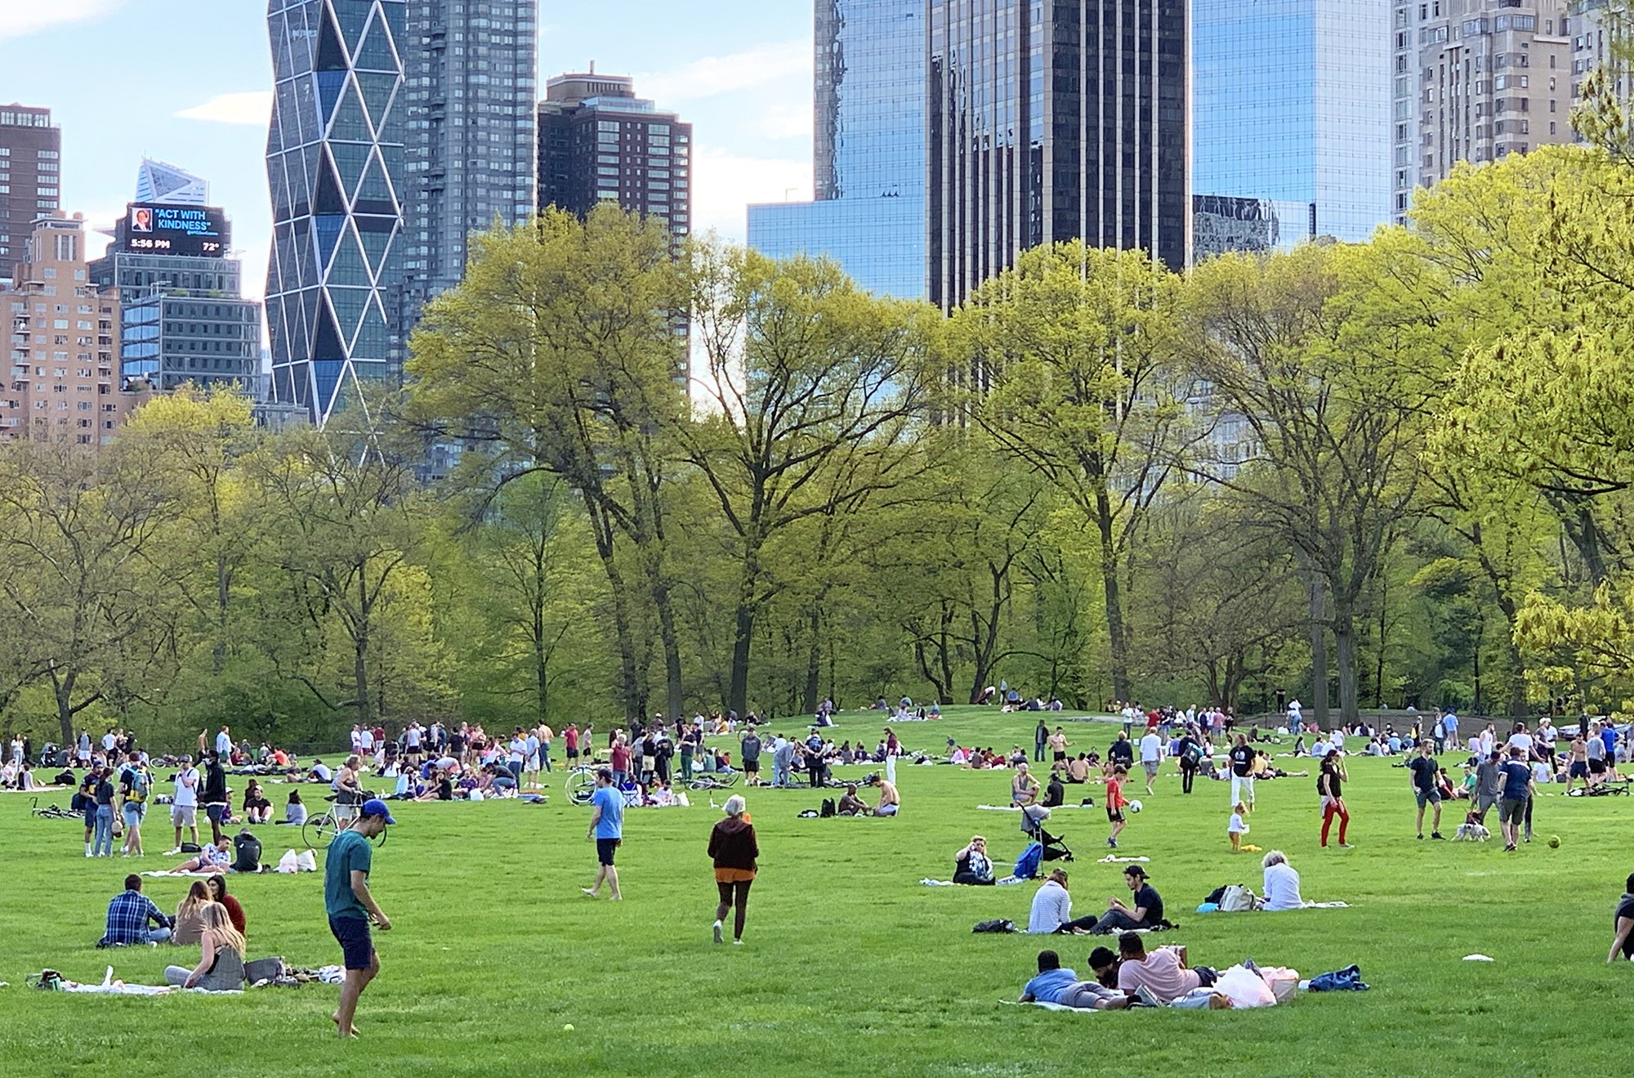
covering/ disguise/ entertainment/ essential/ urgent/ lifesaver/ shield/ safeguard/ crucial/ performer/ elaborate/ central/ basic.

Slide 22
Central, adj 1.in the centre of something 2. most important Of course, you pay more for premises with a central location

Slide 23
covering/ disguise/ entertainment/ essential/ urgent/ lifesaver/ shield/ safeguard/ crucial/ performer/ elaborate/ central/ basic.

Slide 24
Lifesaver/ noun something that saves a person's life. This multipurpose tool can be a real lifesaver when something needs fixing.

Slide 25
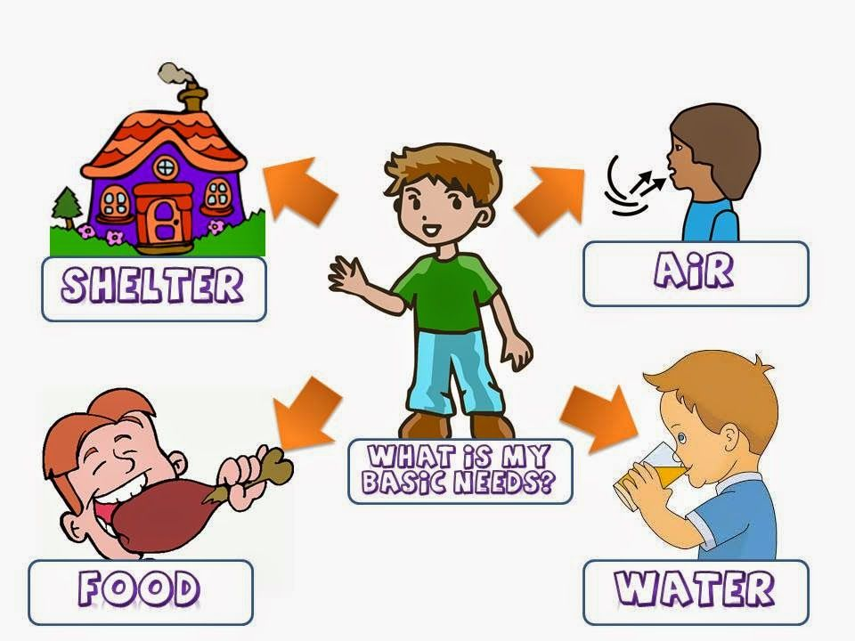
covering/ disguise/ entertainment/ essential/ urgent/ lifesaver/ shield/ safeguard/ crucial/ performer/ elaborate/ central/ basic.

Slide 26
Basic/ adj forming a part of something that is most necessary and from which other things develop. In this class, you will learn the basic principles of chemistry.

