Slide 1
up

Slide 2
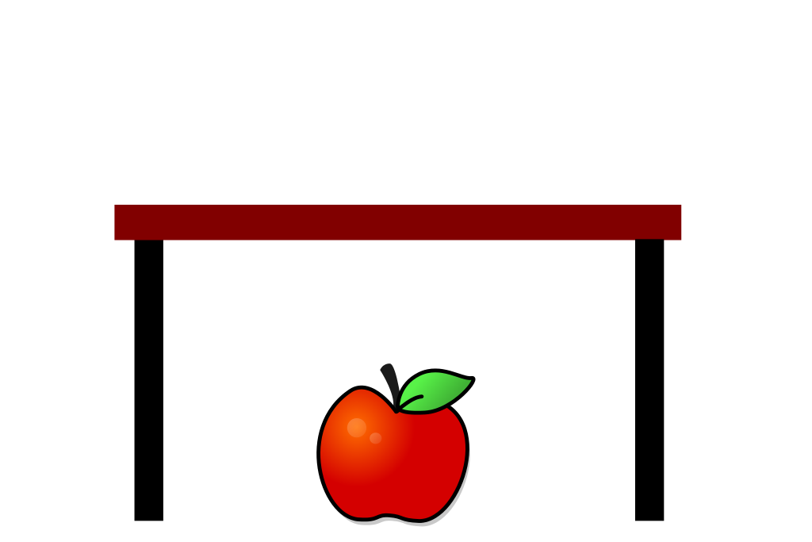
under

Slide 3
umbrella

Slide 4
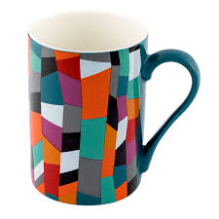
mug

Slide 5
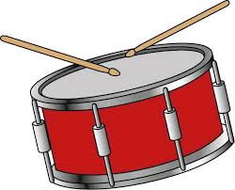
drum

Slide 6
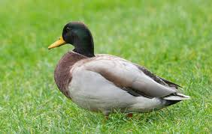
duck

Slide 7
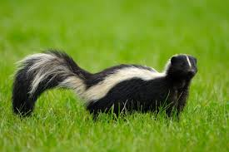
skunk
. . . . .

Slide 8
sun

Slide 9
hut but
. . . . . .

Slide 10
nut cut
. . . . . .

Slide 11
mug gum
. . . . . .

Slide 12
gun run
. . . . . .

Slide 13
hug rug
. . . . . .

Slide 14
hunt

Slide 15
stunt
.. . . .

Slide 16
duck
. . .

Slide 17
dust
. . . .

Slide 18
mud

Slide 19
drum
. . . .

Slide 20
truck

Slide 21
must

Slide 22
hump

Slide 23
skunk

