Slide 1
up

Slide 2
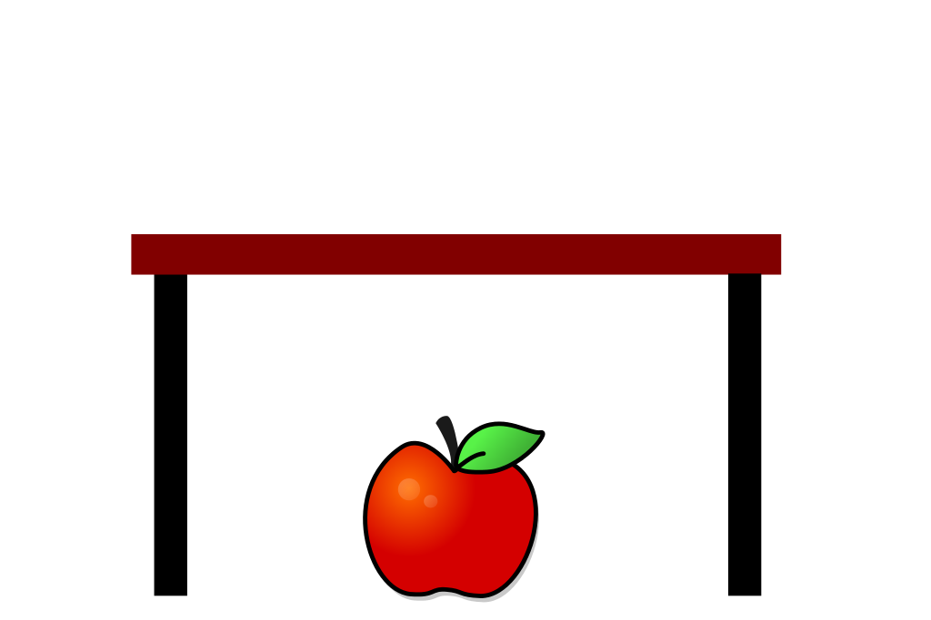
under

Slide 3
umbrella

Slide 4
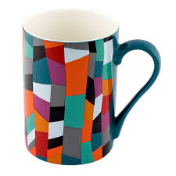
mug

Slide 5
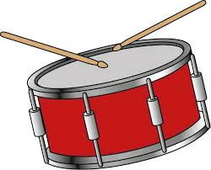
drum

Slide 6
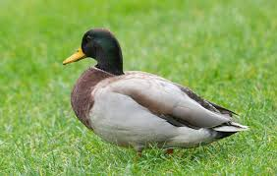
duck

Slide 7
sun

Slide 8
mud

Slide 9
hunt

Slide 10
truck

Slide 11
must

Slide 12
hump

