Slide 2
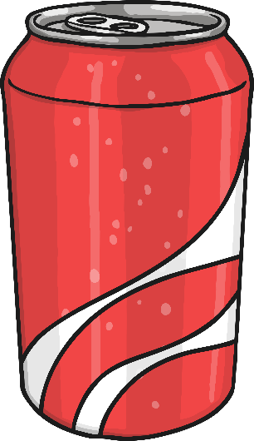

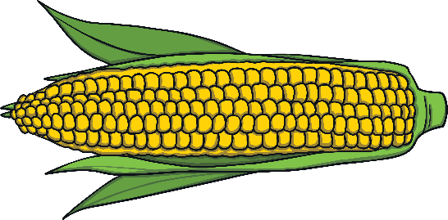
What is a compound word?
A compound word is two or more words used together to make a different word with its own meaning. This is sometimes called a compound noun.
Let’s see an example:
pop
+
corn
=
popcorn

Slide 3


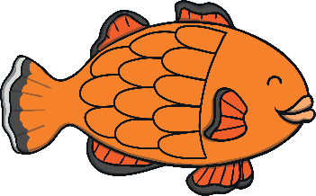

rainbow
Which two words make this compound word?
+
rain + bow = rainbow

Slide 4

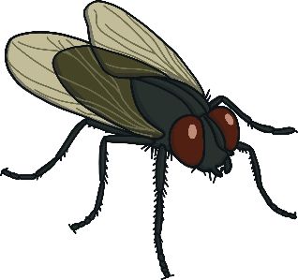
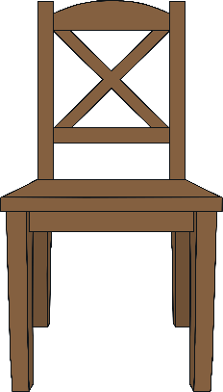
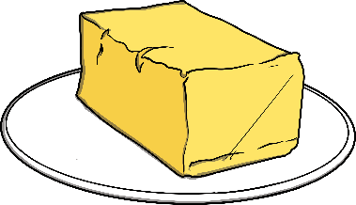
butterfly
Which two words make this compound word?
+
butter + fly = butterfly

Slide 5



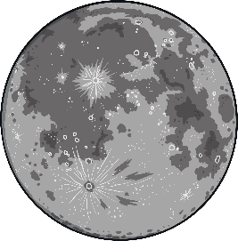
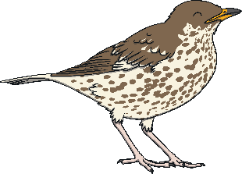
starfish
Which two words make this compound word?
+
star + fish = starfish

Slide 6
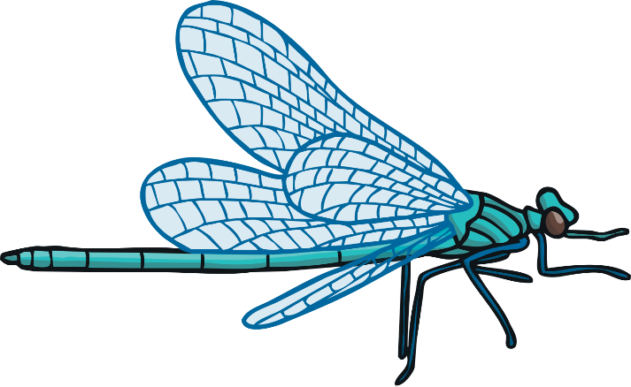



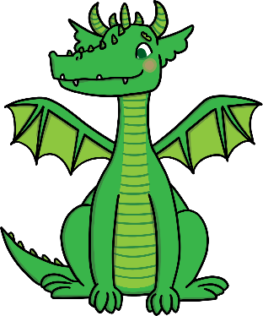
dragonfly
Which two words make this compound word?
+
dragon + fly = dragonfly

Slide 7
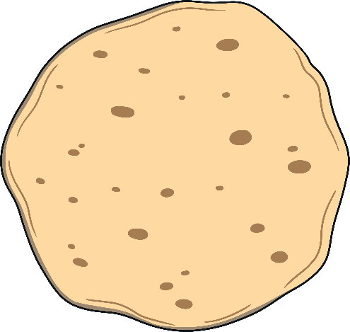




pancake
Which two words make this compound word?
+
pan + cake = pancake

Slide 8




handbag
Which two words make this compound word?
+
hand + bag = handbag

Slide 9
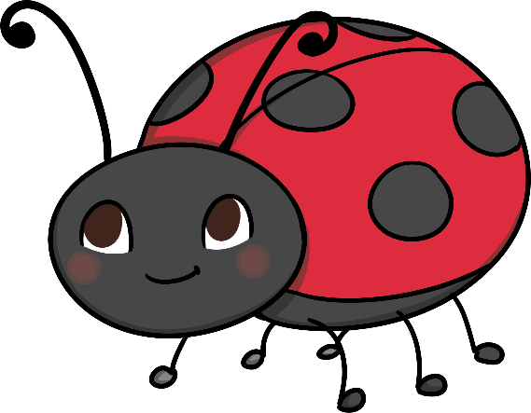




ladybird
Which two words make this compound word?
+
lady + bird = ladybird

Slide 10




snowman
Which two words make this compound word?
+
snow + man = snowman

Slide 11



Which compound word is made up of these words?
+
=
tooth + brush = toothbrush

Slide 12




Which compound word is made up of these words?
+
=
sun + flower = sunflower

Slide 13

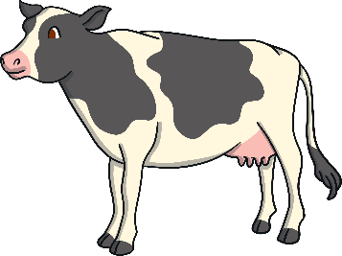
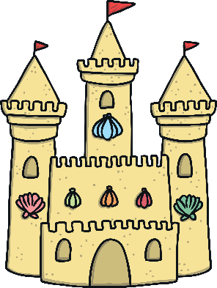
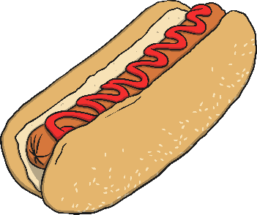
Which compound word is made up of these words?
+
=
cow + boy = cowboy

Slide 14






Can you remember which two words make up these compound words?
pan + cake = pancake
cow + boy = cowboy
snow + man = snowman
tooth + brush = toothbrush
rain + bow = rainbow
star + fish = starfish
lady + bird = ladybird

