Slide 1
Tales and Legends unit 4
Page 58

Slide 2
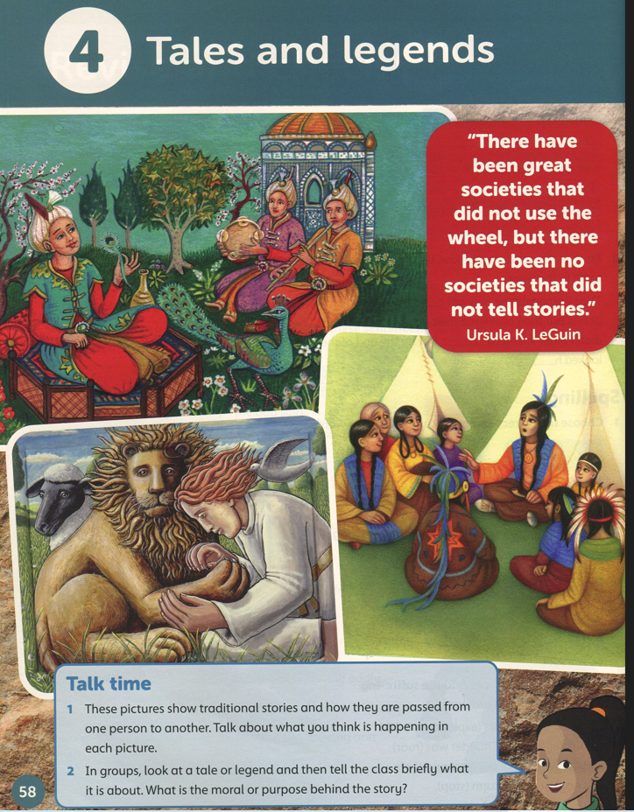

Slide 3
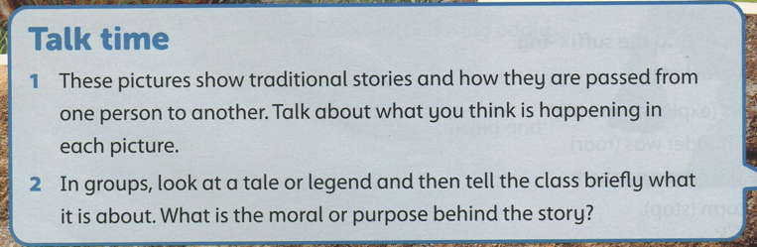
What is the main feature of tales, fables and legends?
There is always a moral ( lesson) to be learned.

Slide 4
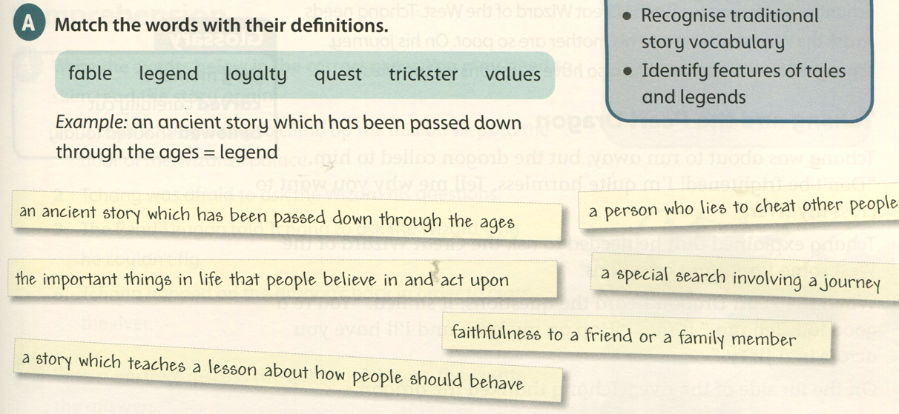
Student’s book page 59
trickster
legend
values
quest
loyalty
fable

Slide 5
https://video.search.yahoo.com/search/video?fr=mcafee&p=introduction+to+fables#id=1&vid=a9f042a3f37ca825f88b85a4adcf8c9e&action=click
https://www.youtube.com/watch?v=KAX8YUUWBtI
https://www.youtube.com/watch?v=rf7ascNGbcM
https://www.twinkl.com/teaching-wiki/traditional-tale

Slide 6
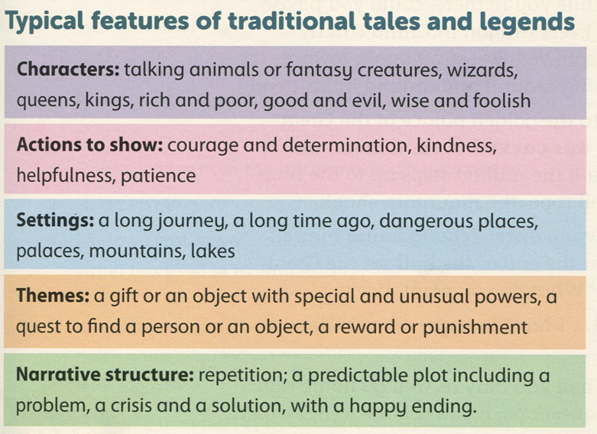
Dragons, witches, children, old men or women, giants, dwarves
generosity, loyalty, honesty
forests, islands, caves
How something happened / why something is the way it is.
Uses magic words or formulas

Slide 7
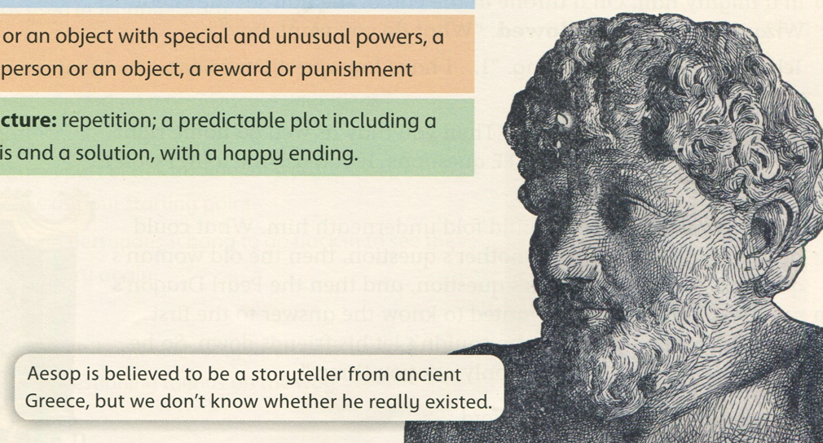

Slide 8
Myths: Stories set in the ancient past to explain the world and events that people didn’t understand such as floods, earthquakes or how the world began. The plot often involves gods or supernatural beings and unbelievable events not based on anything factual. | Legends: Stories passed from person to person based on something that once possibly happened with heroic characters, fantastical places and unlikely events. The plot focuses on a main character who overcomes difficulties-often a monster. It can be about places, objects and animals.
Features in Myth | Features in Legend
Gods and goddesses Explains a natural phenomenon Fantastical creatures Superhuman or unlikely powers A classic opening e.g. “Long, long ago…” “Once…..” | Gods and goddesses Heroes and villains May be based on an historical event Fantastical creatures Set long ago Superhuman or unlikely powers Dangerous quest or challenge Exaggerated or unlikely events A classic opening e.g. “Long, long ago…..” “Once……”

