Slide 1
Present Continuous for future plans
Grammar book Unit 5 p.31+32+33+34

Slide 2
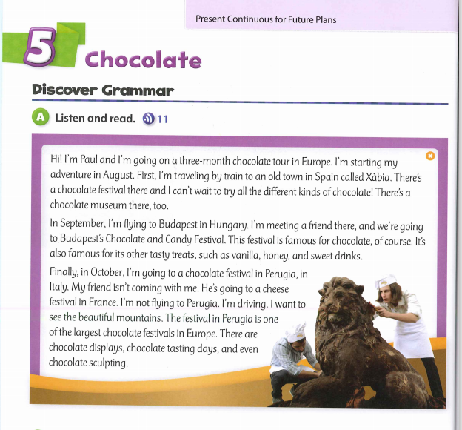

Slide 3
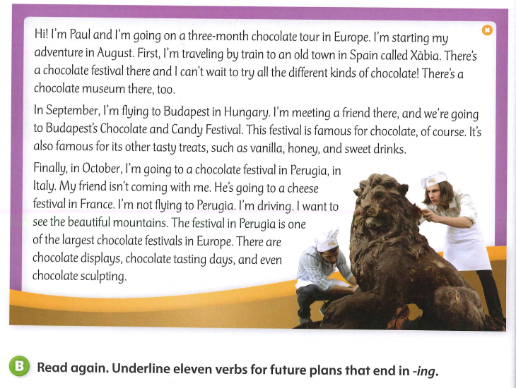

Slide 4
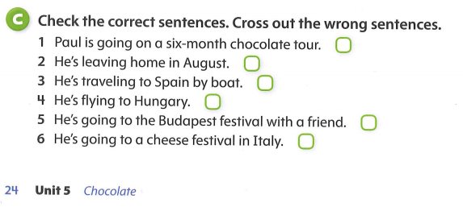



$$√$$
$$√$$
$$√$$
31

Slide 5
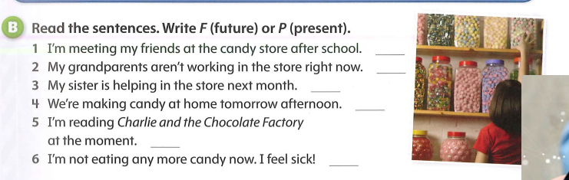
F
P
F
F
P
P

Slide 6
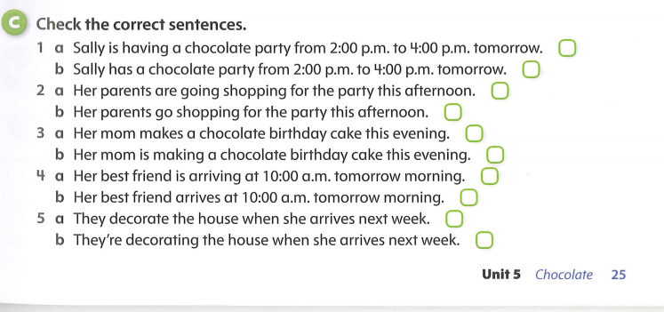
Page 32

Slide 7
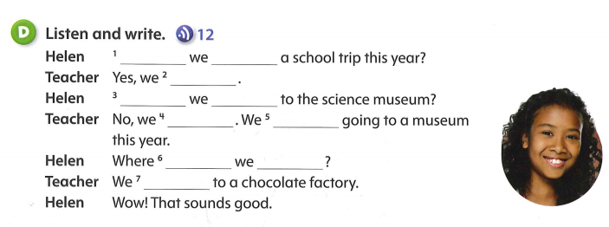
Are
having
are
Are
going
aren’t
’re not
are
going
’re going

Slide 8
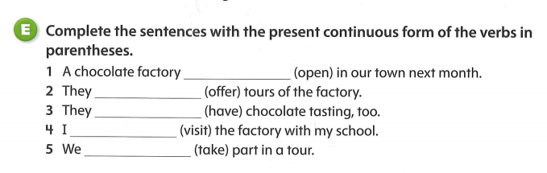
is opening
’re offering
’re having
’m visiting
’re taking

Slide 9
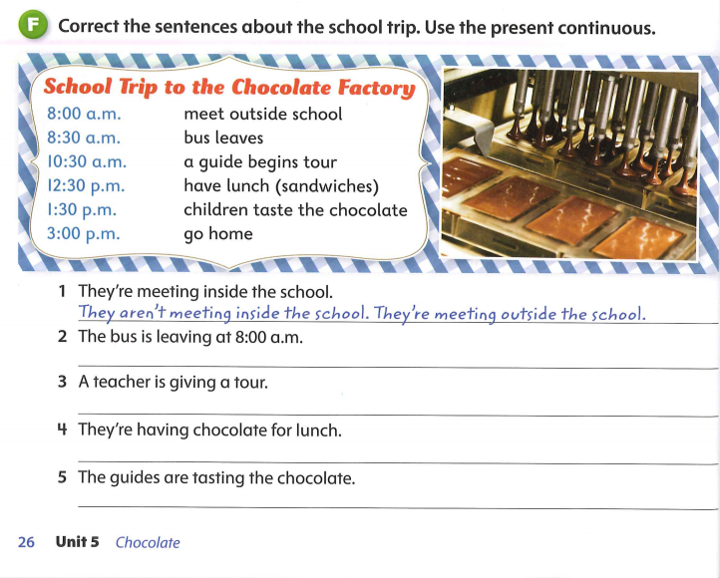
The bus isn’t leaving at 8:oo. It’s leaving at 8:30.
A teacher isn’t giving a tour. A guide is giving a tour.
They aren’t having chocolate for lunch. They’re having sandwiches for lunch .
The guides aren’t tasting the chocolate. The children are tasting the chocolate.
33

Slide 10
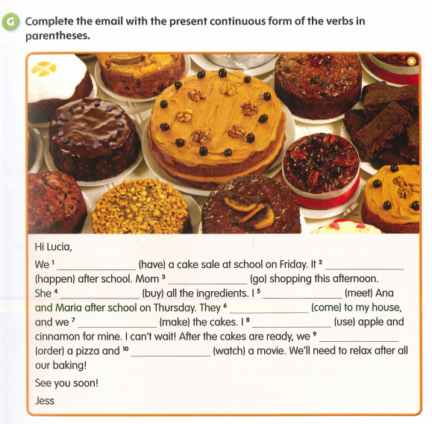
S
are having
’s happening
’s going
’s buying
’m meeting
’re coming
’re making
’m using
’re ordering
watching

Slide 11
