Slide 1
Vocabulary Ex. C page 46

Slide 2
For a complete list of events, come by the library and pick up a brochure, visit www.library.ellington-ct.gov or call 860-870-3160. Synonyms booklet, circular, flyer (also flier), folder, leaflet, pamphlet

Slide 3
brochure

Slide 4
Doctors were amazed by the sudden improvement in her medical condition. Antonym setback

Slide 5
improvement

Slide 6
She is responsible for many innovations in her field. the introduction of something new

Slide 7
innovations

Slide 8
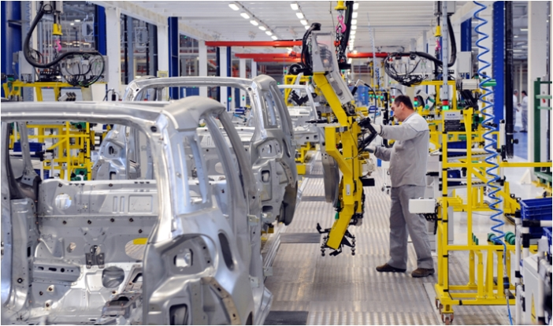
He works for a company that manufactures car parts. Synonym make (PRODUCE)

Slide 9
manufactures

Slide 10
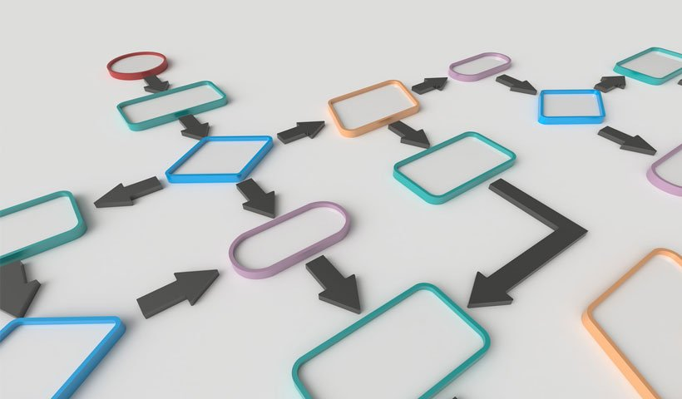
Increasing the number of women in top management jobs will be a slow process. a series of actions that are needed in order to do something or achieve a result

Slide 11
process

Slide 12
At some stage we need to calculate when the project will be finished. a part of an activity or a period of development

Slide 13
stage

