Slide 1
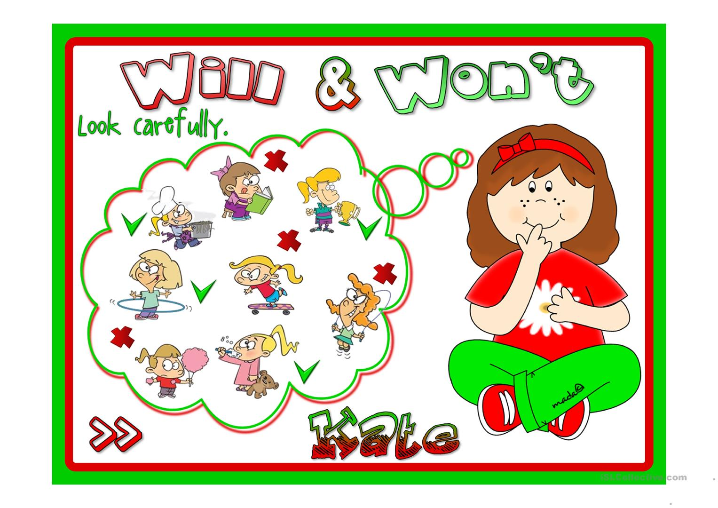
Future Forms

Slide 2
Use

Slide 3
Jill will be 2 years old next month.

Slide 4
For situations which will definitely happen in the future and which we can not control it .

Slide 5
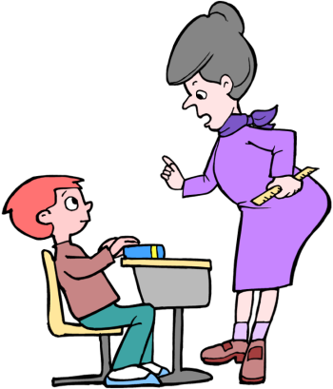
Be Quiet or I will send you out.

Slide 6
For Threats or warning.

Slide 7
I’ll help you teacher.

Slide 8
For promises and quick decisions.

Slide 9
I hope he will pass his exam.

Slide 10
With the verbs hope, think , believe, expect, etc.

Slide 11
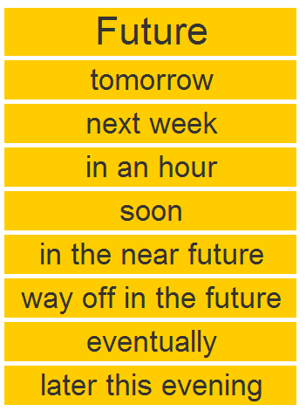
The Time Expression

Slide 12
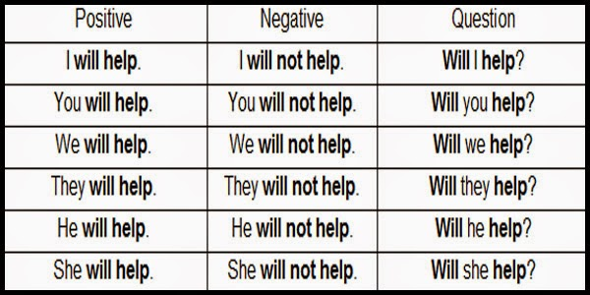

Slide 14
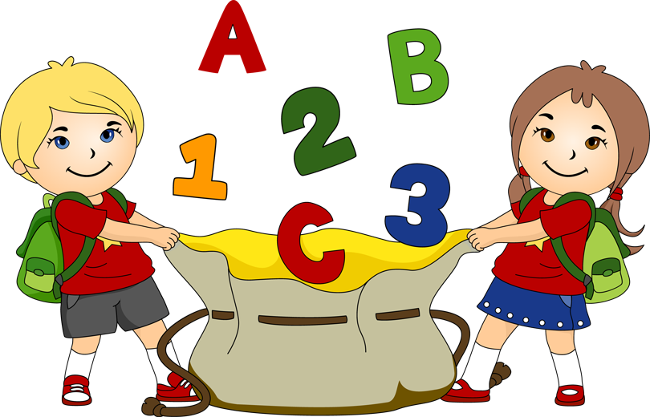
Be Going to We Use Be Going To:

Slide 15
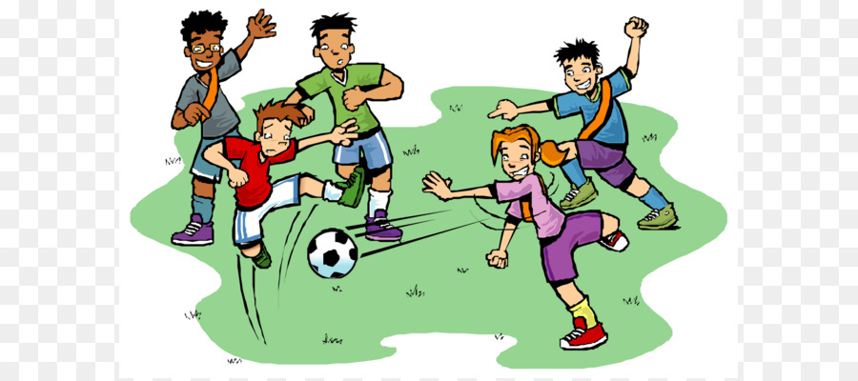
I am going to play football this afternoon.

Slide 16
Plans for the near future.

Slide 17
It’s going to rain. There are dark clouds in the sky.

Slide 18
When there is an evidence that something is going to happen in the near future.

Slide 19
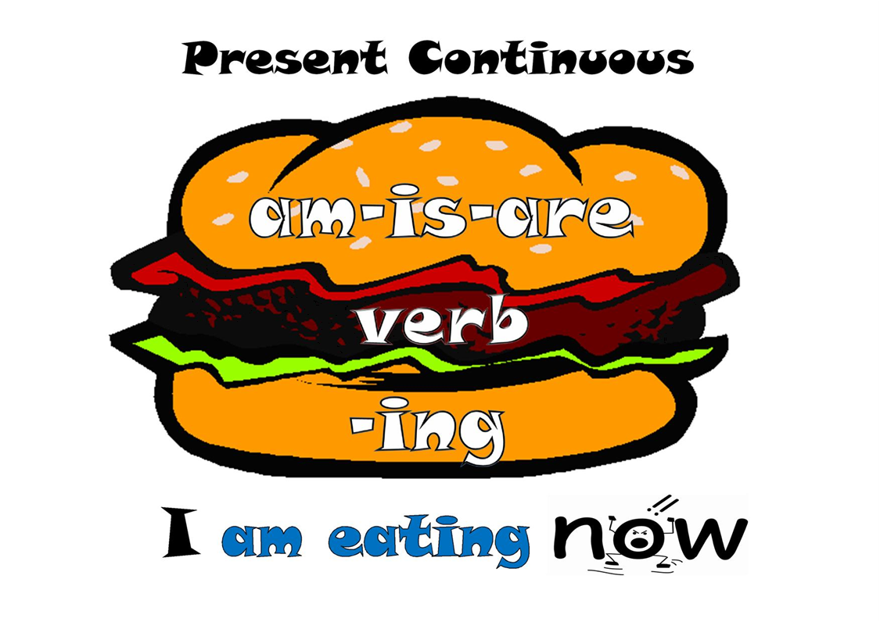
Present Continuous

Slide 20
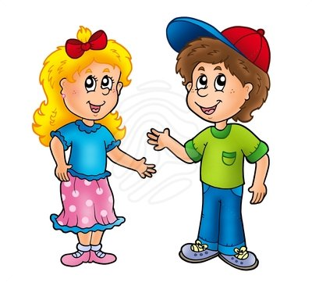
I am meeting Rania Khalileyah at two o’clock.

Slide 21
The rule is: We use the present continuous for actions we have already arranged to do in the near future. A future arrangement is a plan that you have decided and organized with another person. I'm spending Christmas and New Year with my Mum and Dad. We're meeting Susan at 3 o'clock tomorrow afternoon.

Slide 22
Future continuous Will be + verb + Ing I will be using my laptop this afternoon

Slide 23
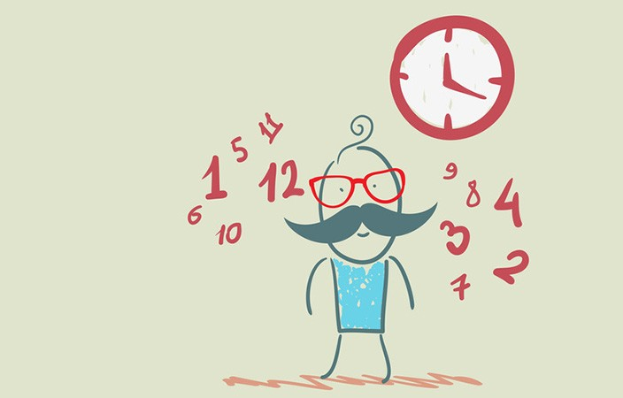
The Rule is: Actions that will be in progress at a specific time in the future The future continuous tense is used to talk about future events that will be in progress at a specific time in the future. This time tomorrow I will be celebrating my birthday.

Slide 24
Future perfect simple Tim will have finished his project by Monday.

Slide 25
The rule is: Something that will be finished before a specific time in the future. The future perfect tense is used to indicate a future event that has a definitive end date. We will have reached home before you come.

Slide 26
Song https://www.youtube.com/watch?v=-487Fwatb64 future form conversation https://www.youtube.com/watch?v=lGcXggbeLH8 Will / Going to / Be ING / Present simple – Future https://www.youtube.com/watch?v=2LSBme2M4Qo

Slide 27
Time Expressions https://www.youtube.com/watch?v=h_2NXbDyISo

