Slide 1
Pronouns Worksheet

Slide 2
To identify to what or to whom pronouns refer to and use them in sentences.
Subject pronouns | Object pronouns | Possessive adjectives | Possessive pronouns | Reflexive pronouns
I | me | my | mine | myself
you | you | your | yours | yourself
he | him | his | his | himself
she | her | her | hers | herself
it | it | its | - | itself
we | us | our | ours | ourselves
they | them | their | theirs | themselves
you | you | your | yours | yourselves

Slide 3
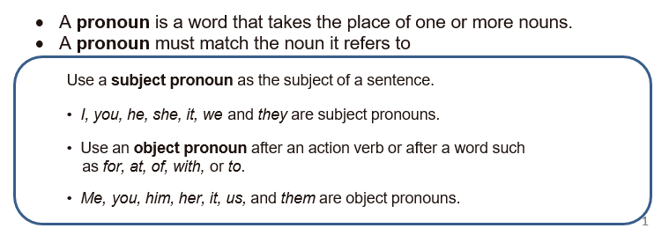

Slide 4
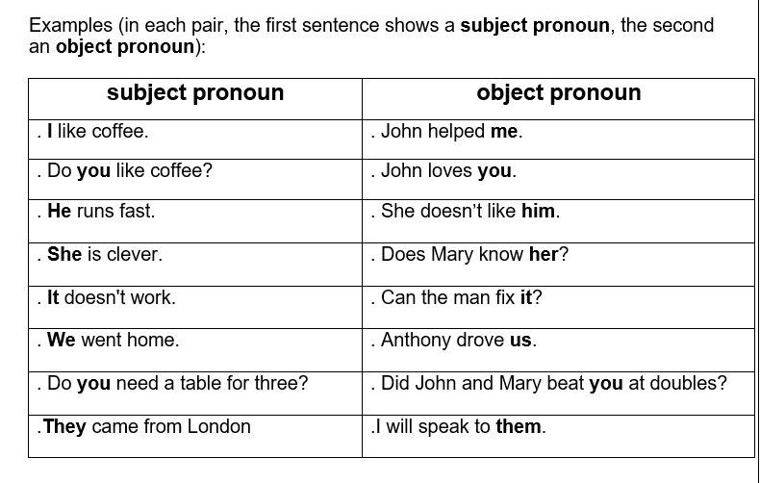

Slide 5
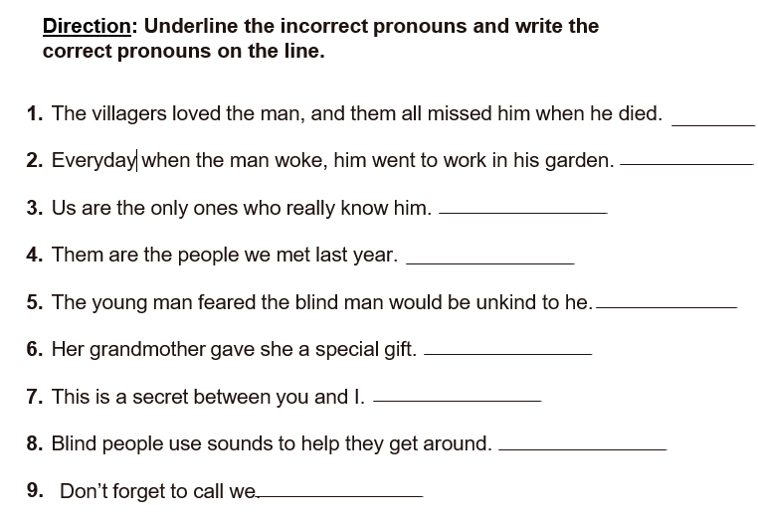
they
he
we
they
him
her
me
them
us

Slide 6
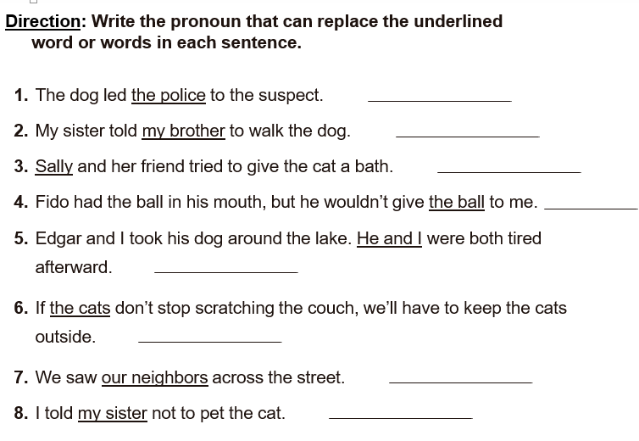
them
him
She
it
we
they
them
her

Slide 7
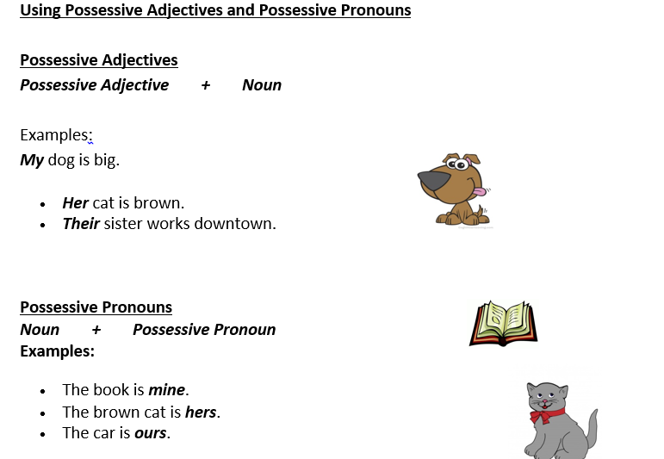

Slide 8
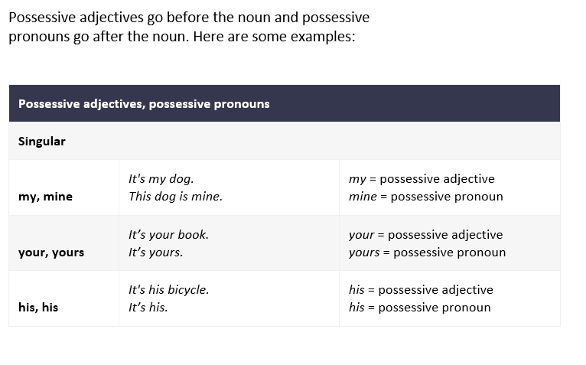

Slide 9
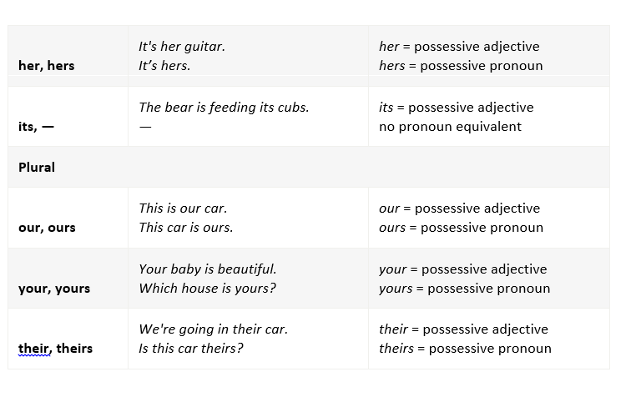

Slide 10
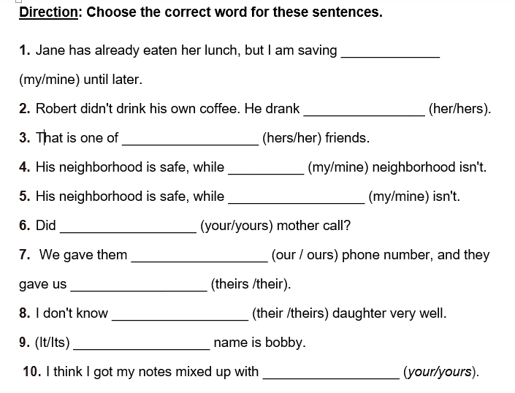
mine
hers
her
my
mine
your
our
theirs
their
Its
yours

Slide 11
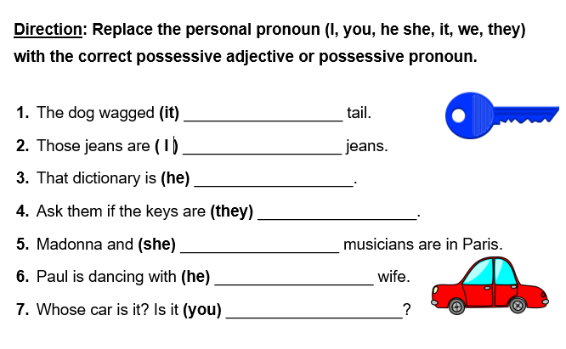
its
my
his
theirs
her
his
yours

Slide 12
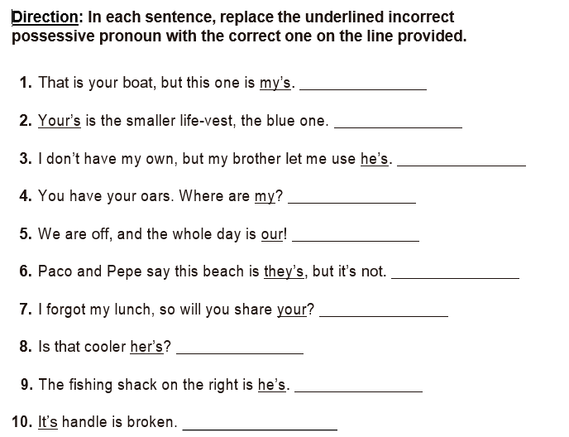
mine
yours
his
mine
ours
theirs
yours
hers
his
Its

Slide 13
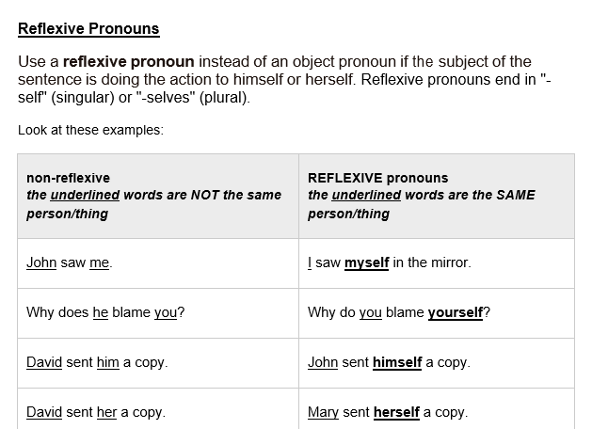

Slide 14
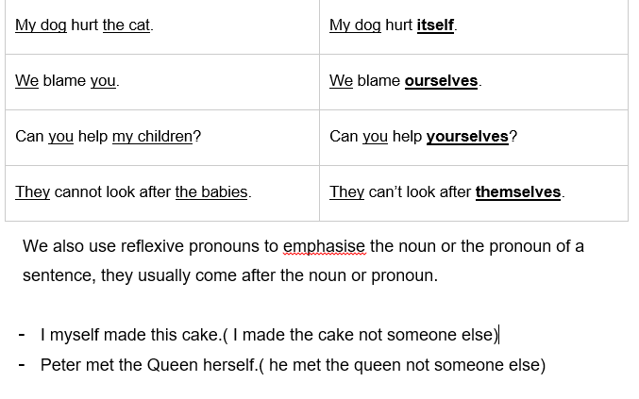

Slide 15
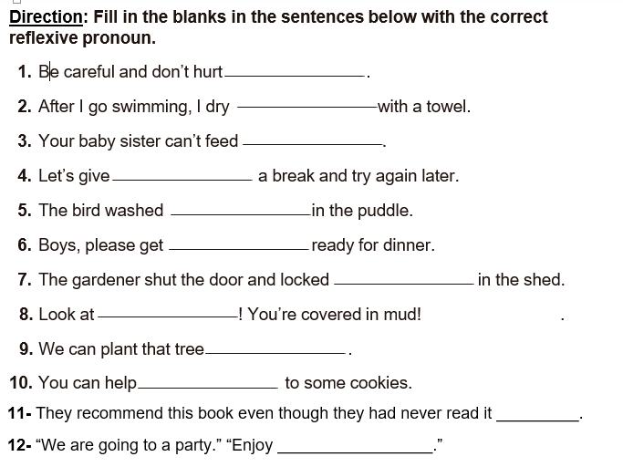
yourself
myself
herself
ourselves
itself
yourselves
himself
yourself/ yourselves
ourselves
yourself/ yourselves
themselves
yourselves

