Slide 1
Reflexive Pronouns
Reflexive Pronouns
Subject pronouns | Object pronouns
I | Myself
You | Yourself
He | Himself
She | Herself
It | Itself
We | Ourselves
You | Yourselves
They | themselves

Slide 2
https://video.search.yahoo.com/search/video;_ylt=AwrE19f.NRhgX48AbblXNyoA;_ylu=Y29sbwNiZjEEcG9zAzEEdnRpZANDMDE2MF8xBHNlYwNwaXZz?p=reflexive+pronouns&fr2=piv-web&fr=mcafee#id=28&vid=955c5362cd57faab8c24753011982526&action=view
https://create.kahoot.it/details/32abadbc-9988-4942-9c0e-559dd8a453e8
https://www.liveworksheets.com/worksheets/en/English_as_a_Second_Language_(ESL)/Reflexive_Pronouns/Reflexive_pronouns_*_practice_ay513lm

Slide 3
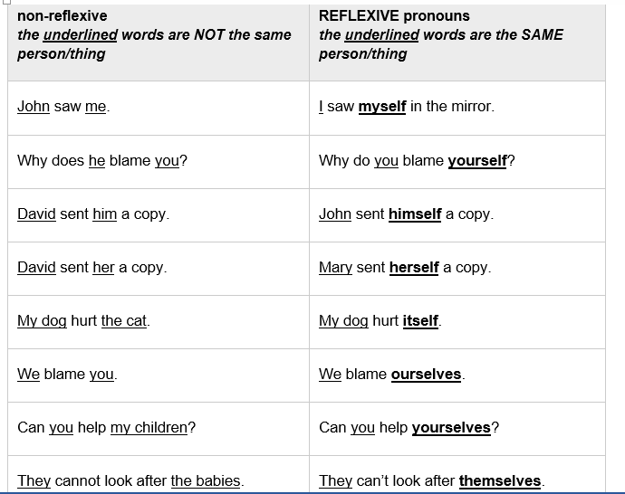

Slide 4
We use reflexive pronouns to indicate that the person who performs the action of the verb is the same person receiving the action.
I cut myself.
It washed itself.
She burnt herself while cooking.
He looked at himself in the mirror.
You hurt yourselves.

Slide 5
Reflexive pronouns are used for emphasis.
We did it ourselves.
( no one helped us)

Slide 6
On one’s own = by oneself
She painted the room by herself.
She painted the room on her own.

Slide 7
Certain Expressions
Enjoy yourself! ( have a good time)
Behave yourself at the party. ( be good)
Help yourself to some cake.( you are welcome to have some more cake if you want)

Slide 8
https://www.liveworksheets.com/worksheets/en/English_as_a_Second_Language_(ESL)/Reflexive_Pronouns/Personal_Pronouns_and_Reflexive_Pronouns_fo59389rz

