Slide 1
Pronouns

Slide 2
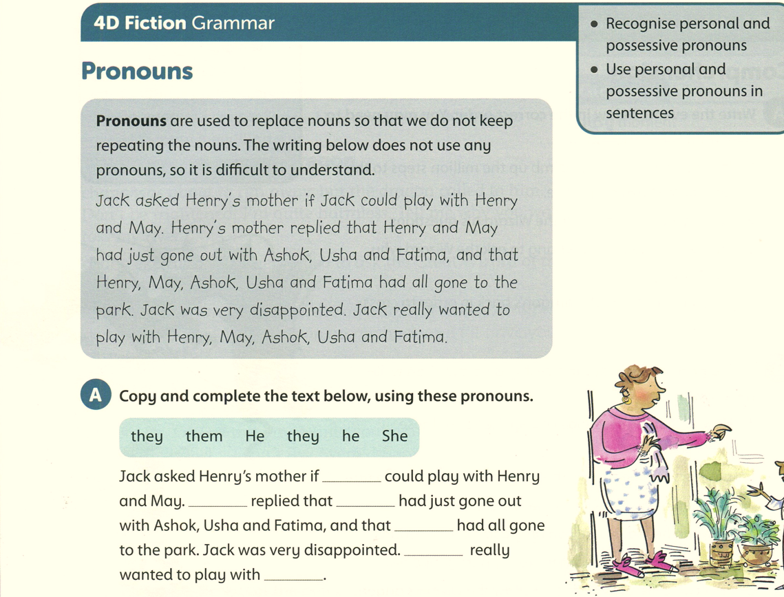
Student’s book 62

Slide 3
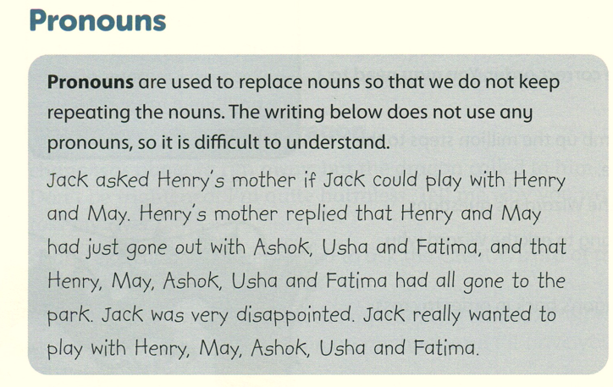
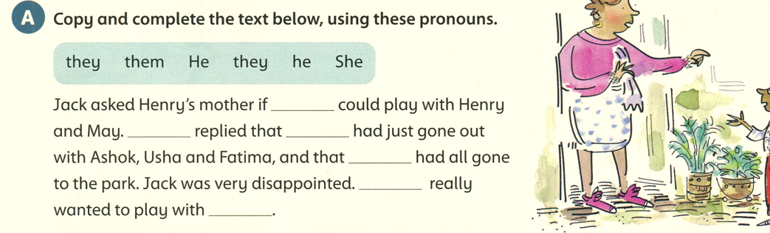
Student’s book 62
he
She
they
they
He
them

Slide 4
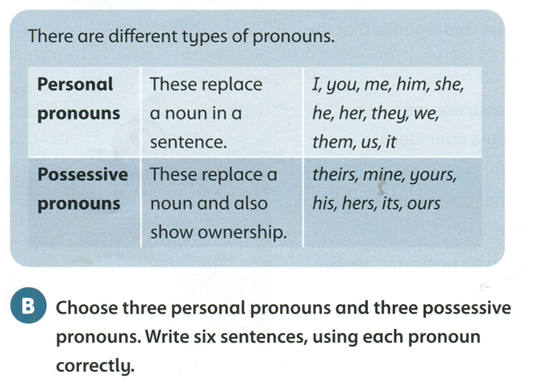

Slide 5

I, you, me, him, he, it, them ( personal pronouns)
His ( possessive pronoun)

Slide 6
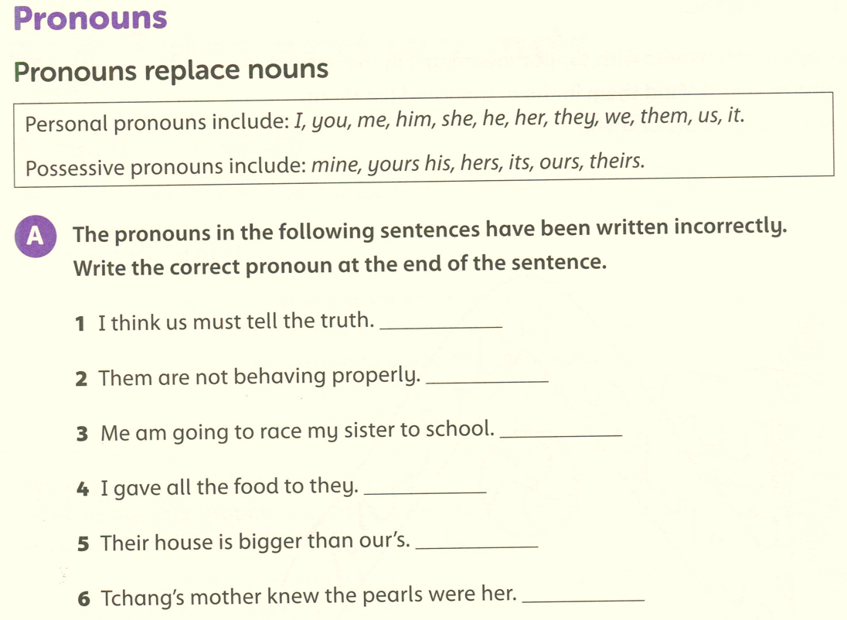
Workbook page 30
we
they
I
them
ours
hers

Slide 7
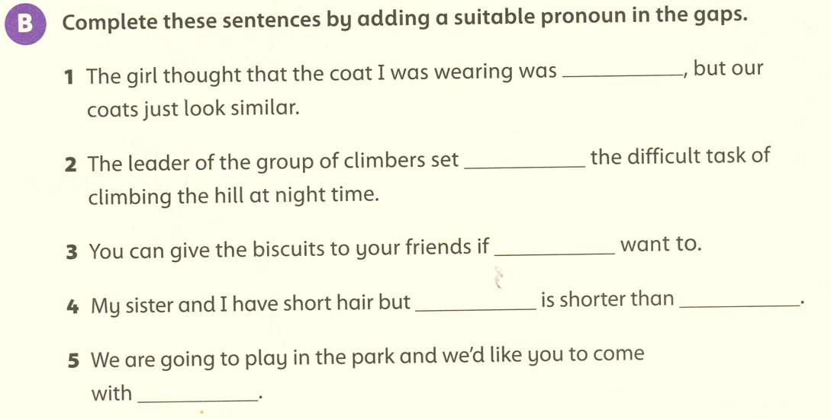
Workbook page 30
hers
himself
you
hers
mine
us

Slide 8
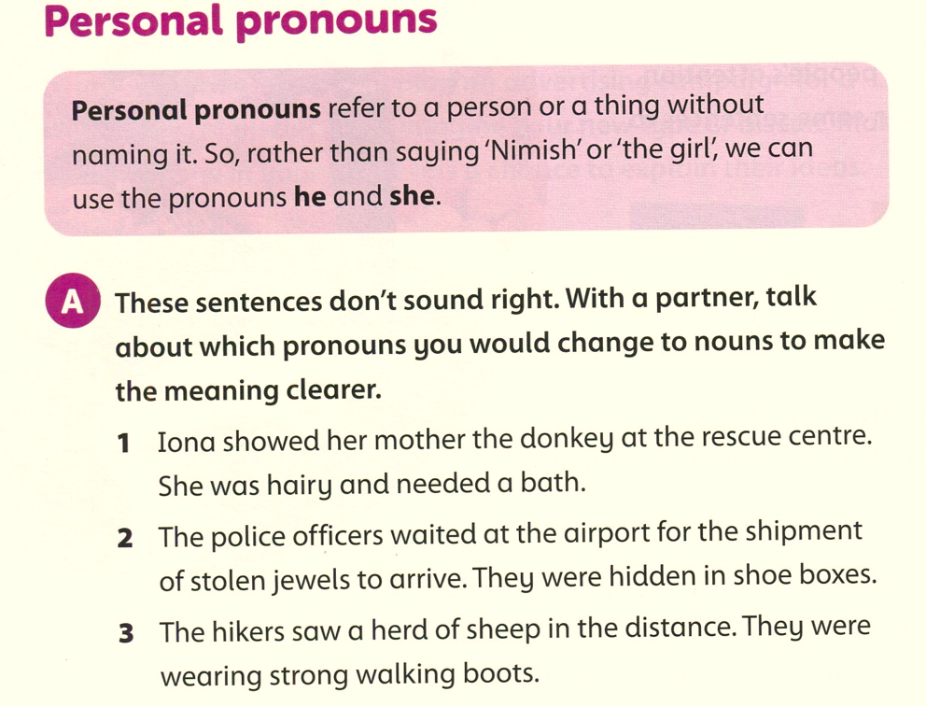
Student’s book page 138
The donkey
The jewels
The hikers

Slide 9
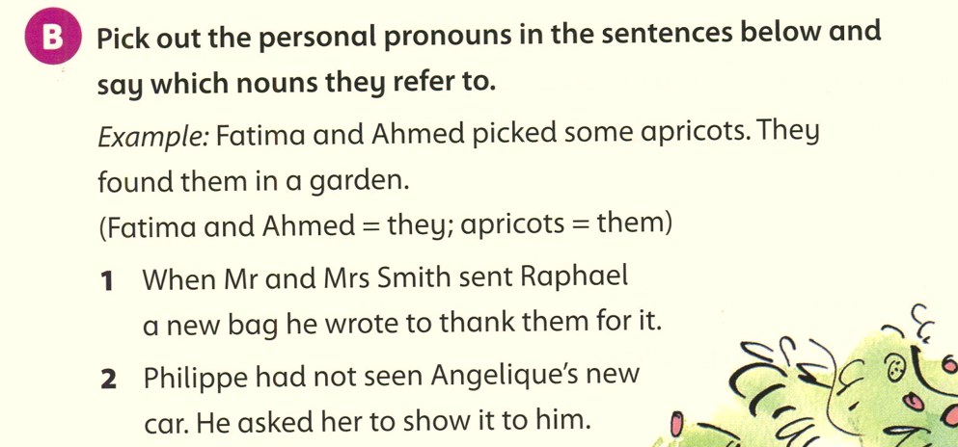
Student’s book page 138
bag
Raphael
Mr and Mrs Smith
Philippe
Angelique
Philippe
car

Slide 10
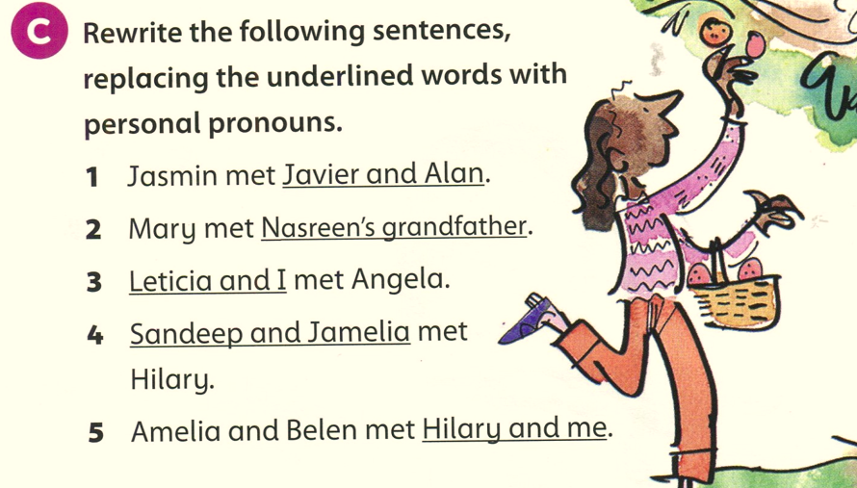
them
him
we
they
us

Slide 11
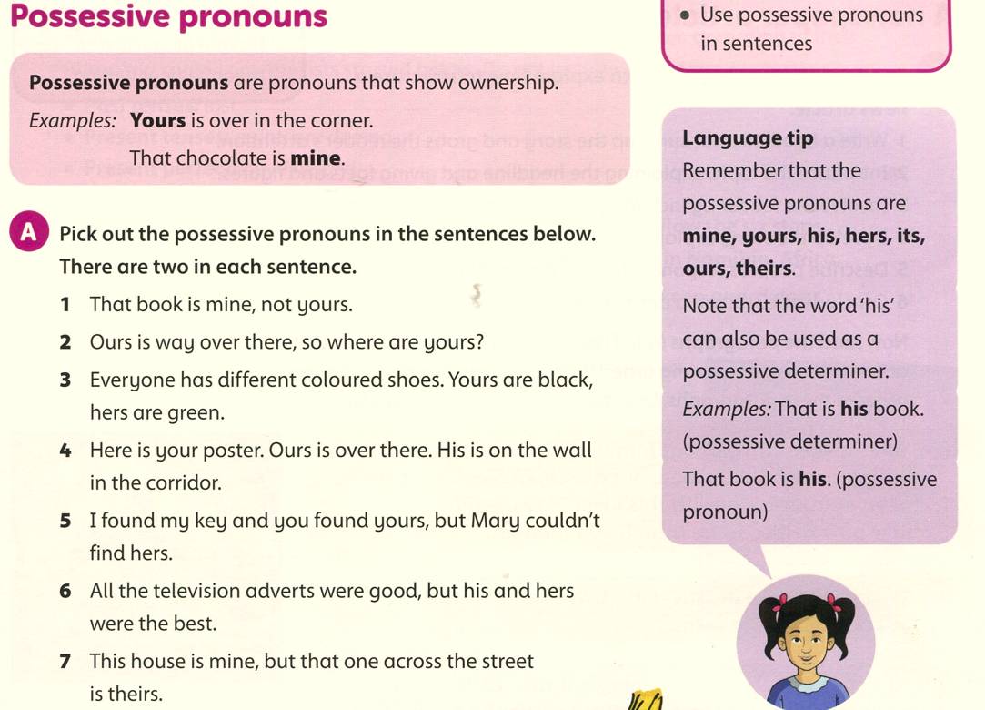
Student’s book page 139

Slide 12
Student’s book page 139

