Slide 1
Magnetism

Slide 2
What Is a Magnet?
A magnet is a metal which attracts or repels other materials. A magnet is made from iron, nickel, steel or cobalt. A magnet has a north end and a south end.
When a magnet attracts another material, there is a pulling force between the two objects.
When a magnet repels another material, there is a pushing force between the two objects. If you observe an object being attracted to a magnet, this is magnetism.
Using two bar magnets, see what happens when you put the two blue ends together, the two red ends together and then a blue and a red end together.
Can you think of any magnets used at home?
Think about it!
Have a Go!

Slide 3
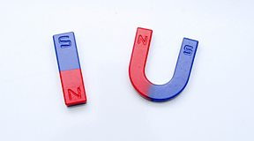
Permanent magnets can come in lots of different shapes and sizes. Bar magnets and horseshoe magnets are two of the most common shapes of magnet.
- One of the most important features of a permanent magnet, whatever shape it is, is that it has two different ends. These ends are called . There is a north (N) pole and a south (S) pole.
The magnetic effect is the strongest at the poles.

Slide 4
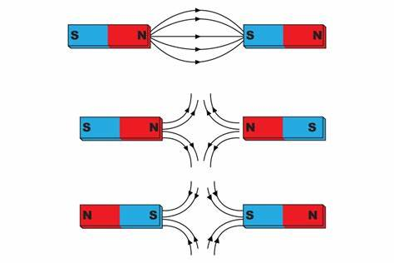
Different poles attract.
Alike poles repel.
Alike poles repel.

Slide 5
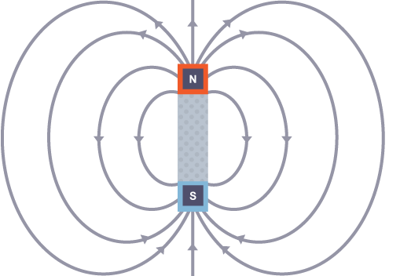
A magnetic force can be either an attraction or a repulsion
The region around a magnet where a force can be felt is called the magnetic field. If enter this region, they will be attracted to the magnet.
The magnetic field of a magnet is shown
by lines with arrows that point from North
to South.

Slide 6
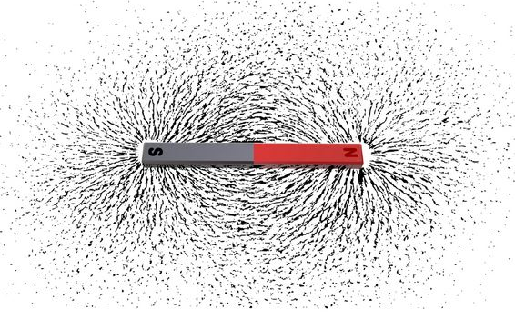
Magnetic materials: Magnetic materials are materials that feel a force from a magnetic field. If you bring a magnet and a magnetic material together they will pull towards each other, or attract. The attraction gets stronger as the a magnetic material gets closer. Some materials are magnetic. For example: iron, steel, cobalt, nickel. Lots of metals are not magnetic. For example: copper, aluminium. Materials such as sand, wood and plastic are not magnetic.

Slide 7
Earth acts as a magnet:
Earth acts as a magnet with two poles, and a magnetic field over which exerts magnetic force.
It is because the core of the Earth is made mostly of metal iron.

Slide 8
Permanant magnets:
They are found in hundreds of tools: in toys and different machines, like: magnets on cabinet door, motors of electric trains, credit cards and kitchen tools.
They are also called permanent magnets, they are magnets all the time and keep their magnetism for months or years.

Slide 9
Animals and magnetism
Some animals seem to sense magnetism
They use it to help them navigate, or find their way while migrating.
These include birds like swallows and geese. Large sea mammals like whales and seals. Fish like salmon. Land animals like caribou.
These animals seem to have a built-in compass.

