Slide 10
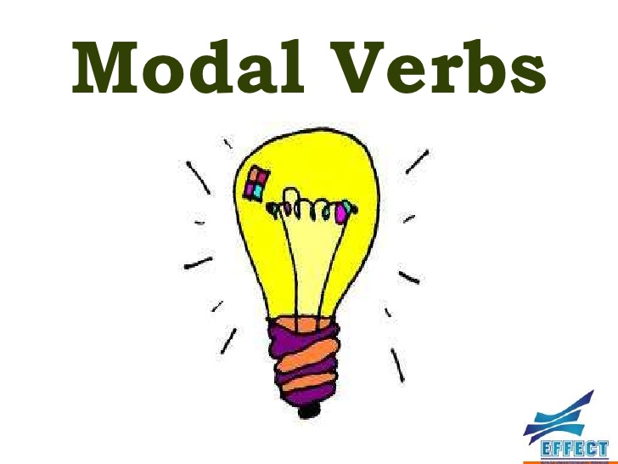
Structure of Modal Verbs
I | Modal Verb (can /should, etc.) | Infinitive (without TO)
You
He
She
It
We
They

Slide 11
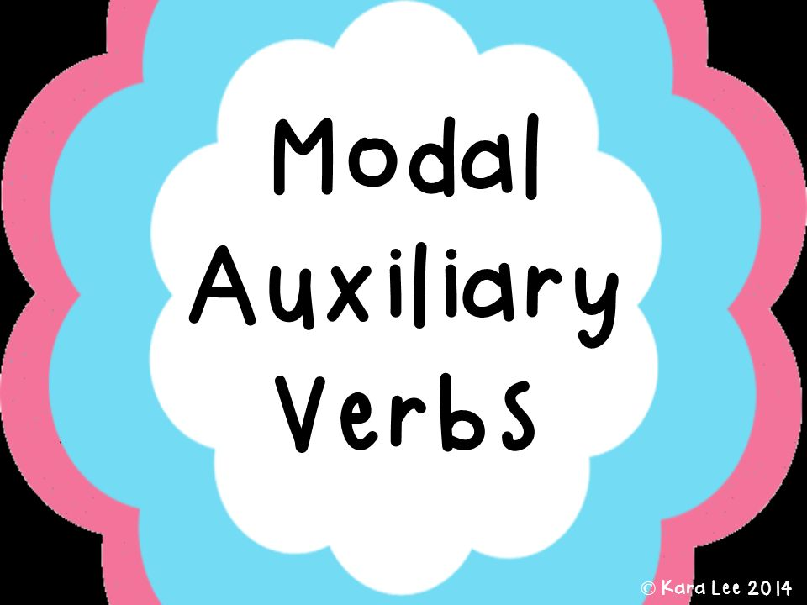
Form
She must study.
He could play football in his youth. (general ability)
We should have gone the other way.
Modal verbs are followed by an infinitive without to

