Slide 1
dad

Slide 2
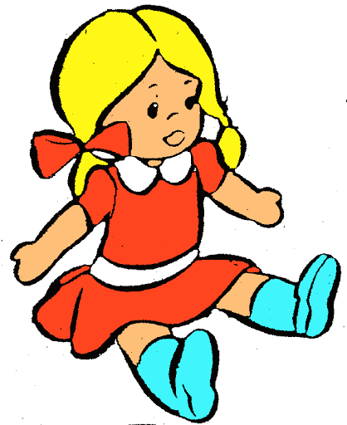
doll

Slide 3
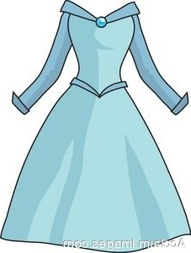
dress

Slide 4
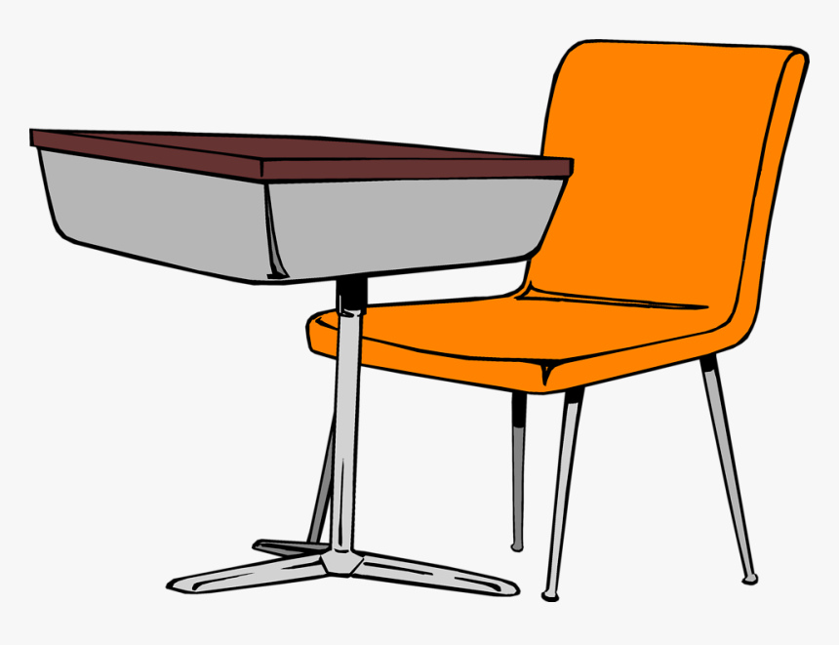
desk

Slide 5
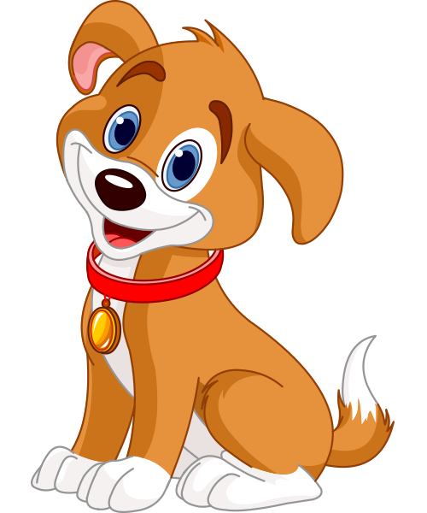
dog

Slide 6
drum

Slide 7
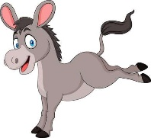
donkey

Slide 8
dots

Slide 9
dip

Slide 10
pad

Slide 11
din

Slide 12
had

Slide 13
dad

Slide 14
red

Slide 15
add

Slide 16
send

Slide 17
spend

Slide 18
sad

