Slide 1
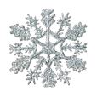

Slide 2
I0
t
e
n

Slide 3
I 2 3 4 5

Slide 4
6 7 8 9 I0

Slide 5
six
nine
three
Zero
two
five
ten
one
seven
five
eight

Slide 6
One more than 7 is
One more than 5 is
One more than 9 is
One more than 0 is
One more than I is
8
6
I0
I
2

Slide 7
4 + 5 =
9

Slide 8
5 + 5 =
I0

