Slide 1
Daily message
Today, we are going to read a new page from the story (Zack).

Slide 2
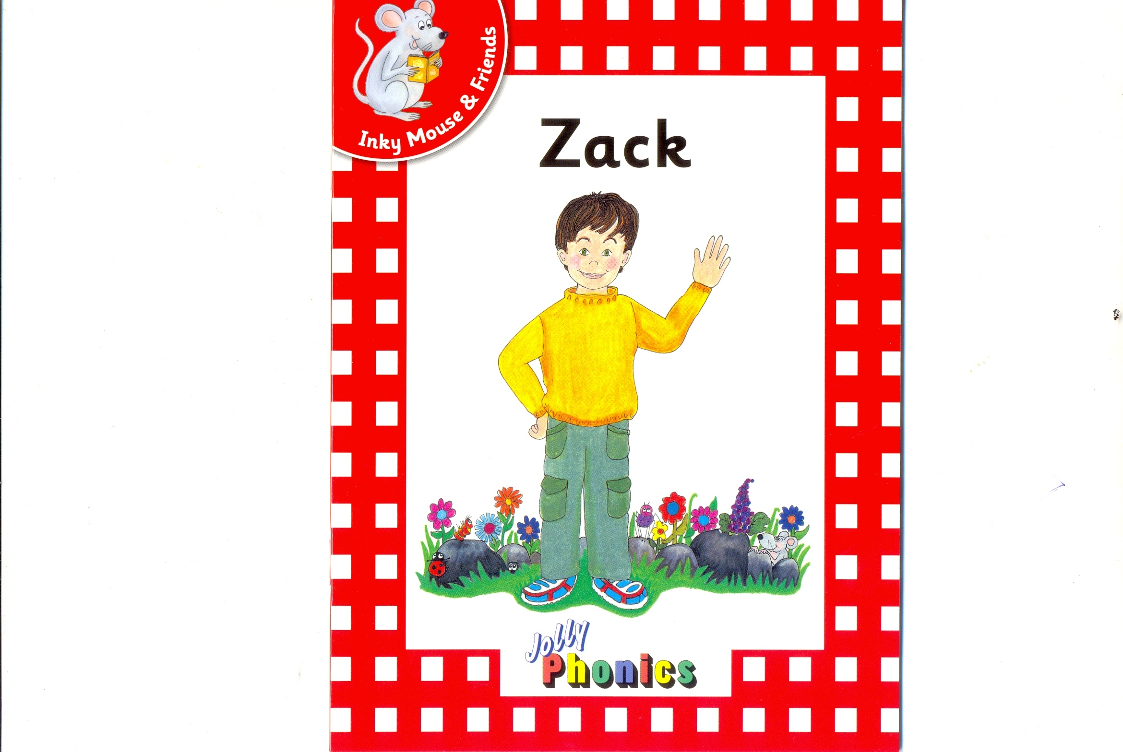

Slide 3
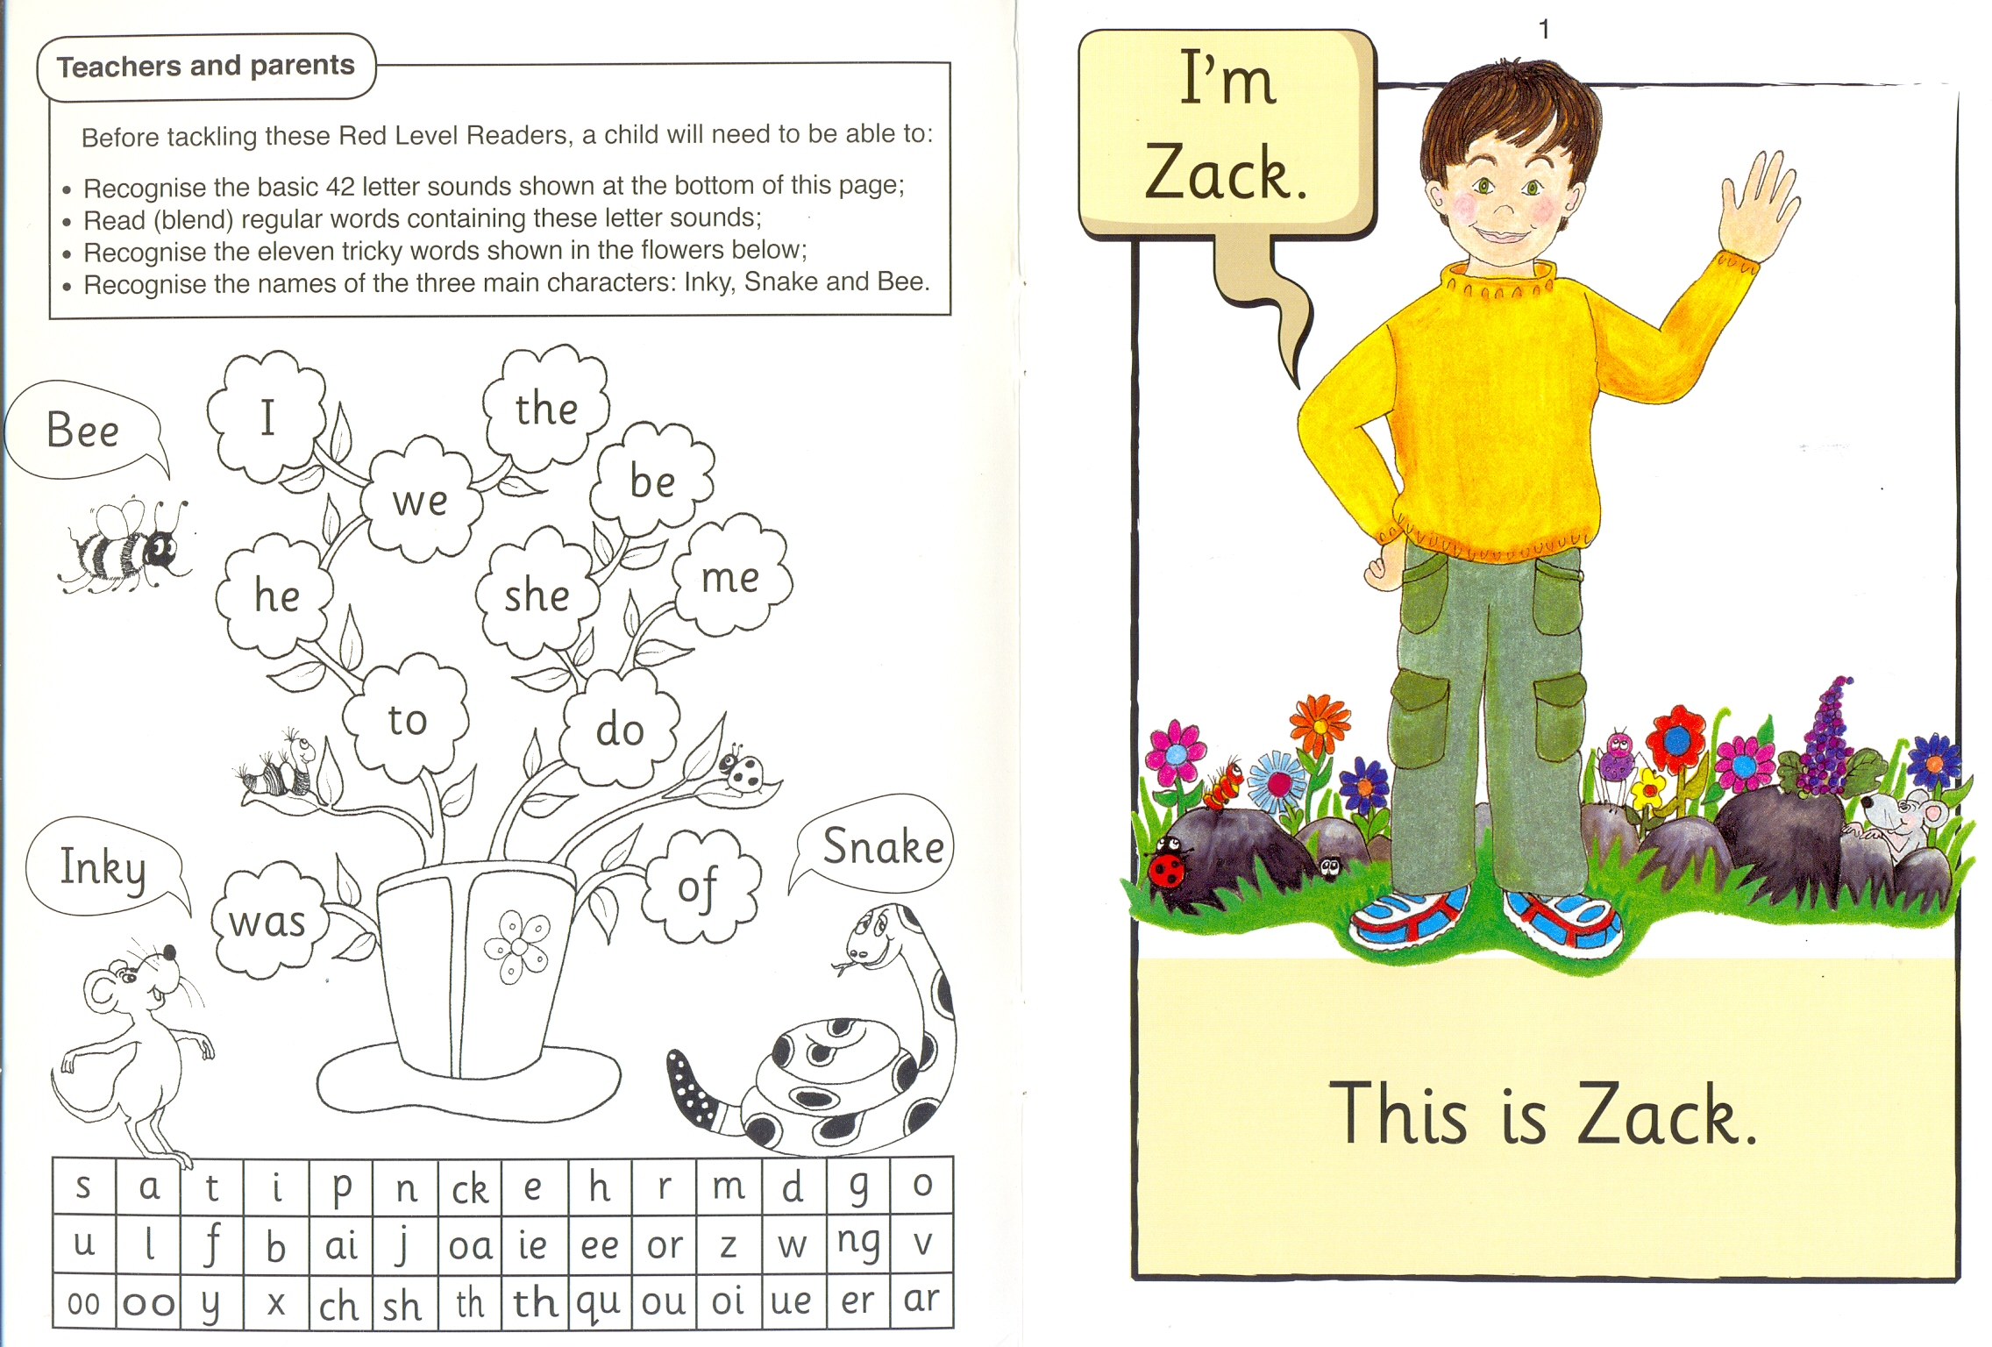

Slide 4
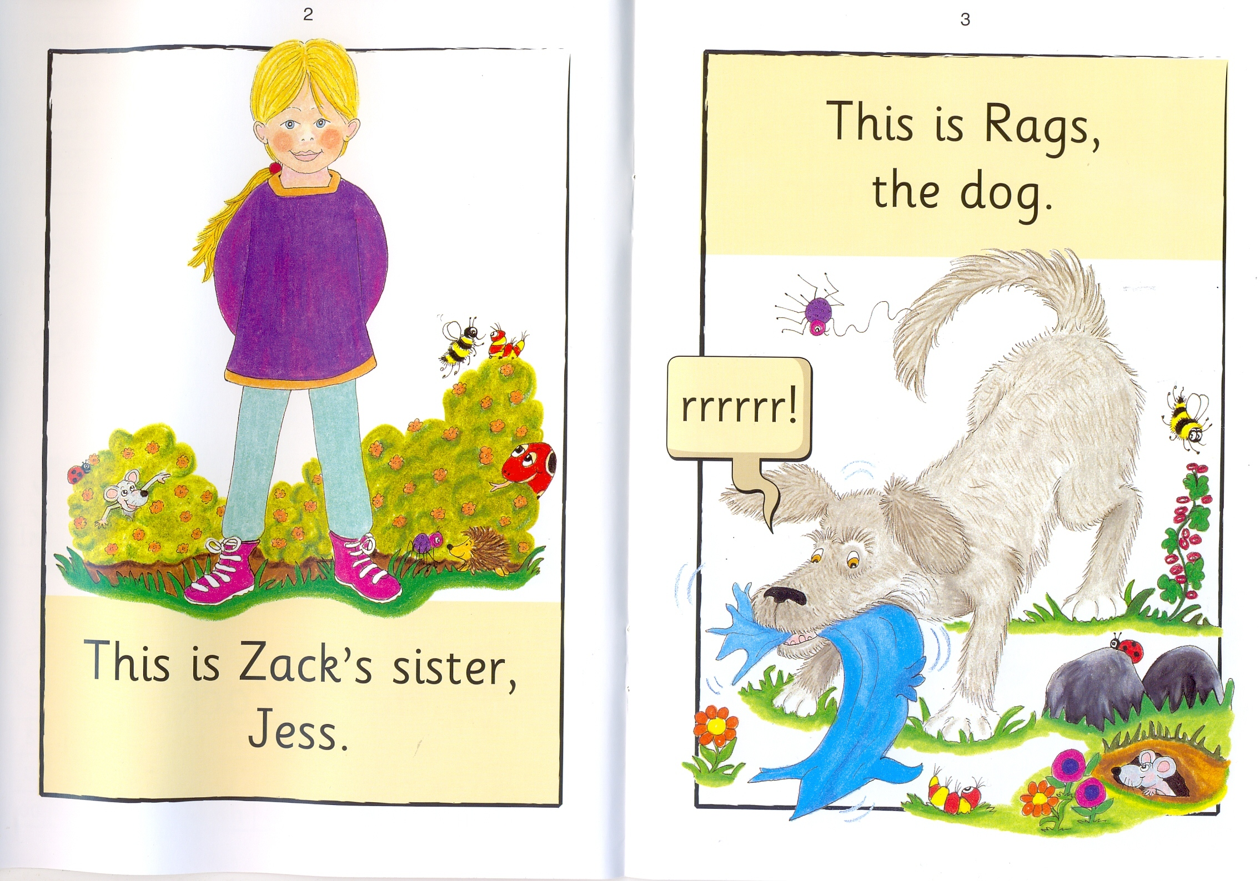

Slide 6
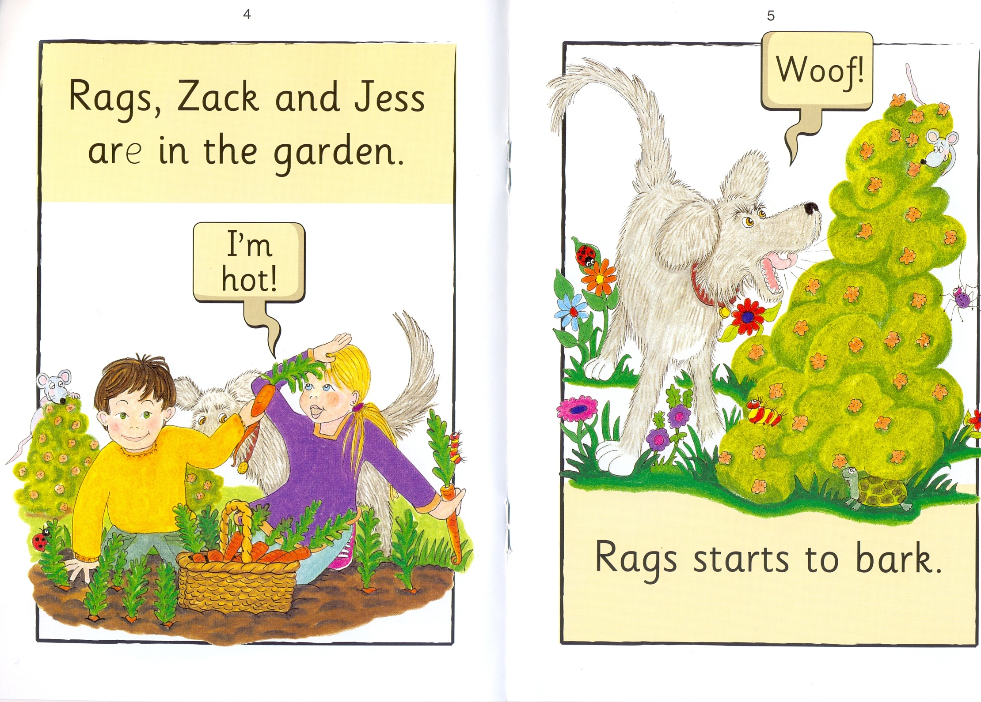

Slide 8
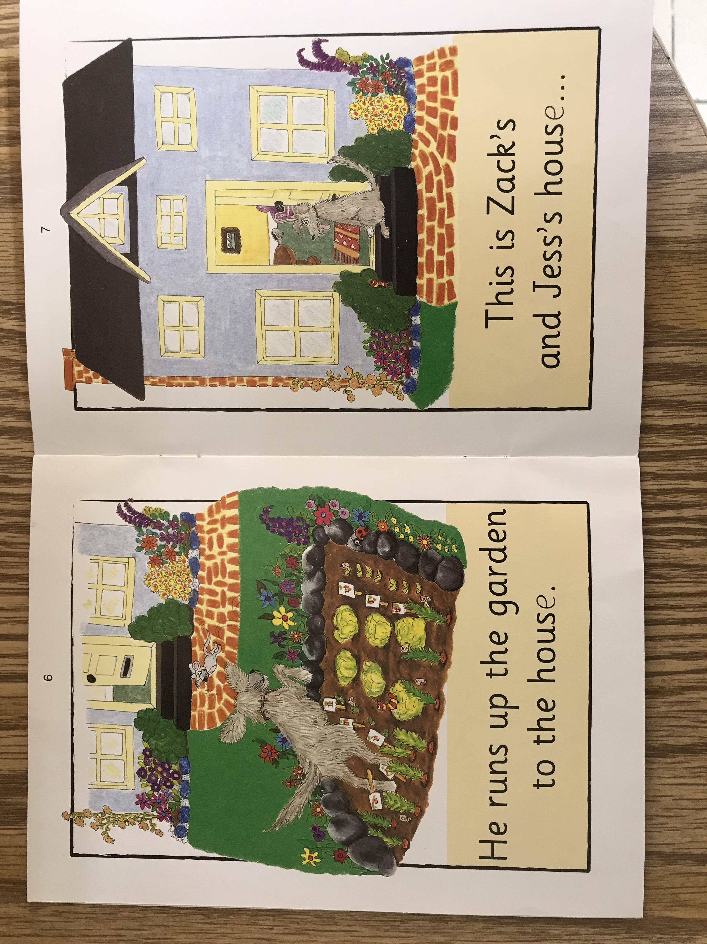

Slide 10
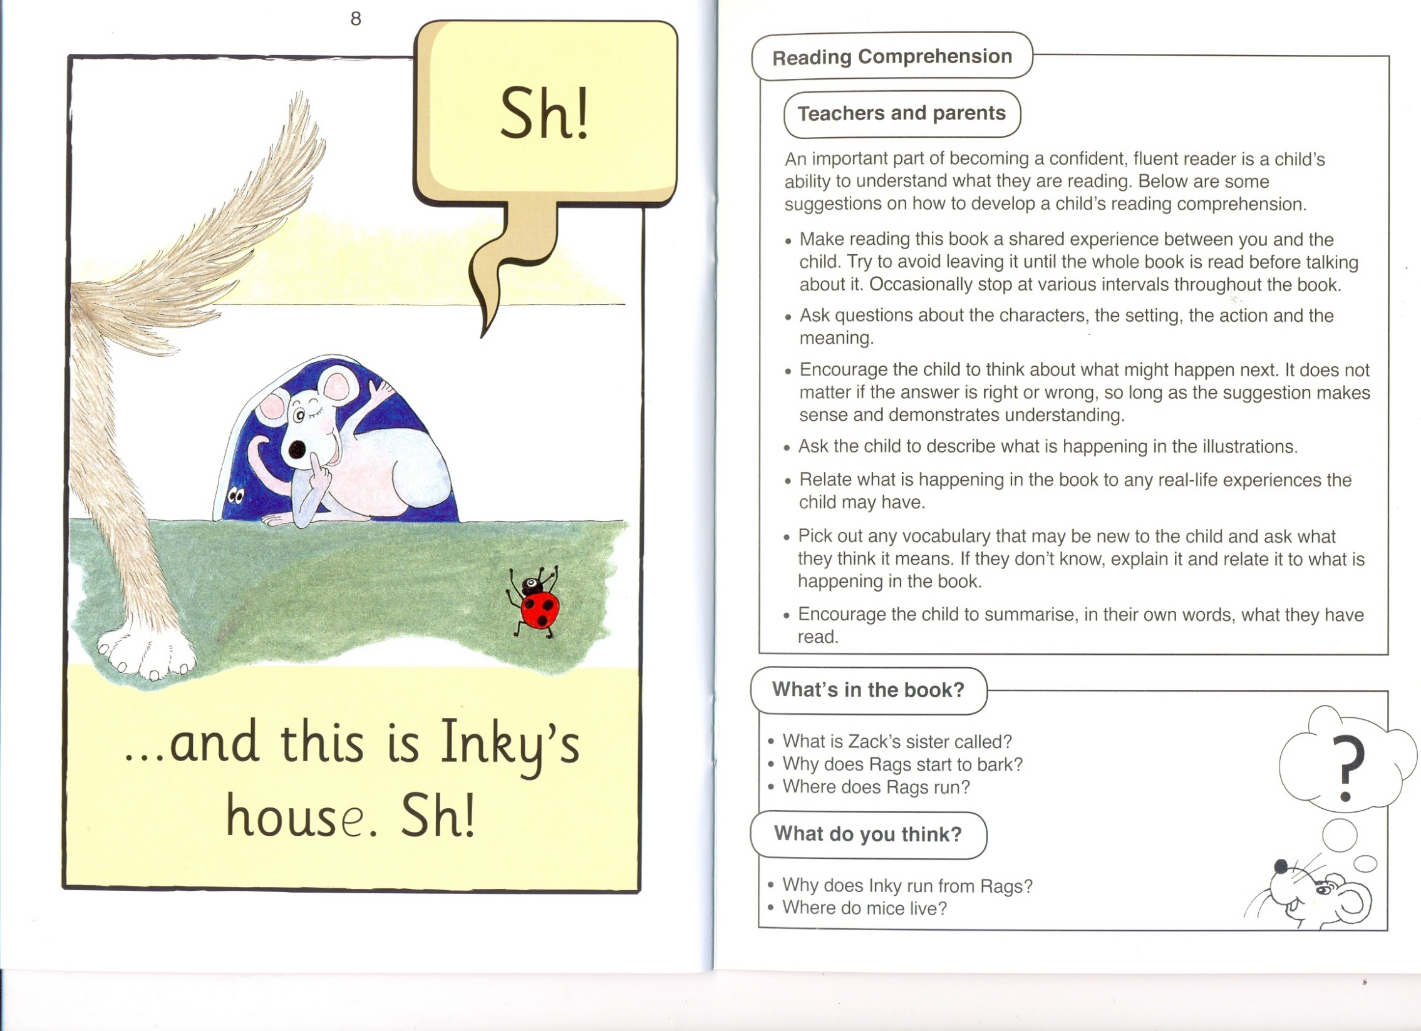

Slide 11
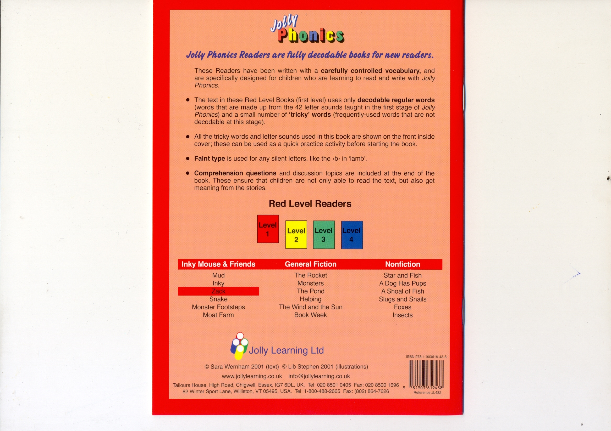

Slide 12

Zack

Slide 13
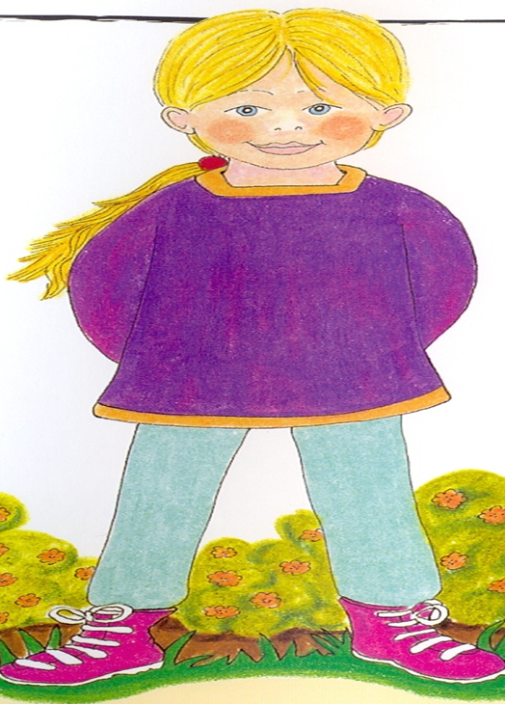
Jess

Slide 14
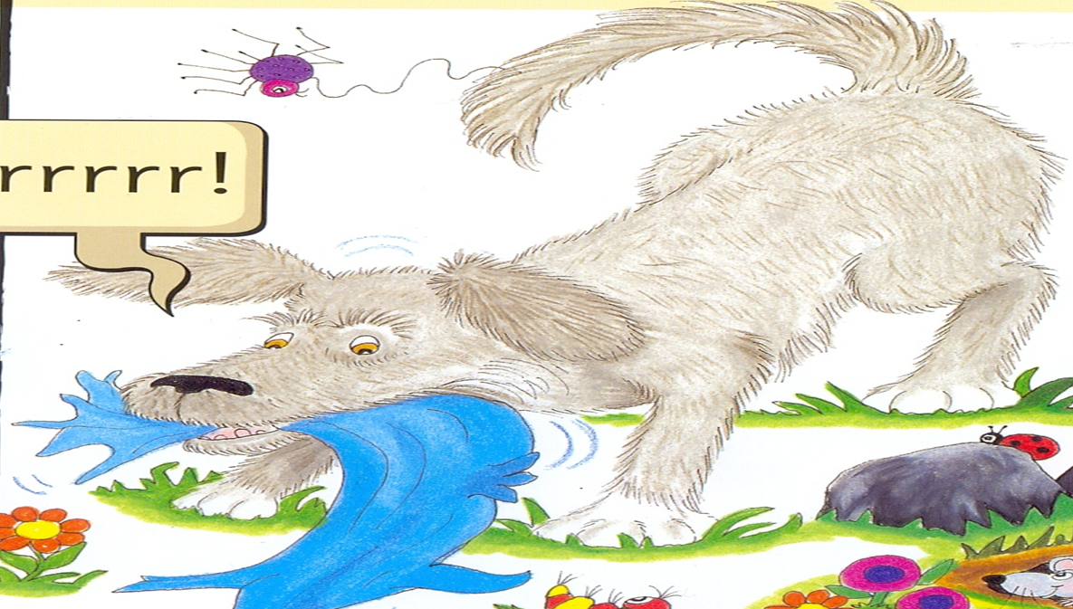
Rags

Slide 15
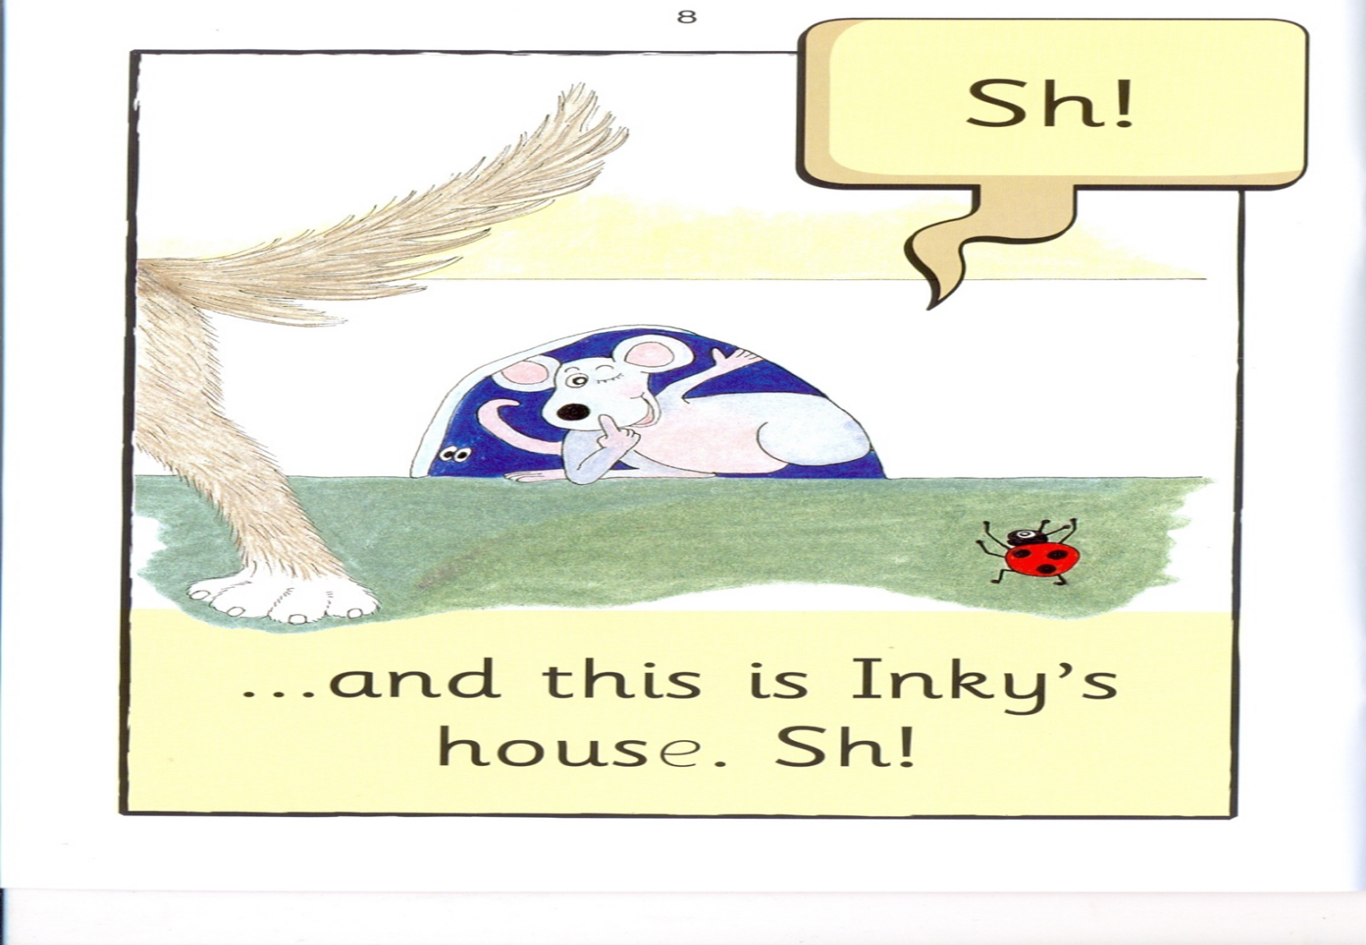
Inky

Slide 16
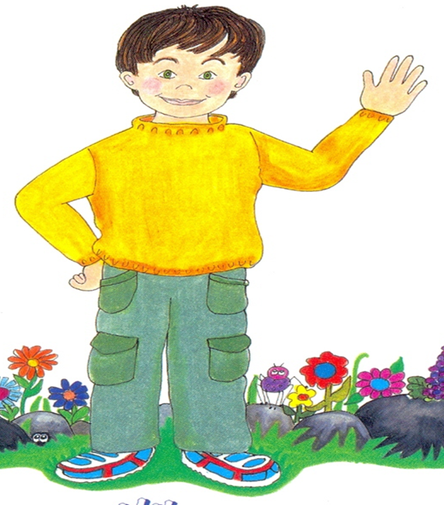

Jess
Zack
Inky
I 2 3

Slide 17
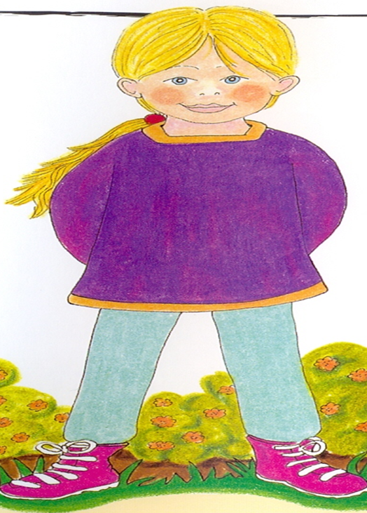
Rags
Jess
Zack
I 2 3

Slide 18
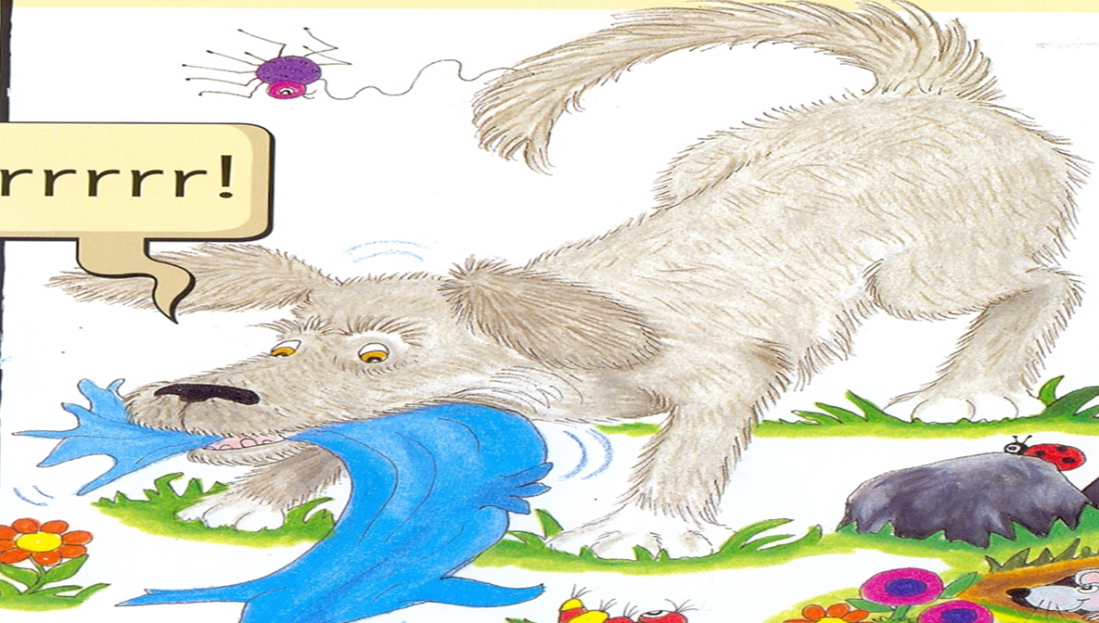
Zack
Rags
Inky
I 2 3

Slide 19
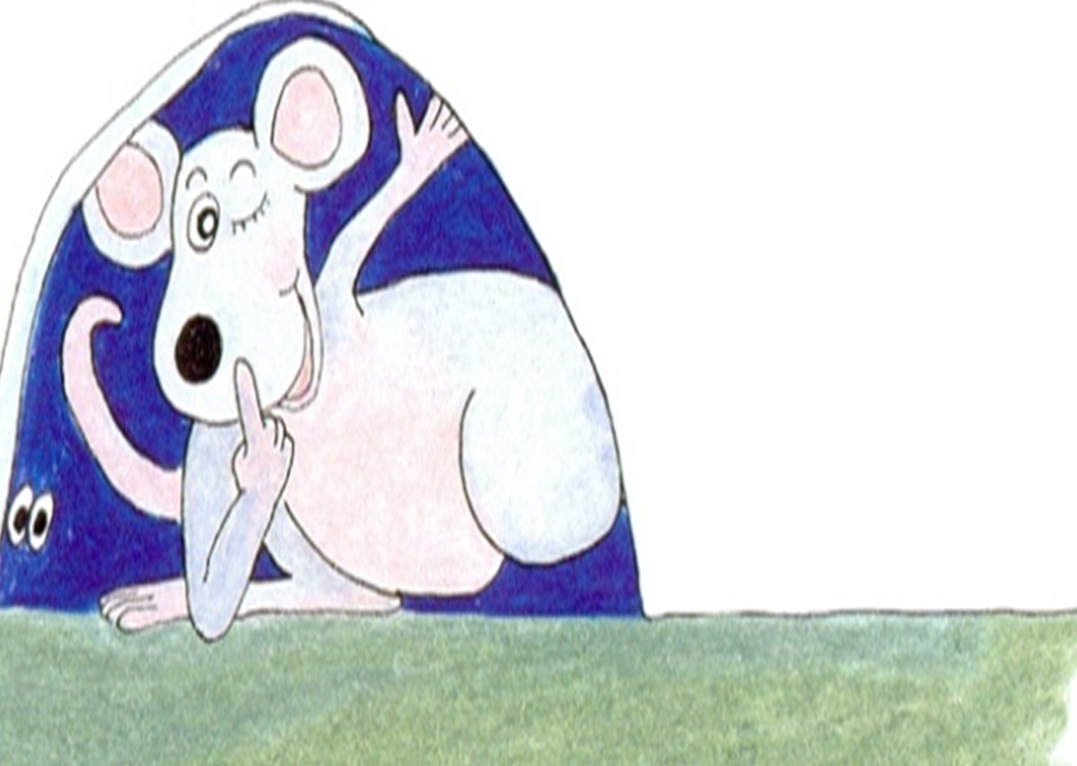
Inky
Zack
Jess
I 2 3

Slide 20


is
This
2
I

Slide 21

sister
Rags
I 2

Slide 22

is
sister

Slide 23

the
dog
I 2

Slide 24

hot
garden

Slide 25

starts
bark

Slide 26
starts
woof

Slide 27
Zack
I`m
This
the
I 2 3 4
Jess
is
sister
dog
5 6 7 8

Slide 28
and
in
garden
9 I0 II
hot
starts
bark
woof
I2 I3 I4 I5

Slide 29
I`m Zack.
This is Zack.

Slide 30
This is Zack`s sister, Jess.

Slide 31
This is Rags the dog.

Slide 32
Rags, Zack and Jess are in the garden.
I`m hot.

Slide 33
Rags starts to bark .
woof

