Slide 1
Daily message
Today, we are going to read a new page from the story (Zack).

Slide 2
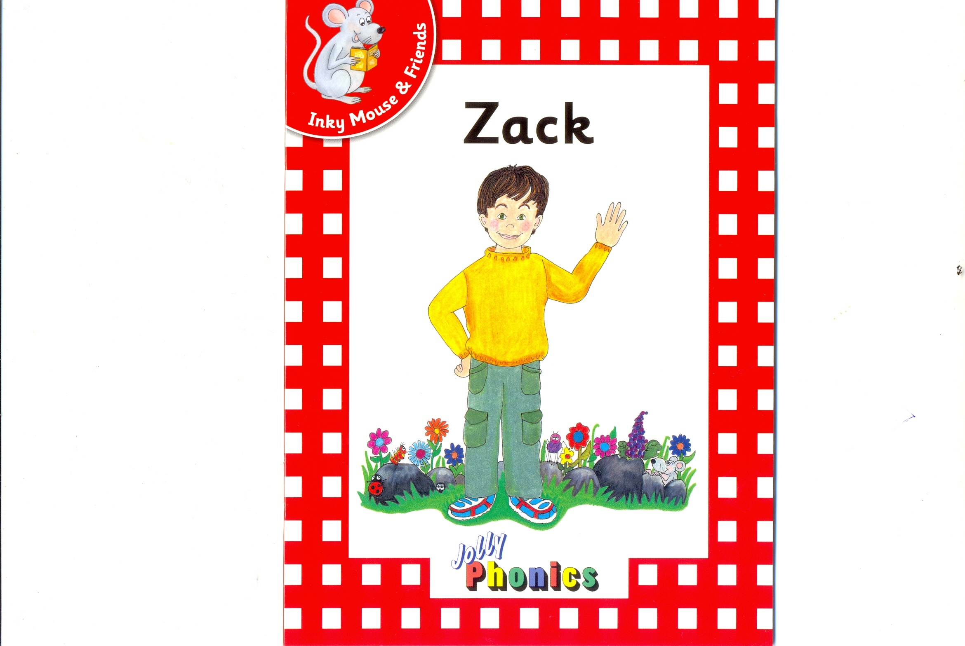

Slide 3
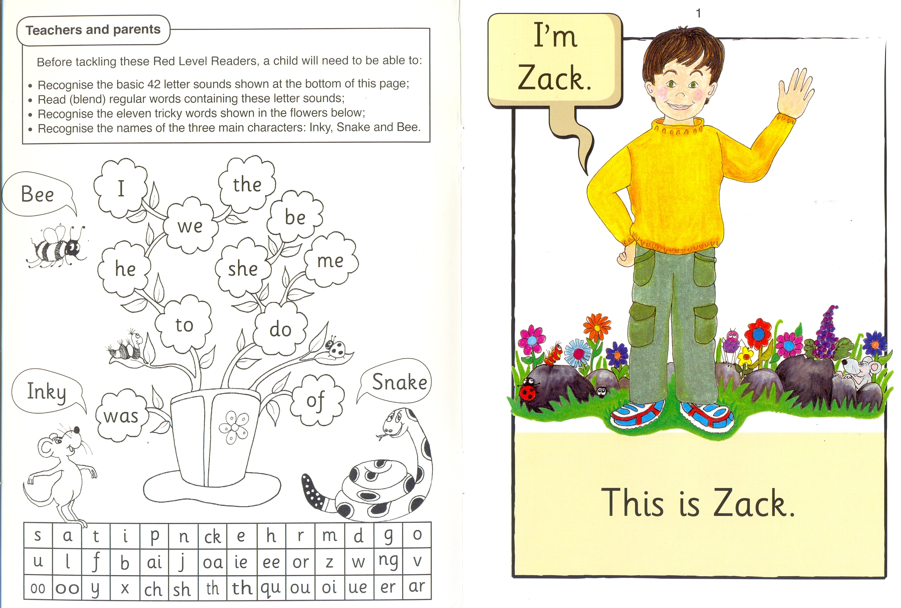

Slide 12
Zack

Slide 13
Jess

Slide 14
Rags

Slide 15
Inky

Slide 16
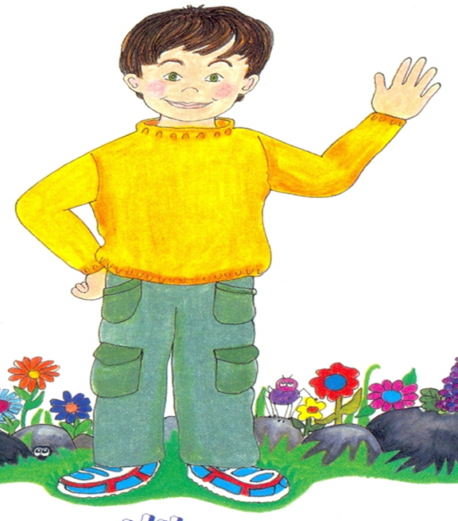
Jess
Zack
Inky
I 2 3

Slide 17
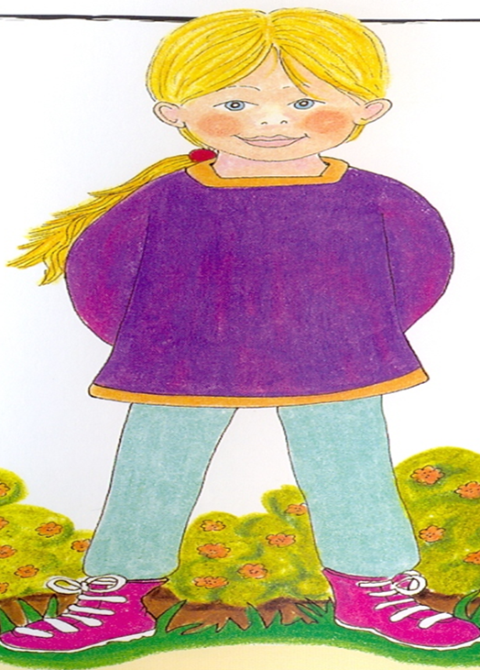
Rags
Jess
Zack
I 2 3

Slide 18
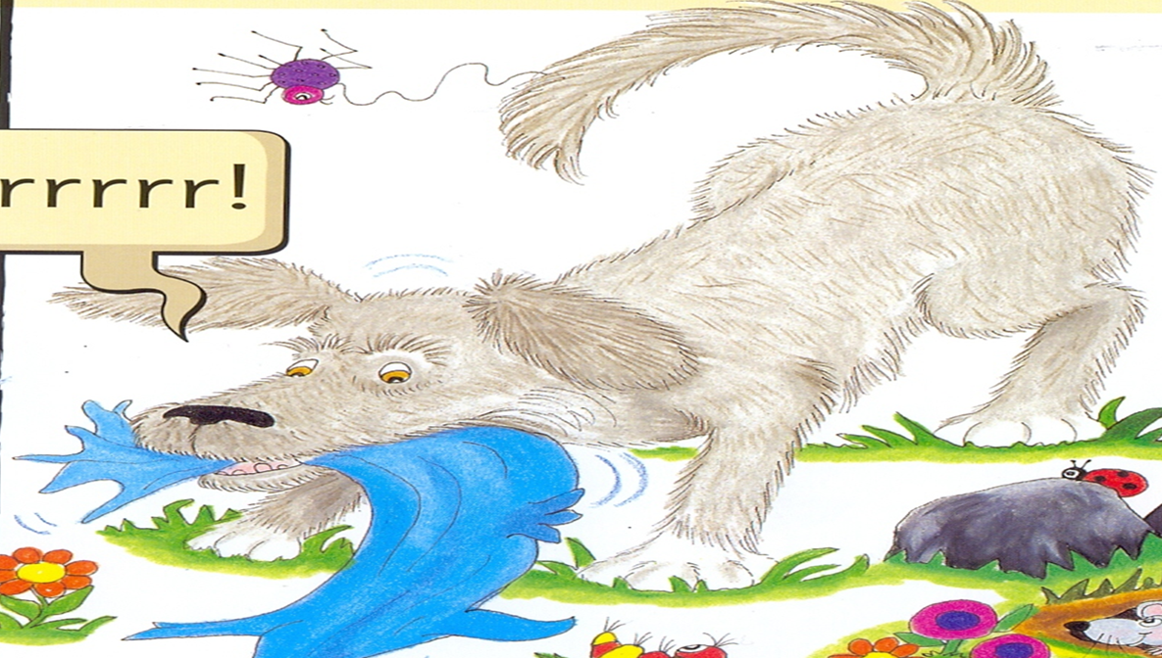
Zack
Rags
Inky
I 2 3

Slide 19
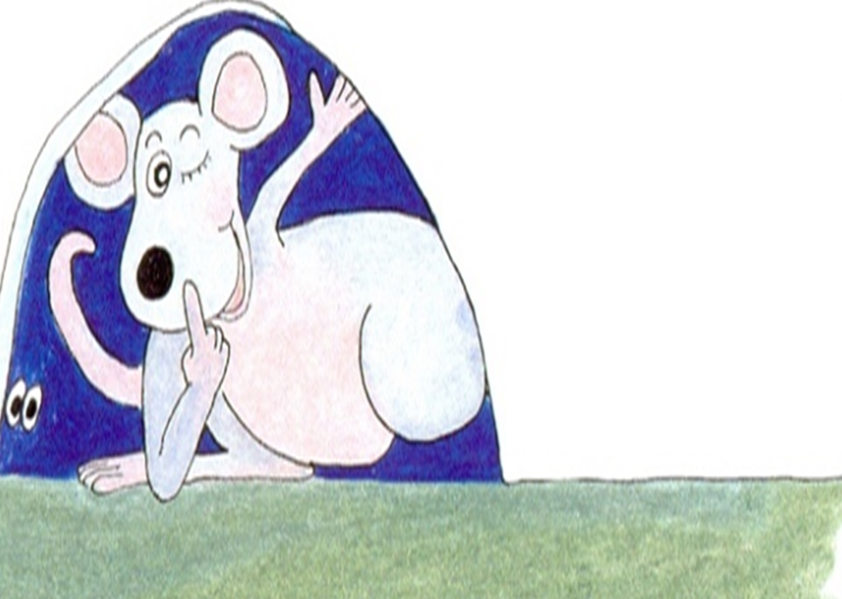
Inky
Zack
Jess
I 2 3

Slide 20
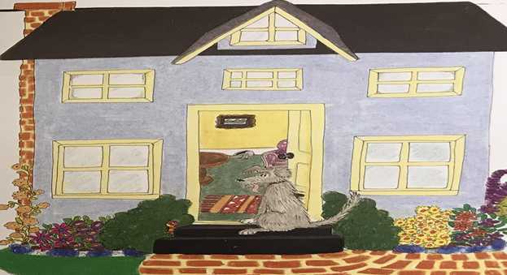
house

Slide 21
garden

Slide 22
is
This
2
I

Slide 23
sister
Rags
I 2

Slide 24
is
sister

Slide 25
the
dog
I 2

Slide 26
hot
garden

Slide 27
starts
bark

Slide 28
starts
woof

Slide 29
runs
up

Slide 30
He
house

Slide 31
to
the

Slide 32
Zack
I`m
This
the
I 2 3 4
Jess
is
sister
dog
5 6 7 8

Slide 33
and
in
garden
9 I0 II
hot
starts
bark
woof
I2 I3 I4 I5

Slide 34
runs
up
he
I6 I7 I8
to
the
house
I9 20 2I

Slide 35
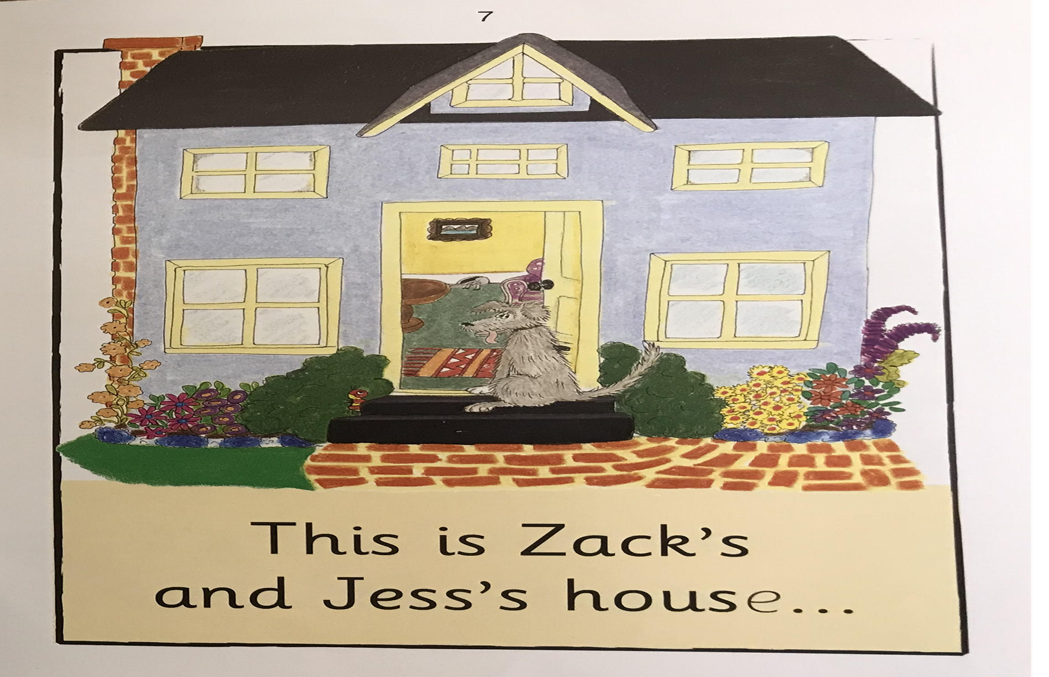
This is Zack.
This is Zack`s house.

Slide 36
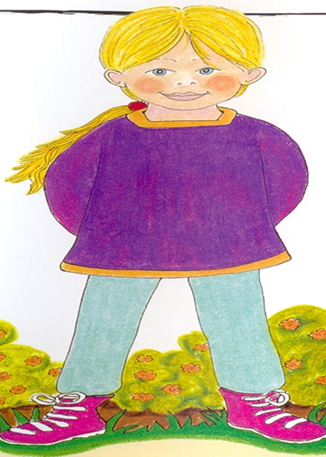
This is Jess.
This is Jess`s house.

Slide 37
I`m Zack.
This is Zack.

Slide 38
This is Zack`s sister, Jess.

Slide 39
This is Rags the dog.

Slide 40
Rags, Zack and Jess are in the garden.
I`m hot.

Slide 41
Rags starts to bark .
woof

Slide 42
He runs up the garden to the house.

Slide 43
This is Zack`s and Jess`s house.
... And this is Inky`s house Sh!

