Slide 1
Workbook page 44

Slide 2
groaned
danced/ skipped
flew
called
ate

Slide 3
The sun winked at me as the day ended.
The flag danced in the wind.
The sun played hide and seek with the clouds.
The leaves whispered to each other.

Slide 4
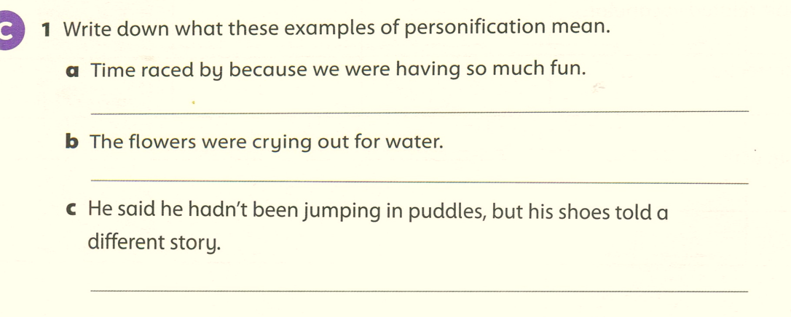
Time went quickly.
The flowers needed water.
His shoes were muddy or wet, so he must have been in puddles.

Slide 5
Work book Page 45
white
hard
light
old
slippery
free

Slide 6
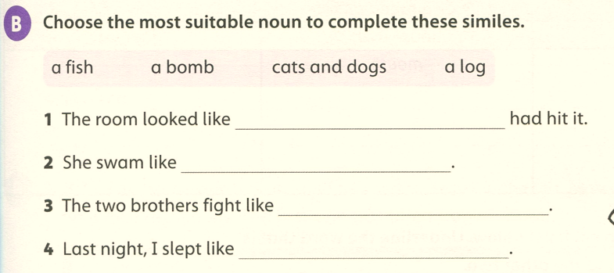
a bomb
a fish
cats and dogs
a log

Slide 7
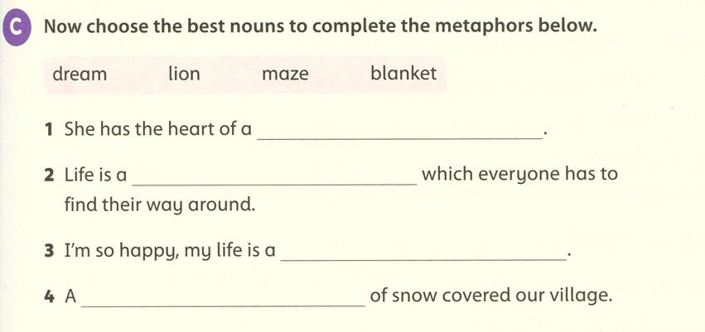
lion
maze
dream
blanket

