Slide 1

Modal Verbs

Slide 2
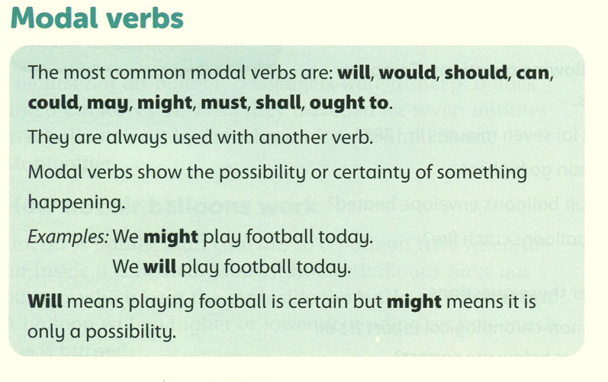

Slide 3
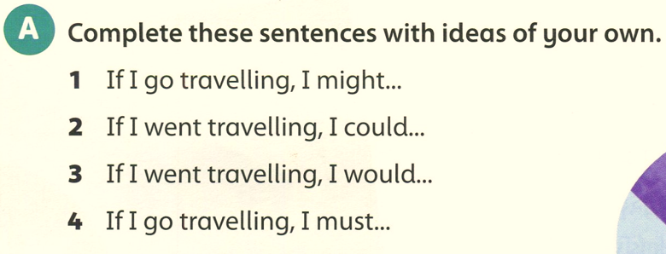
visit Australia.
visit my relatives in Canada.
visit all the capital cities in Europe.
take lots of photographs.

Slide 4
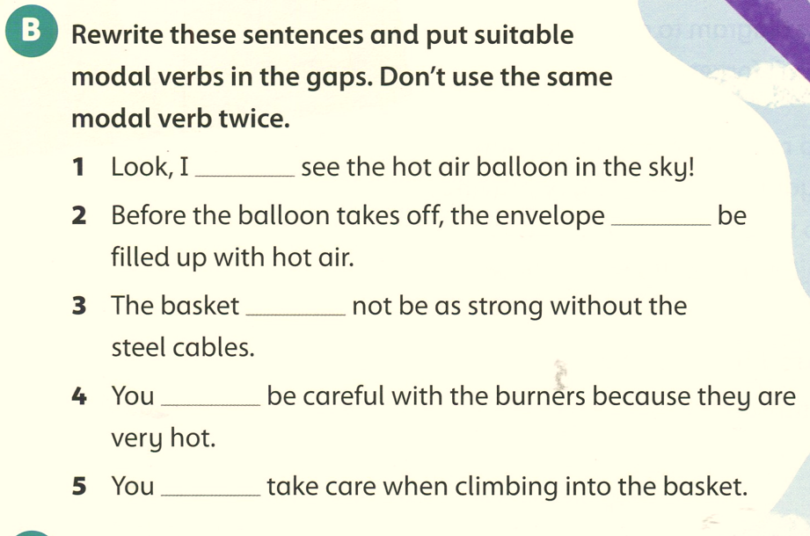
can
must
should
will
would
will
must
ought to should
Should
must
ought to

Slide 5
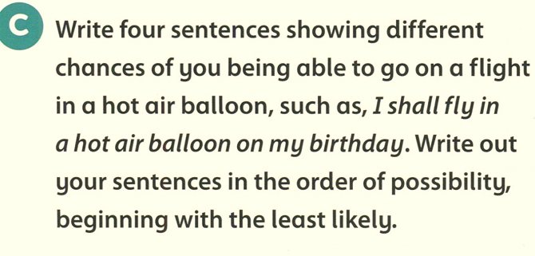
I might/ could/ ought to / will fly in a hot air balloon on my birthday.

Slide 6
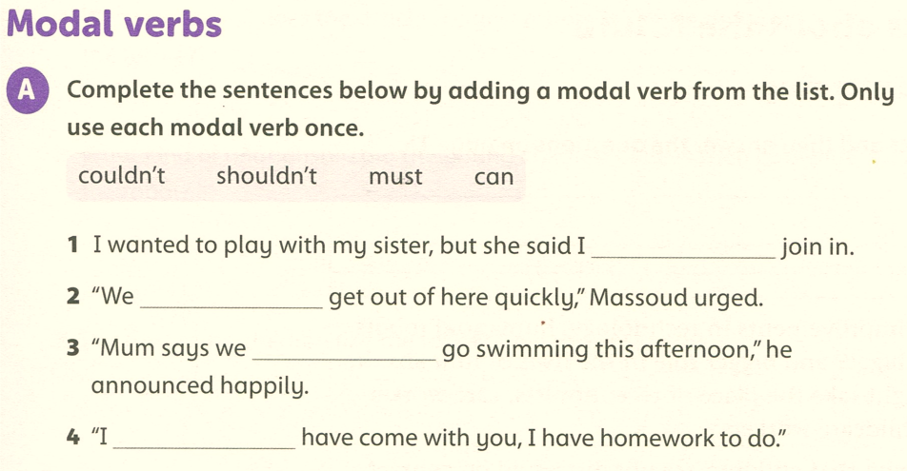
couldn’t
must
can
shouldn’t

Slide 7
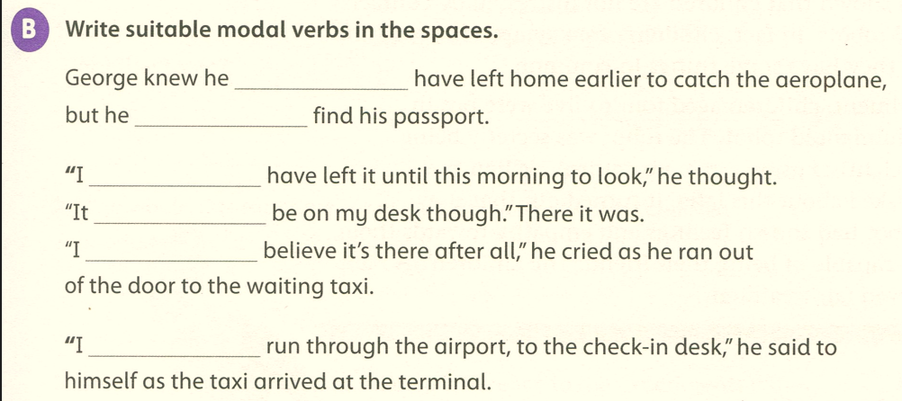
should
couldn’t
shouldn’t
Should/ ought to
can’t
must

Slide 8
