Slide 1
Subordinate clauses and conjunctions

Slide 2
The old man likes to go for a walk when the sun is shining.
When the sun is shining, the old man likes to go for a walk.

Slide 3
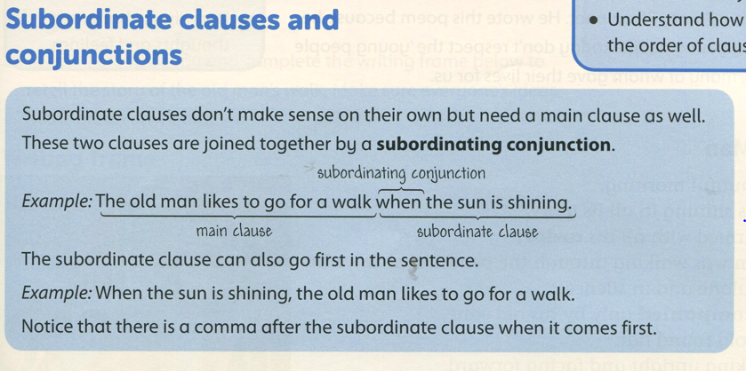

Slide 4
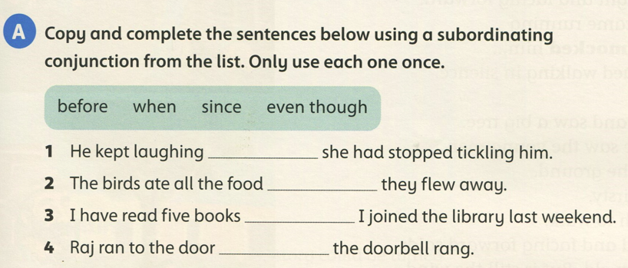
even though
before
since
when

Slide 5
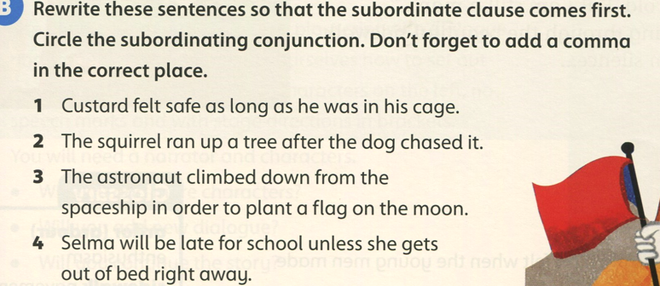
page 103
1- As long as he was in his cage, Custard felt safe.
2- After the dog chased it, the squirrel ran up a tree.
3- In order to plant a flag on the moon, the astronaut climbed down from the spaceship.
4- Unless she gets out of bed right away, Selma will be late for school.

Slide 6
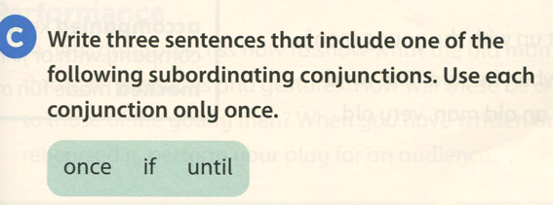
Once he ate the chocolate, he felt a sugar rush.
If it is sunny, we will go to the park.
I will stay in bed until I recover from my illness.

