Slide 1
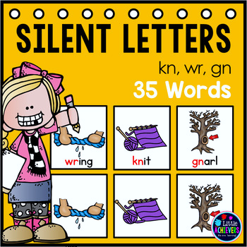
Silent consonants wr/gn/kn
Spelling

Slide 2
Objective:
To be able o read and identify words with the silent letters.

Slide 3
Let’s watch a video about silent letters.
Silent Letters for Kids | Reading & Pronunciation | Kids Academy - YouTube

Slide 4
What is silent letter?
A silent letter is a letter that we write but we do not pronounce it when we read out loud!

Slide 5
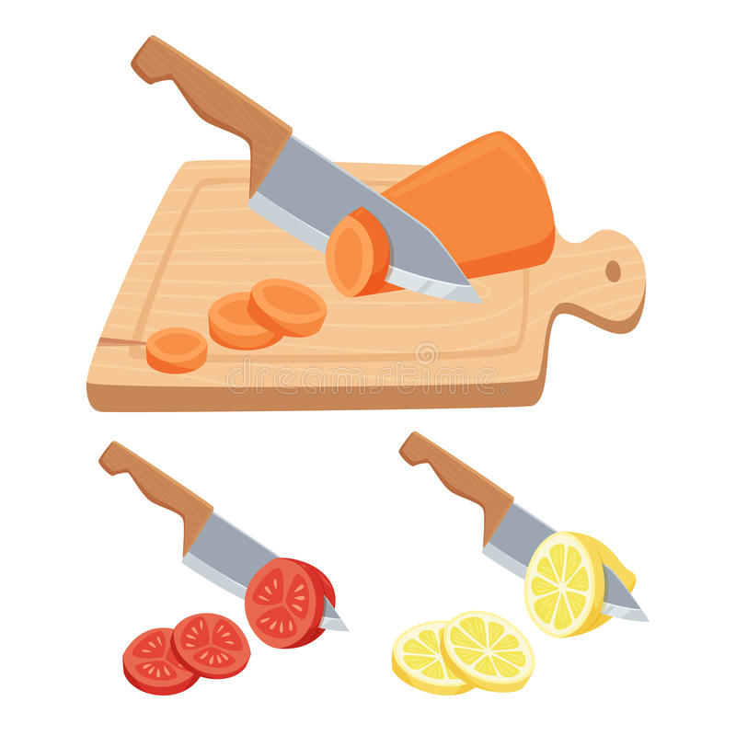
First, let’s take a look at this word, do you notice anything strange about it?
Knife
Usually we begin figuring out a word by looking at the beginning letter but that doesn't work here, this word breaks the rules it is a jail word words like this with a silent letter can be tricky let's look at some more rule breakers.

Slide 6
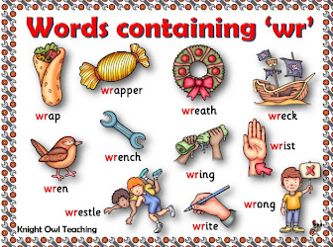
There are a lot of silent letters but for now we will be talking about 3 letters that are silent
The silent /k/
The silent /w/
The silent /g/

Slide 7
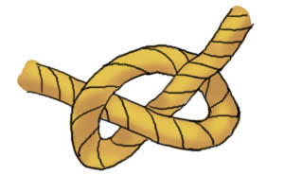
When is the K silent ?
If an there is a /k/ before the /n/ , it is a silent k meaning we do not pronounce it
Examples :
knife
knot
know

Slide 8
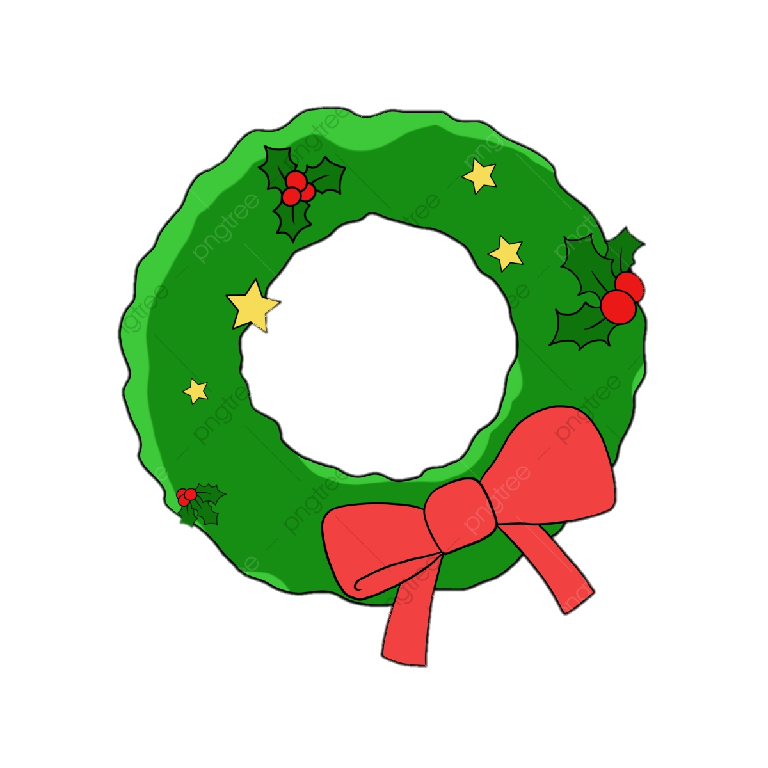
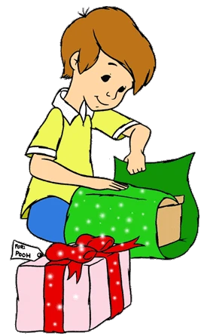
When is the w silent?
If there is a /r/ before the /w/ , it a silent /w/ , meaning we do not pronounce it.
Examples :
wreath
wrap
write

Slide 9
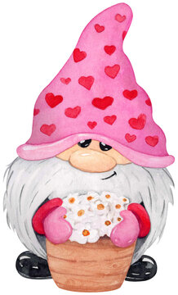
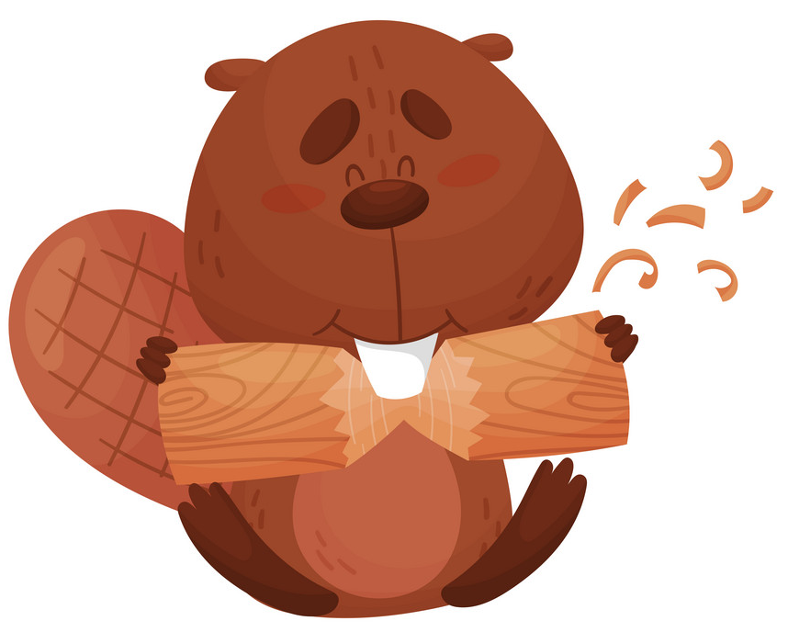
When is the g silent?
If there is a /n/ before the /g/ , it a silent /g/, meaning we do not pronounce it.
Examples :
gnome
gnaw
sign

