Slide 1
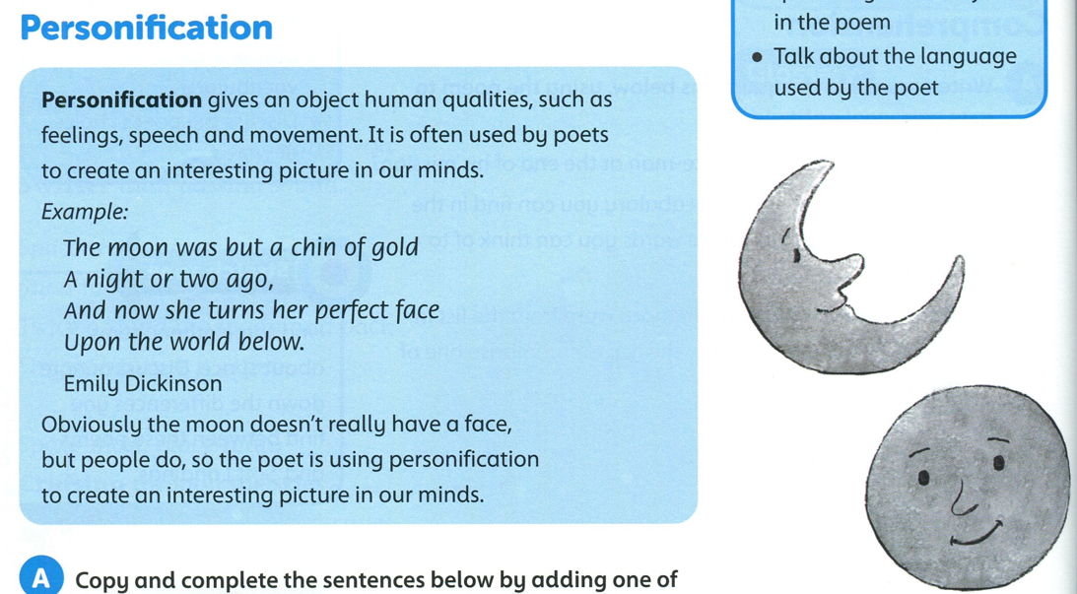
Page 98

Slide 2
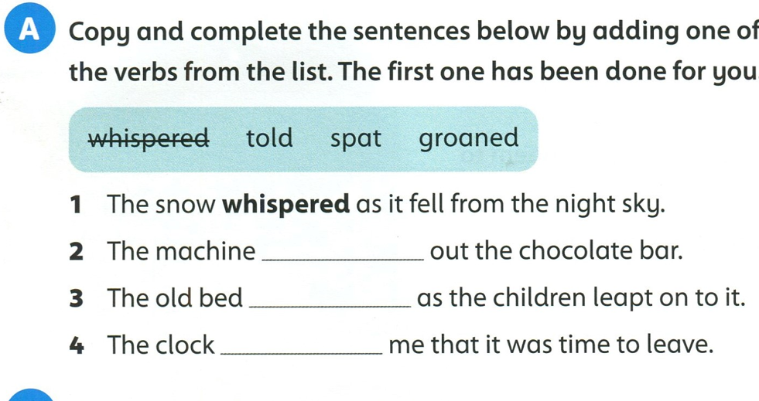
spat
groaned
told

Slide 3
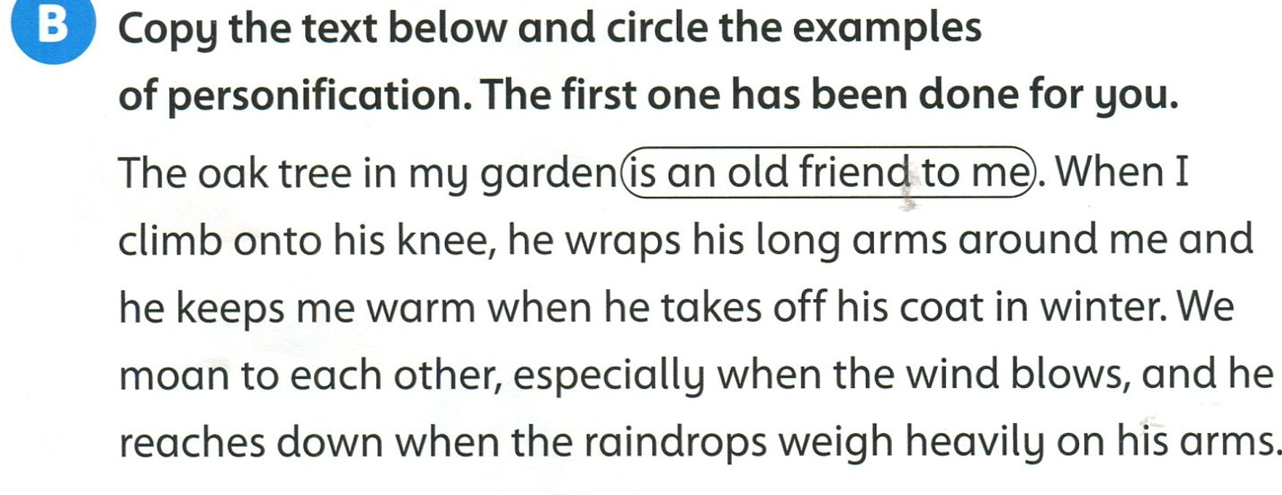

Slide 4
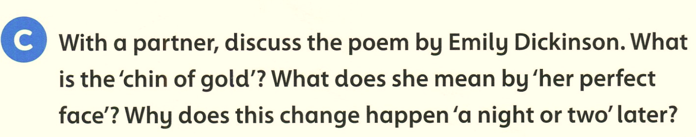
Full moon
Part of the moon before it was full
the moon was full a few days after the chin

Slide 5
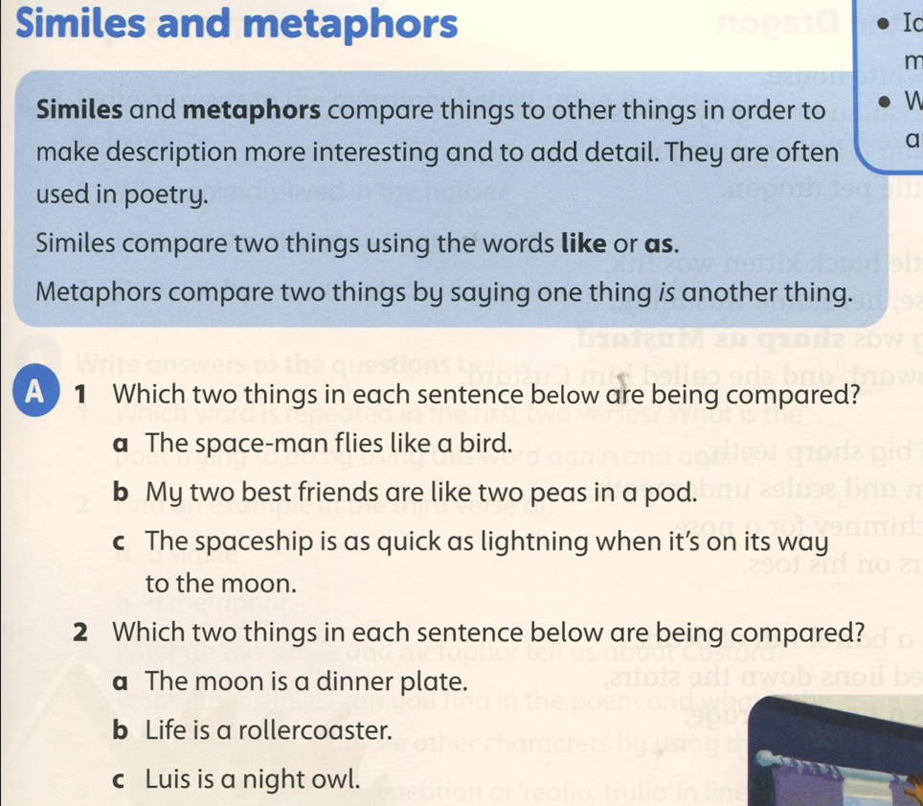
Student’s book Page 99
spaceman, bird
two best friends, two peas in a pod
spaceship, lightning
the moon, dinner plate
life, roller coaster
Luis, owl

Slide 6
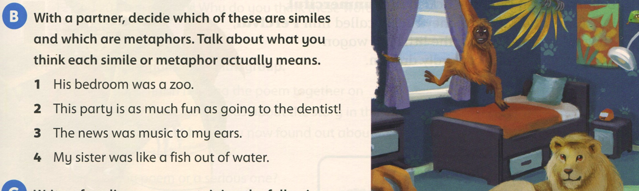
metaphor
simile
metaphor
simile

Slide 7
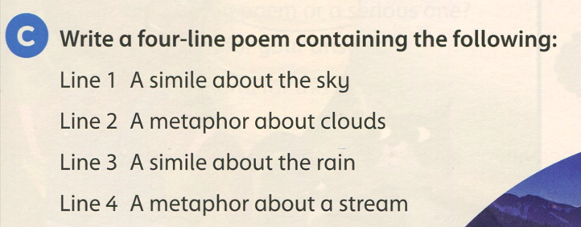

Slide 8
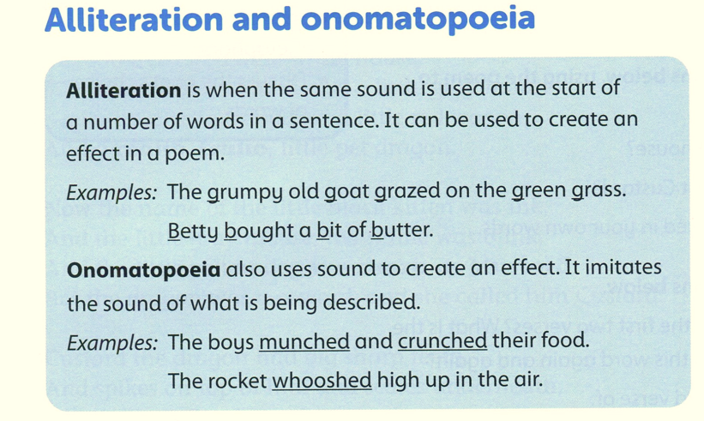
buzz, clink, clang, boom, swish, pop, splash
hiss, oink, meow, tweet, quack.

Slide 9
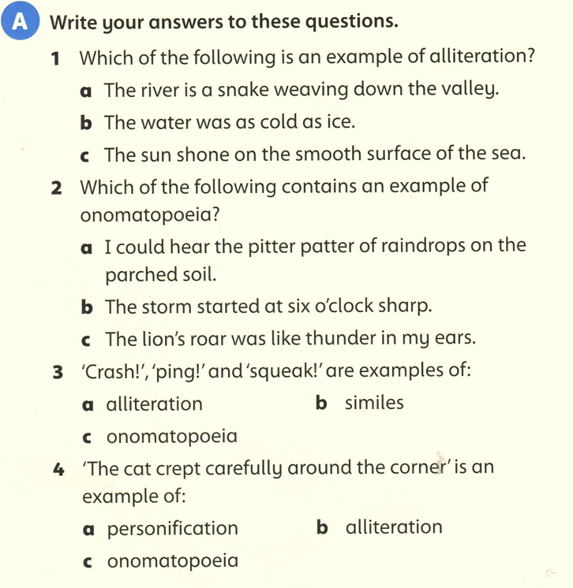

Slide 10
https://create.kahoot.it/details/f0780125-3312-48d5-abc9-de69284c1bf5
https://create.kahoot.it/details/da9cc1a2-586c-4695-b767-19b9922dab6e
https://wordwall.net/resource/6773196/english/personification-alliteration-onomatopoeia
https://wordwall.net/resource/270915/metaphors-similes-and-personification

